Slide 1
Surgical Technology
6th edition
CHAPTER 36
Neurosurgery

Slide 2
Anatomy and Pathology
Lesson 36.1
Identify key anatomical features of the nervous system.
Describe basic physiology of the autonomic nervous system.
Describe basic diagnostic procedures of the nervous system.

Slide 3
Terminology Review
Review terms and definitions listed at beginning of chapter
Use your medical dictionary if necessary
Notes:
Familiarize yourself with the chapter terminology.

Slide 4
Neurosurgery
Highly specialized field that focuses on
Treatment of disease of the brain
Functional disorders of the brain
Treatment of the spine
Treatment of the peripheral nerves
Notes:
The surgical technologist should have a solid foundation in the anatomy and pathology of the nervous system.

Slide 5
Cells of the Nervous System
Neurons
Soma
Axon
Dendrites
Notes:
The neuron is the primary cell type of the nervous system.
Describe the three parts of the neuron. (The soma acts as the sending and receiving area for nerve impulses and is the energy center for the cell. The axon carries nerve impulses away [efferent] from the cell. The dendrites carry nerve impulses toward [afferent] the cell.)

Slide 6
Neuroglia and Schwann Cells
Provide support to the neurons
Brain and spinal cord tissue
Astrocytes
Oligodendrocytes
Microglia
Ependymal
Schwann
Notes:
What are the most common types of neuroglia? (Astrocytes, oligodendrocytes, and microglia)
What function do the Schwann cells serve? (Their main functions are the production of myelin and the removal of cellular debris.)

Slide 7
The Skull
Frontal bone 1
Parietal bones 2
Temporal bones 2
Occipital bone 1
Notes:
Why does the scalp bleed profusely when cut? (The vessels are held open by the connective tissue under the skin and they bleed from both cut ends as there is widespread anastomosis of the vessels.)
The skull's bony plates are connected by a thin membrane called a suture.

Slide 8
Meninges
Dura mater
Outermost layer
Arachnoid mater
Middle layer
Pia mater
Inner layer
Notes:
Describe the tissue found in the meninges. (The outermost layer, the dura mater, is composed of very dense, fibrous tissue. The middle layer is the arachnoid mater. The arachnoid mater is a very delicate, serous membrane that has the appearance of a spider web. Beneath the arachnoid mater is the subarachnoid space, which is filled with CSF. The pia mater is the layer closest to the brain. This is a vascular membrane that contains portions of areolar connective tissue.)

Slide 9
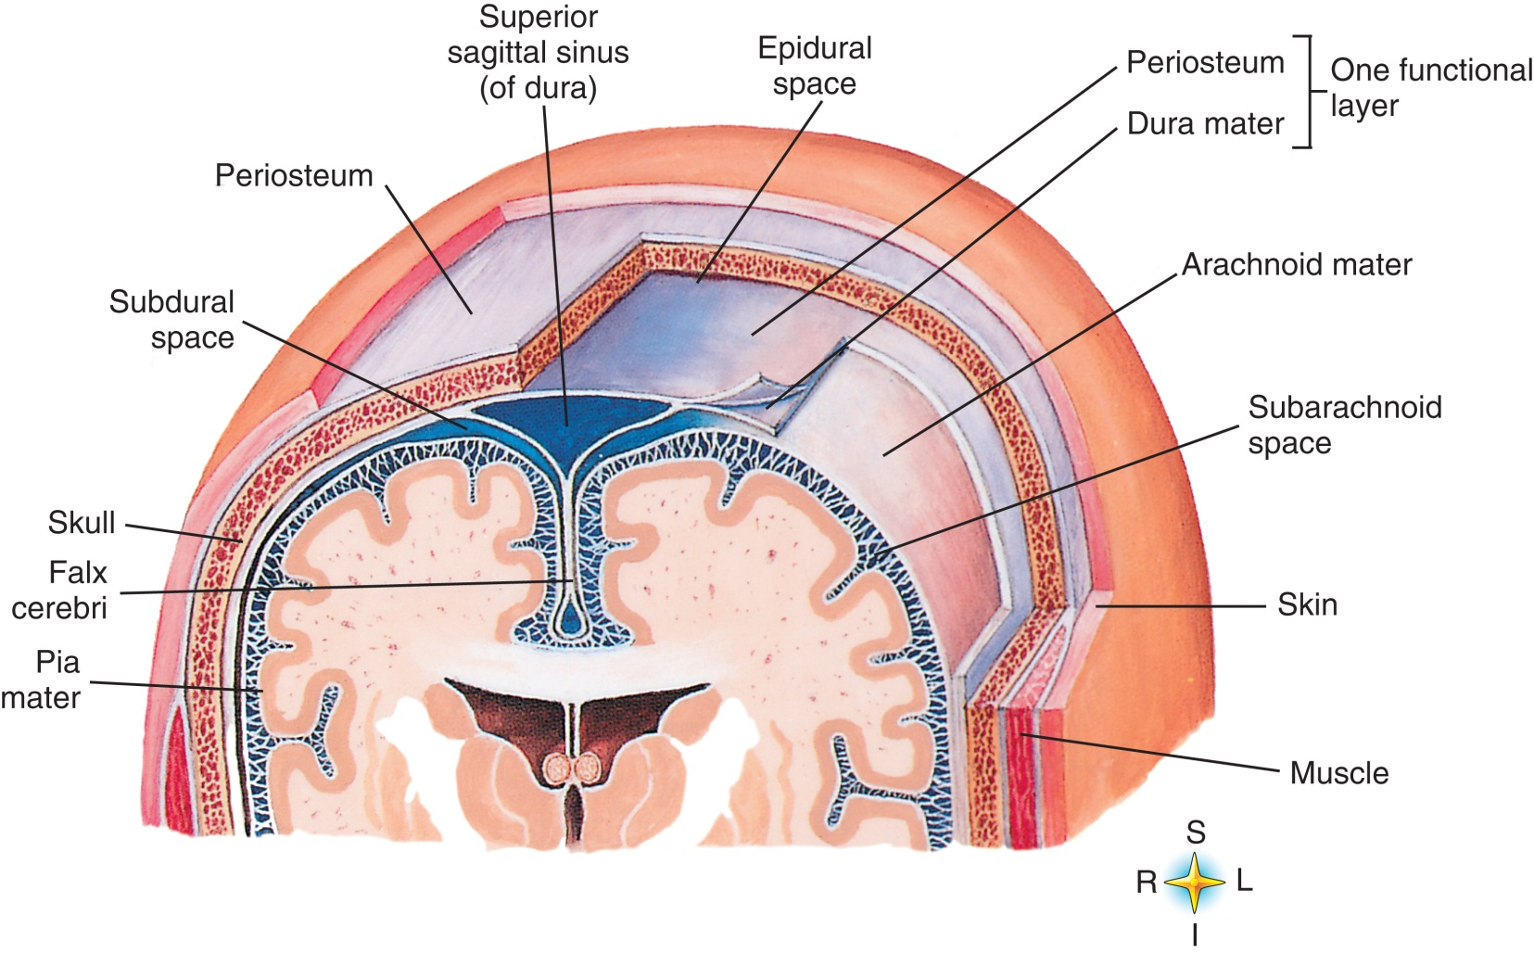
The Skull and Meninges
From Abrahams P, Hutchings RT, Marks SC: McKinn’s color atlas of human anatomy, ed 4, St Louis, 1999, Mosby.
Notes:
The pia mater dips down into the various crevices and convolutions of the brain.

Slide 10
The Brain
Forebrain
Midbrain
Hindbrain
Notes:
Reference Figure 36-4, Divisions of the brain, in the textbook.

Slide 11
The Cerebrum (Forebrain)
Gyri – Bulges
Sulci – Shallow indentations between bulges
Fissures – Larger, deeper furrows
Notes:
What functions does the cerebrum control? (It controls all motor activity and sensory impulses.)
The cerebrum is the largest portion of the brain, comprising 7/8 of the total weight of the organ.

Slide 12
The Cerebral Cortex
Frontal lobe
Parietal lobe
Temporal lobe
Occipital lobe
Notes:
The cerebral cortex is the outer tissue layer of the cerebrum.
The cerebral cortex is divided into lobes, which are named for the bones that lie over them.

Slide 13
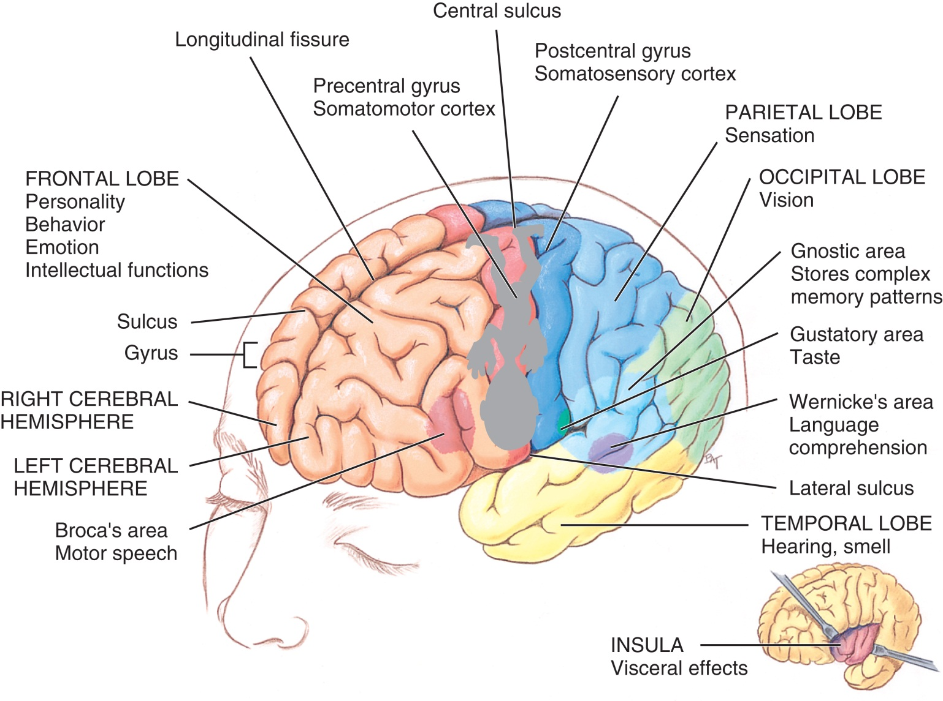
Lobes and Functional Areas: The Cerebrum
From Applegate E: The anatomy and physiology learning system, ed 2, St Louis, 2000, WB Saunders.
Notes:
The cerebral cortex is composed of gray matter, which is composed of nerve cells and blood vessels.

Slide 14
Diencephalon
Thalamus
Hypothalamus
Posterior pituitary gland
Pineal gland
Notes:
The brainstem is composed of what three sections? (The brainstem is composed of three sections: the medulla oblongata, midbrain, and pons.)
What are the cerebral peduncles? (White matter contains millions of myelinated nerve fibers that carry impulses between the neurons.)
What are the corpora quadrigemina responsible for? (This section is responsible for relaying auditory and visual impulses.)

Slide 15
Rhombencephalon
Cerebellum
Medulla oblongata
Pons
Notes:
What do the anterior and posterior cerebellar lobes control? (The anterior and posterior lobes help control coordination and movement. The flocculonodular lobe helps control equilibrium.)
Coordination between the cerebrum and the cerebellum is necessary for the planning and execution of movement.

Slide 16
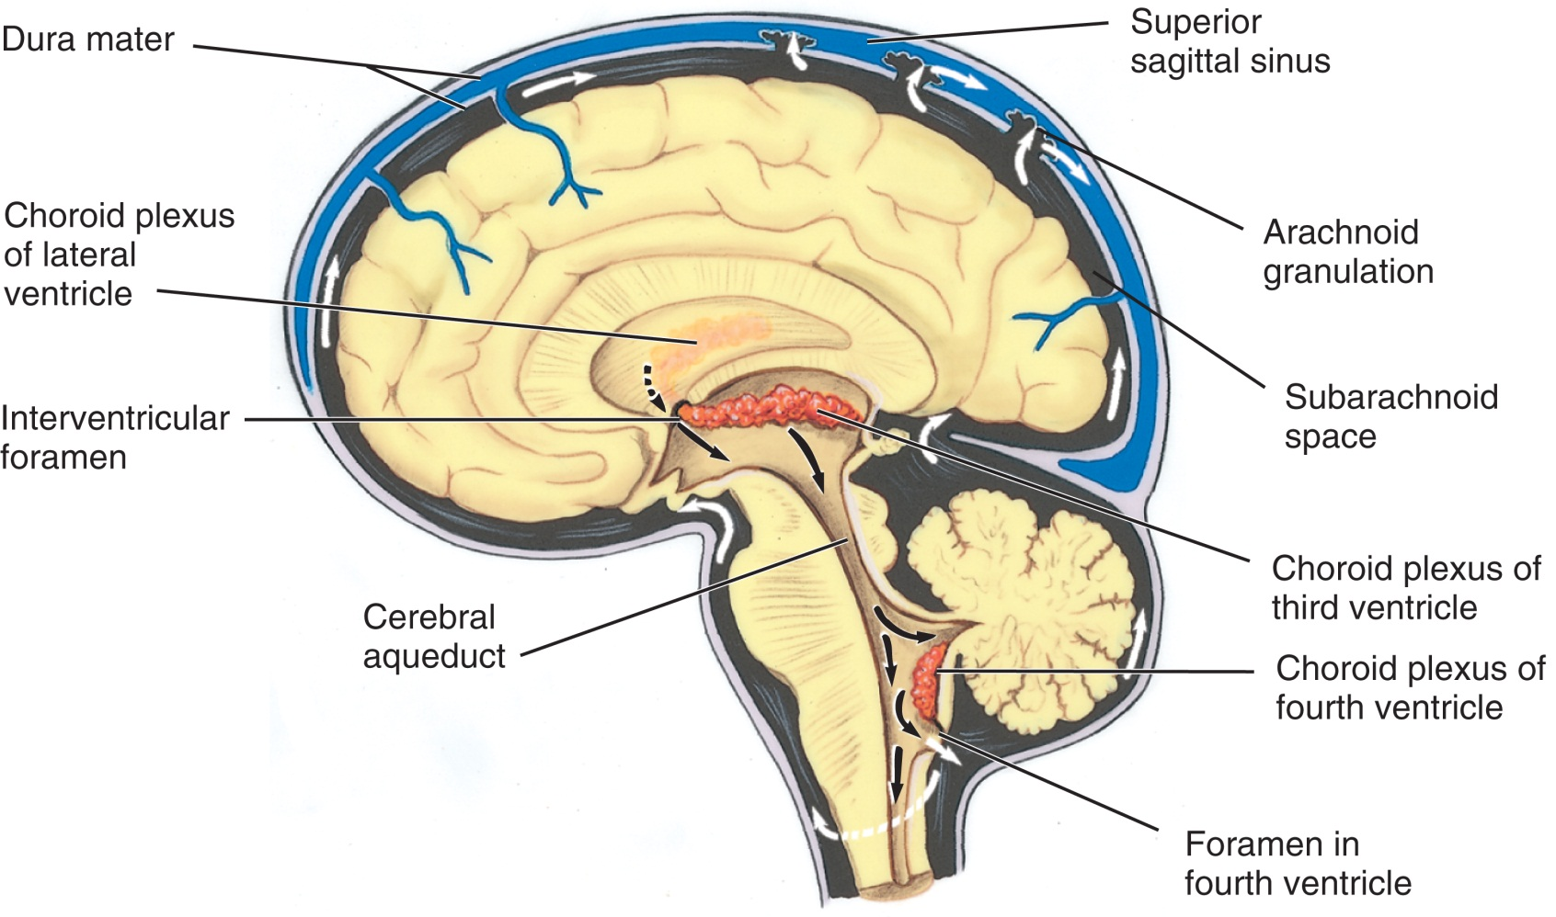
Ventricles of the Brain
From Applegate E: The anatomy and physiology learning system, ed 2, St Louis, 2000, WB Saunders.
Notes:
Reference Figure 36-8, The ventricles of the brain, in the textbook.

Slide 17
Blood Supply to the Brain
Internal carotids
Vertebral arteries
Circle of Willis
Notes:
The brain requires 20% more oxygen than other organs to function adequately.
Describe the circle of Willis. (The circle of Willis gives rise to the other arteries that supply blood to the cerebral hemispheres and ensures continuity of the blood supply to the brain if any of the arteries are compromised.)

Slide 18
Vertebral Column
Composed of 33 bones or vertebrae
7 cervical vertebrae
12 thoracic vertebrae
5 lumbar vertebrae
5 sacral vertebrae (fused as one)
Notes:
The vertebral column provides structure and protects the spinal cord.
The vertebrae are referred to by what designation? (The vertebrae are referred to by a numerical designation preceded by the first letter of the region where they are located [e.g., the first cervical vertebra is C-1; the first thoracic vertebra is T-1].)

Slide 19
Cervical Vertebrae
Atlas – First cervical vertebra supports the skull
Axis – Second cervical vertebra provides rotational movement
Notes:
Each vertebra has a body with a circular opening through which the spinal cord passes.
How are the vertebrae separated? (The vertebrae are separated by cartilaginous cushions called intervertebral discs.)

Slide 20
The Spinal Cord
Begins at the foramen magnum
Ends at the cauda equina (first and second lumbar vertebrae)
Notes:
Reference Figure 36-12, Cross-section of the spinal cord, in the textbook.
Describe the structure of the spinal cord. (Structurally, the spinal cord is somewhat flat on the dorsoventral side. It has an outer layer of white matter and an inner body of gray matter. A cross-section of the cord reveals that the gray matter forms a rough H shape.)

Slide 21
Blood Supply to Spinal Cord
Branches of the vertebral artery
Posterior spinal arteries
Posterior inferior cerebral arteries
Various regions of the aorta
Notes:
The anterior and posterior spinal veins are responsible for venous drainage from the cord.

Slide 22
Cranial Nerves
Olfactory
Optic
Oculomotor
Trochlear
Trigeminal
Abducens
Notes:
The cranial nerves are 12 pairs of nerves that originate in the brain.
What functions are the cranial nerves responsible for? (The cranial nerves are 12 pairs of nerves that originate in the brain and are responsible for the sensory and motor functions of the body.)

Slide 23
Cranial Nerves (Cont.)
Facial
Vestibulocochlear (acoustic)
Glossopharyngeal
Vagus
Accessory
Hypoglossal
Notes:
What nerve affects eye movement and sight? (Oculomotor)
What nerve is responsible for salivation? (IX—glossopharyngeal)

Slide 24
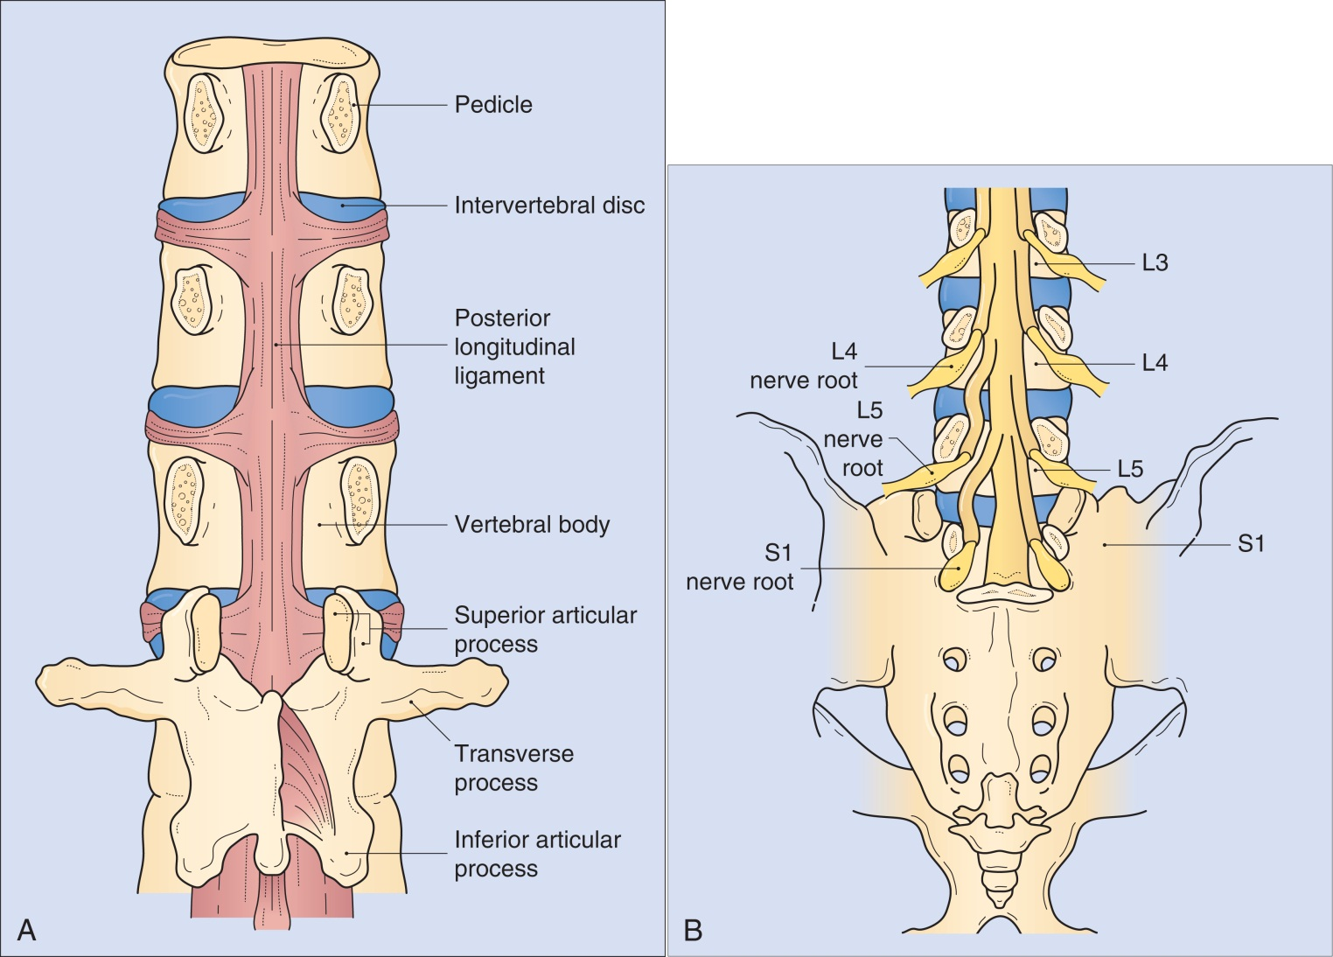
Spinal Nerves
From Rengachary S, Ellenbogen R: Principles of neurosurgery, ed 2, St Louis, 2005, Mosby.
Notes:
Describe the two parts of the accessory nerve. (The two part are a cranial portion and a spinal portion. The cranial portion joins the vagus nerve to help control the pharyngeal and laryngeal muscles. The spinal portion controls the trapezius and sternocleidomastoid muscles.)

Slide 25
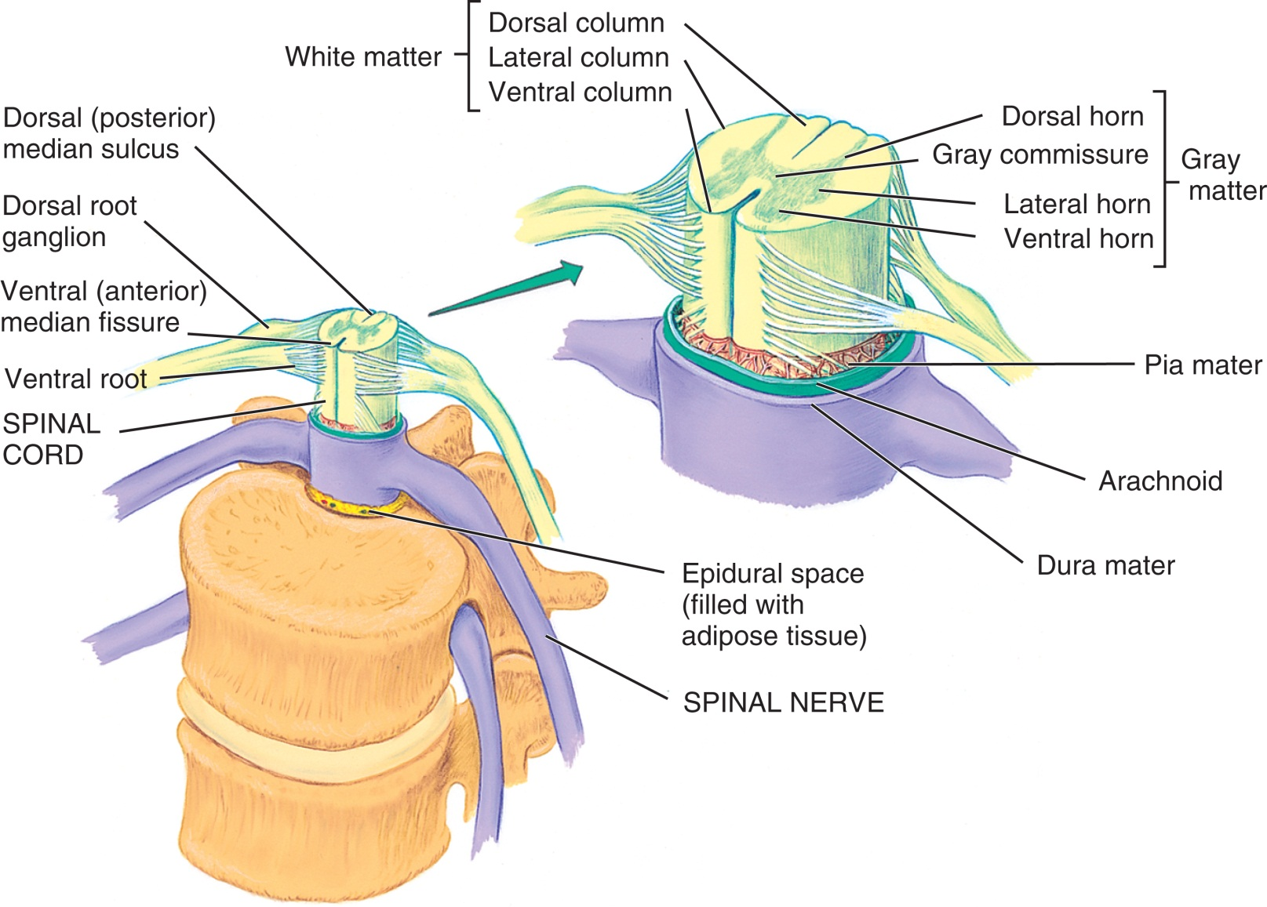
Spinal Nerves (Cont.)
From Applegate E: The anatomy and physiology learning system, ed 2, St Louis, 2000, WB Saunders.
Notes:
There are 35 pairs of spinal nerves that correspond to the spinal segments, with each segment containing one pair of nerves.

Slide 26
Autonomic Nervous System
Involuntary system that transmits signals for vital functions such as
Heart rate
Respiration
Digestion
Connects the central nervous system (CNS) to viscera via the cranial and spinal nerves
Notes:
Describe the components of the autonomic nervous system. (The sympathetic component is responsible for the "fight-or-flight" mechanism the body uses in response to a threat. The sympathetic response results in the diversion of blood [via vasoconstriction] from nonessential organs and systems [e.g., the gastrointestinal system and skin] to the brain, heart, lungs, and muscles. The parasympathetic component is responsible for the resting functions that promote energy conservation through the dilation of blood vessels and relaxation of muscle groups, as is seen with increased blood flow to the gastrointestinal tract to promote the digestion of food.)
The two components work together to maintain homeostasis.

Slide 27
Somatic Nervous System
Connects the CNS to the skin and the skeletal muscles via the cranial and spinal nerves
Keeps the body in touch with its surroundings
Notes:
Why is the somatic nervous system described as a voluntary system? (It is described as a voluntary system because many of its actions [e.g., blinking the eyelids] can be controlled.)

Slide 28
Diagnostic Procedures
History and physical
Imaging studies
Computed tomography (CT)
Magnetic resonance imaging (MRI)
Functional MRI (fMRI)
Stereotactic MRI
Angiography
Magnetic resonance angiography (MRA)
Digital subtraction angiography (DSA)
Three-dimensional CT
Myelography
Discography
Ultrasound
Notes:
How does the neurosurgeon evaluate the patient's cerebellar function? (The patient's cerebellar function is evaluated by testing balance and coordination. Sensory function generally is evaluated during the cranial nerve examination.)
Copies of any relevant films must be available in the operating room (OR) before the surgery begins.

Slide 29
Electrical and Neurotransmission Studies
Electroencephalogram (EEG)
Electromyography (EMG)
Somatosensory evoked potentials (SSEP)
Notes:
What is EEG used to measure before a procedure? During a procedure? (In the perioperative setting, it can be used during a procedure to monitor the depth of anesthesia or to monitor brain activity in procedures that require occlusion of the carotid artery.)
What does EMG measure? (Electromyography [EMG] measures the conduction rate of motor nerves.)
What does SSEP measure? (The somatosensory evoked potentials [SSEP] test measures sensory impulses from the body to the brain.)

Slide 30
Case Planning for Nervous System Procedures
Lesson 36.2
Discuss key elements of case planning for pediatric surgery.
List and describe common surgical procedures of the nervous system.

Slide 31
Patient's Fears
Not waking after surgery
Loss of sight
Loss of hearing
Loss of mobility
Notes:
Neurosurgery patients may appear to be unaware or unconscious, but may actually be highly aware of their surroundings.
Providing emotional and psychological support is an important responsibility of the perioperative team.

Slide 32
Standard Equipment
Operating room bed with headrest
Monopolar electrosurgical unit
Nitrogen (inline or tank)
Suction units
Imaging equipment
Operating microscope
Notes:
What is the difference between a Mayfield table and a Mayo stand? (The Mayfield table can be positioned over the patient during cranial surgery so that instruments and equipment can be passed to the surgeons, who stand at the patient's head. During spinal surgery, the table can be placed over the patient's lower body. The table is large enough to accommodate the many supplies and solutions needed during a neurosurgical procedure.)
Do your clinical affiliate sites use Mayfield tables for craniotomy procedures? (Answers will vary.)

Slide 33
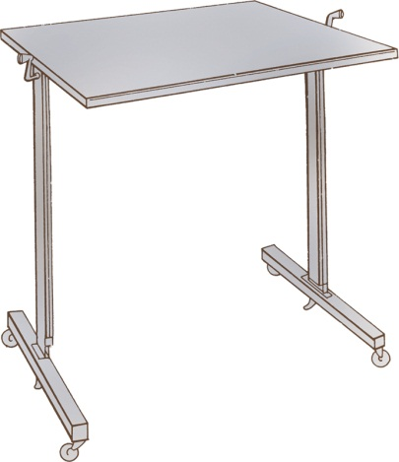
The Mayfield Table
From Rothrock J: Alexander’s care of the patient in surgery, ed 12, St Louis, 2003, Mosby.
Notes:
The Mayfield table is large enough to accommodate the many supplies and solutions needed during neurosurgery.

Slide 34
Instruments
General instruments
Specialty instruments
Microsurgical instruments
Notes:
Reference Box 36-1, Neurological instruments, in the textbook.
Microsurgical instruments are used in both cranial and spinal surgery.

Slide 35
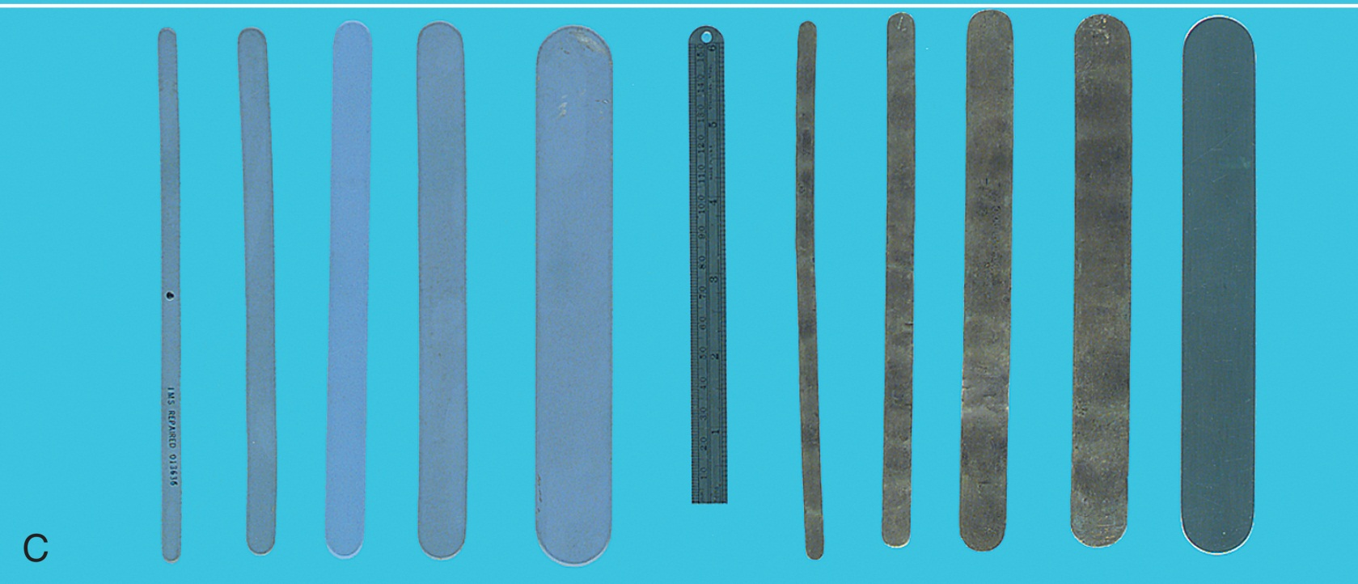
Instruments (Cont.)
From Tighe SM: Instrumentation for the operating room, ed 6, St Louis, 2003, Mosby.
Notes:
The scrub must anticipate which instrument will be needed next and pass it correctly so the surgeon does not have to look away from the field.

Slide 36
Drills
Drills and perforators used for all brain procedures
Craniotomes and perforators with special attachments used to prevent injury to brain tissues
Power source may be pneumatic, battery, or electric
Notes:
The surgical technologist is responsible for the safe handling of power instruments on the surgical field.
The surgical technologist is also responsible for providing irrigation to the tip of the drill when it is in use.

Slide 37
Implants
Tissue
Plates
Rods
Shunts
Chemotherapeutic wafers
Generators
Bone
Screws
Clips
Coils
Notes:
The surgical technologist must take care in handling any implantable device to ensure its sterility and integrity.

Slide 38
Implant Documentation
Device identification (lot number, serial number, mode or batch number)
Date of manufacture
Patient information
Implant location
Physician information
Notes:
The Food and Drug Administration (FDA) regulates the tracking of certain devices and requires processes to locate devices in the event of a recall.
On occasion a previously implanted device will be removed during a procedure. Most explanted devices are sent for pathological examination before disposition.

Slide 39
Sponges
4x4 radiopaque sponges
Cottonoids or patties with radiopaque markers
Cotton balls with radiopaque markers
Notes:
The surgeon may place a cottonoid or cotton ball on top of tissue and suction through it to avoid damaging the tissue.

Slide 40
Drugs and Irrigation
Hemostatic agents
Irrigation fluid
Antibiotics in solution with injectable saline
Notes:
The temperature of the irrigation solution should be below 120˚ F to prevent tissue damage.
What is the purpose of an osmotic diuretic during cranial procedures? (It removes fluid from tissue and prevents swelling resulting from a trauma.)

Slide 41
Drains and Sutures
Drains
Used to evacuate blood, serum, and fluid and to eliminate dead space
Suture
Silk and nylon are commonly used for retraction and closure
Notes:
The lumbar or ventricular drain may be used for what purpose? (A lumbar drain may be placed in the subarachnoid space before a surgical procedure to remove CSF from the spinal canal or brain; this decompresses the tissue. A lumbar drain also can be used to monitor intracranial pressure [ICP].)
A separate surgical field should be set up for placement of a lumbar or ventricular drain.
What material is used to replace the cranial bones? (Wire is used to suture the cranial bones in place following craniotomy.)

Slide 42
Cements
Methyl methacrylate
May be mixed with antibiotics and formed into the shape of beads
Octylcyanoacrylate
May be used to close the edges of the skin that are not under any pressure
Notes:
Bone adhesives are used in neurosurgical procedures.

Slide 43
Anesthesia
Cranium and back procedures
General anesthesia
Electrode placement
Awake or light sedation
Notes:
Thermoregulation is an important consideration for neurosurgical patients undergoing general anesthesia owing to the lengthy nature of most procedures.
Why is smooth emergence from anesthesia extremely important? (Smooth emergence from anesthesia is extremely important to minimize the risk of laryngospasm and struggling.)

Slide 44
Patient Positioning
The long duration of cranial procedures increases the risk of injury related to positioning
The surgical technologist and anesthesia care provider must make sure any pressure points are adequately padded
Notes:
Care must be taken during patient positioning to prevent injury to the spine, the shoulders, and the head.
Describe the specialty operating table used in neurosurgery. (These beds come with many accessories to optimize safe positioning. The Andrews bed and the Jackson spinal table are two examples of specialized operating beds. These specialized tables allow a wide variety of customized positions with clearance for C-arm fluoroscopy.)

Slide 45
Spinal Surgery
Usually in the supine position
Traction may be necessary
Prepping and draping
If hair removal is necessary, complete this as close as possible to the time of the procedure
Notes:
Why might traction be used in spinal surgery? (Traction also may be used, with a chin harness attached to a weight to open the spaces between the cervical vertebrae.)
When a patient's hair is removed, the cut hair must be kept for the patient. Why? (It is returned to the patient as personal property.)
For complex draping routines, surgeons may direct and complete the draping themselves.

Slide 46
Team Positions
Cranial procedures
Surgeon and assistant – head of patient
Scrub to right of surgeon
Spinal procedures
Right-handed surgeon at patient's left
Peripheral procedures
May be completed from a sitting position
Notes:
What are some additional considerations for team positioning? (Other considerations for team positioning include the presence of equipment such as the C-arm, surgical microscopes, Cavitron Ultrasonic Surgical Aspirator [CUSA] console, and other equipment.)

Slide 47
Burr Holes
Procedure performed to relieve pressure on the brain caused by an accumulation of fluid beneath the dura mater
Notes:
Why are burr holes created? (The procedure is performed most often to relieve pressure on the brain caused by the accumulation of fluid beneath the dura mater.)
Burr holes do not extend beyond what layer of the brain?

Slide 48
Craniotomy
Incision into the cranium to permit access to the brain and intracranial structures
Creation of a bone flap
Notes:
Why would a patient need a craniotomy? (A craniotomy may be required to provide access for treatment of a variety of intracranial conditions, such as a neoplasm.)
What is a bone flap, and why is it created? (The patient is placed in the supine, prone, or sitting position. During a craniotomy, a section of the cranium [a bone flap] is removed. The size of the flap is determined by the size and location of the tumor.)

Slide 49
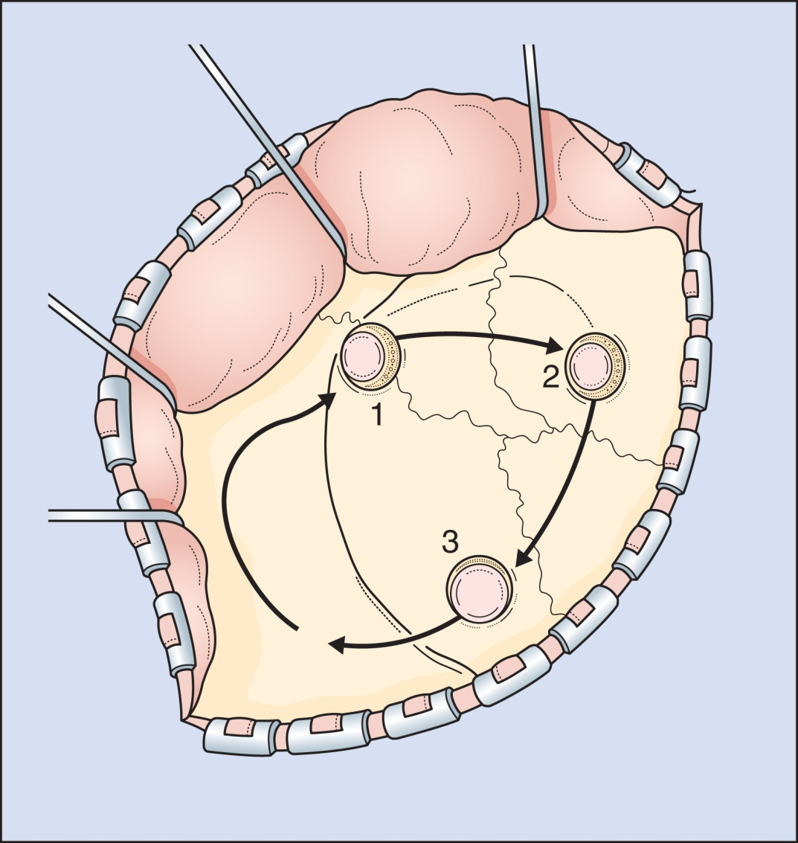
Craniotomy (Cont.)
From Rengachary S, Ellenbogen R: Principles of neurosurgery, ed 2, St Louis, 2005, Mosby.
Notes:
Describe the prep and the drape for a craniotomy. (After infiltrating the incision site with local anesthetic for hemostasis, the surgeon makes a curved incision in the scalp. The surgical assistant applies digital pressure to the wound edges; therefore the scrub should make sure that numerous folded 4x4 sponges are available. The monopolar ESU is used for hemostasis.)
Irrigation fluid should be available at all times during a craniotomy.
What is the purpose of Gliadel wafers? (The Gliadel wafer is impregnated with an antineoplastic agent that delivers chemotherapy directly to the tumor site.

Slide 50
Craniectomy
Differs from a craniotomy in that the bone flap that is removed is not replaced
Notes:
Craniectomy is performed for what conditions? (A craniectomy may be done to remove bone from any region of the skull for decompression of the brain or evacuation of epidural or subdural hematomas. More commonly, a craniectomy is performed to remove tumors in the posterior fossa.)

Slide 51
Cerebral Aneurysm Surgery
Isolation of the aneurysm (weakened area or bulge of a vessel) from the normal circulation while preserving flow of blood to the nearby vessels
Notes:
An intracranial aneurysm has its origin from what artery? (An intracranial aneurysm is the bulging of an artery within the cerebral circulation.)
Where is a berry aneurysm located? (They are commonly found at the base of the brain.)

Slide 52
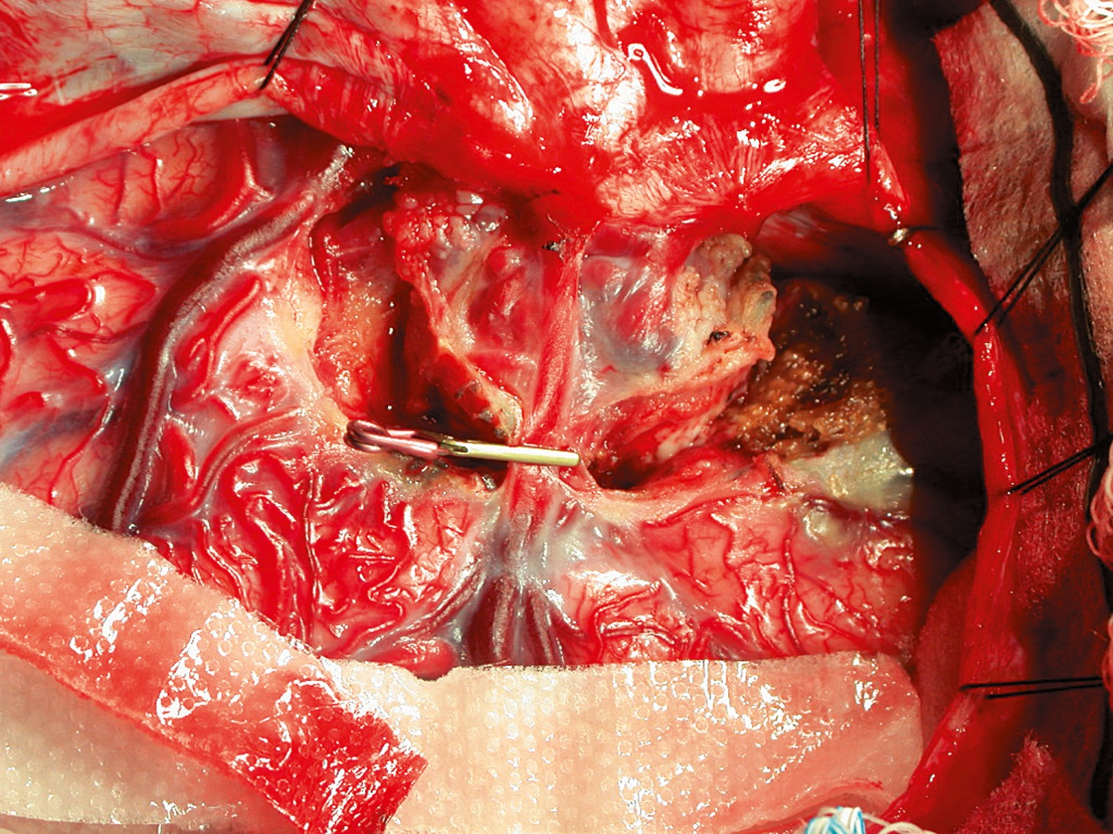
Aneurysm Clips
Aneurysm clip applied over a defect. (From Rengachary S, Ellenbogen R: Principles of neurosurgery, ed 2, St Louis, 2005, Mosby.)
Notes:
Aneurysms are usually caused by a congenital defect.
Aneurysms are approached using what type(s) of craniotomy? (Answers may vary.)

Slide 53
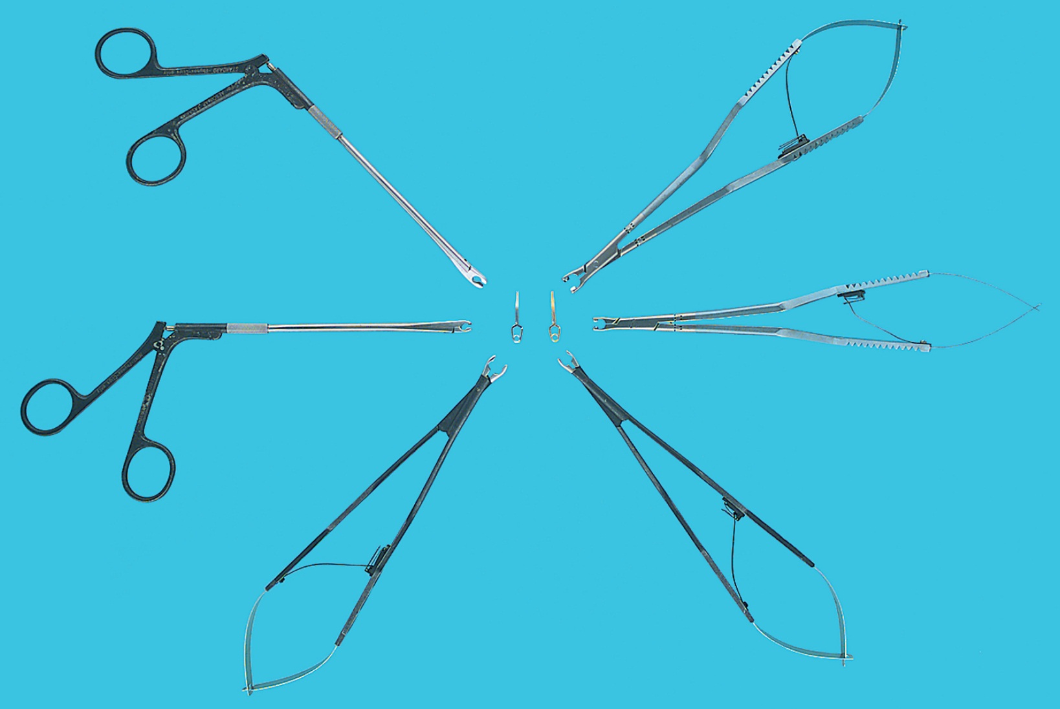
Standard Aneurysm Instruments
From Tighe SM: Instrumentation for the operating room, ed 6, St Louis, 2003, Mosby.
Notes:
Occlusion is achieved by using surgical aneurysm clips, suture, or methyl methacrylate glue.
Slips are supplied as permanent or temporary devices.

Slide 54
Arteriovenous Malformation Resection
Performed to correct a fistula that occurs in an abnormal communication between and artery and a vein
Notes:
At what age are patients with an arteriovenous malformation most commonly diagnosed? (Between 20 and 40)
An interventional radiologist may be involved in preoperative care to embolize the arteriovenous malformation and reduce its size.

Slide 55
Correction of Craniosynostosis
Performed to correct the premature closure of an infant's cranial suture lines by separating the involved bones to prevent resealing until the completion of brain growth
Notes:
At what age is correction of craniosynostosis performed? Why? (Surgery usually is performed when the infant is 6 weeks to 6 months of age, because the skull bones are more malleable and a better cosmetic result can be achieved.)
The scrub must ensure that irrigation solutions are warm to prevent the patient's loss of heat through exposed tissues.

Slide 56
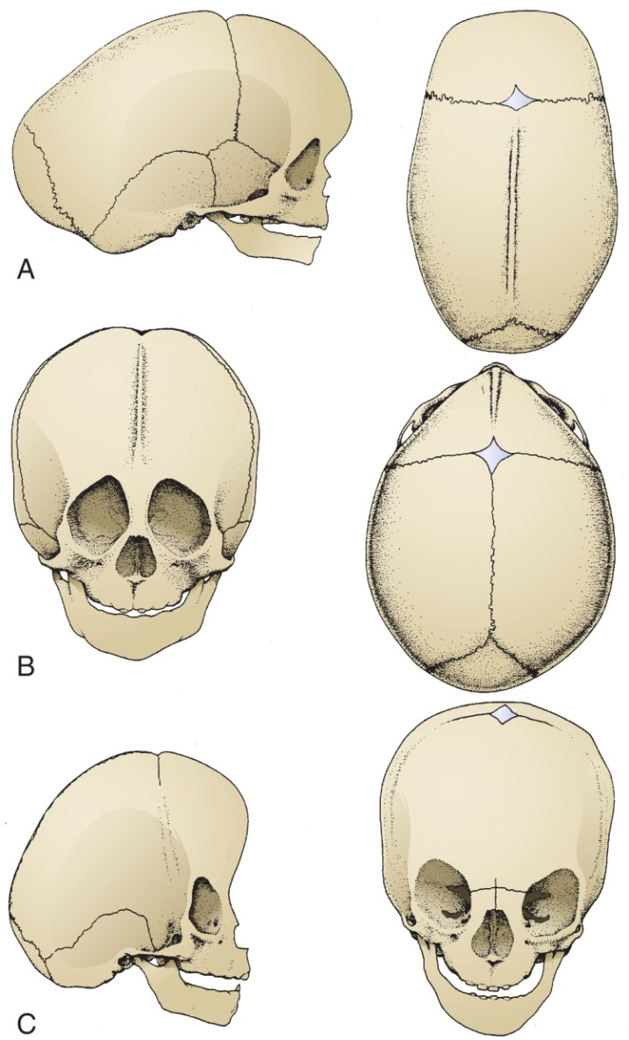
Effects of Major Vault Sutures
From Choux M, DiRocco C, Hockley A, et al: Pediatric neurosurgery, London, 1999, Churchill Livingstone.
Notes:
Reference Figure 36-27 in the textbook.

Slide 57
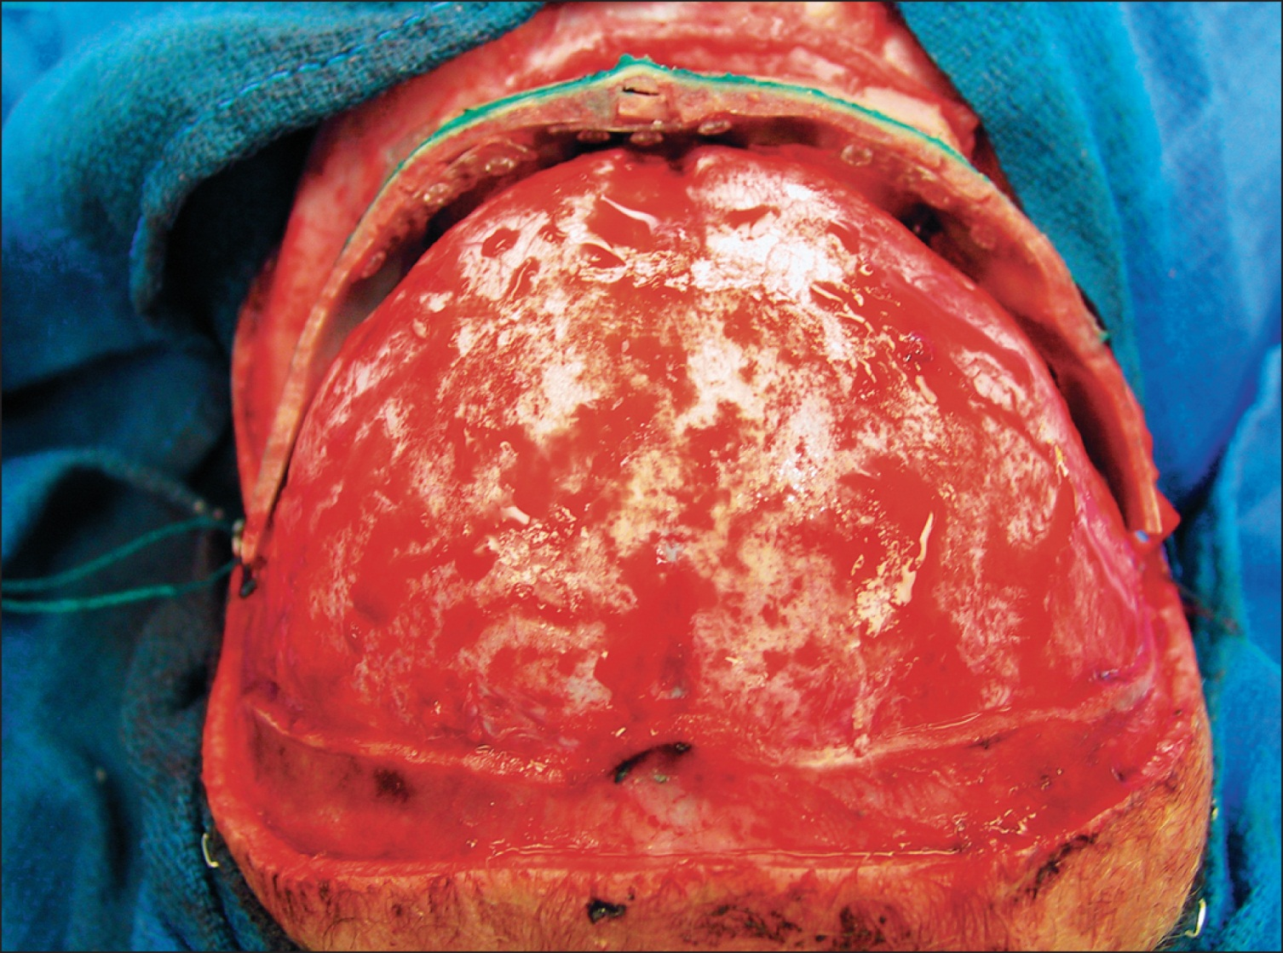
Craniosynostosis (Cont.)
From Rengachary S, Ellenbogen R: Principles of neurosurgery, ed 2, St Louis, 2005, Mosby.
Notes:
Reference Figure 36-28 in the textbook.

Slide 58
Cranioplasty
Replacement of an area of bone in the skull using one of the following
Bone graft
Prosthetic material
Methyl methacrylate plate
Notes:
In a cranioplasty procedure, an area of skull is replaced with a methyl methacrylate plate, autograft, or metal prosthesis.
Any bone that has been trimmed must be saved by the scrub for use in placing the prosthesis.

Slide 59
Ventricular Peritoneal or Ventricular Arterial Shunts
Used to divert cerebrospinal fluid produced in excess away from the ventricles of the brain to prevent intracranial pressure from increasing
Notes:
The distal shunt may be placed where in the body?
What are the indications for inserting a ventricular shunt? (Hydrocephalus can occur as a result of an overproduction of CSF, or it may be the result of a condition that interferes with the normal absorption of fluid. Hydrocephalus can develop in children and adults. Persistent hydrocephalus can interfere with cerebral blood flow and cause enlargement of the skull in infants.)

Slide 60
Shunt Placement
Ventricular peritoneal
Ventricular atrial
Notes:
Shunts may require alteration as the patient grows. They may also fail mechanically or become obstructed.

Slide 61
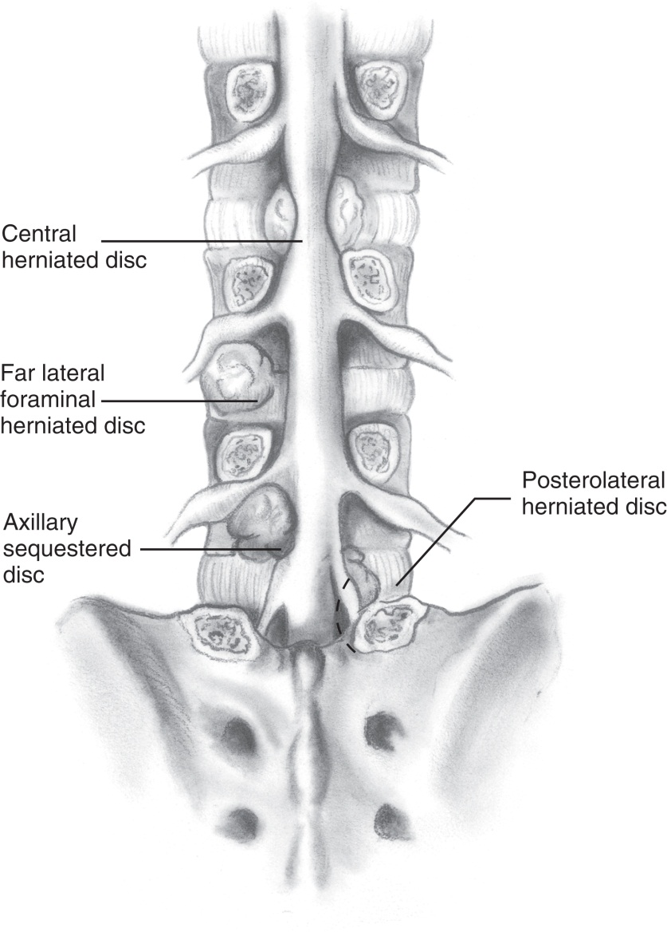
Ventriculoperitoneal Shunt Placement
From Rengachary S, Ellenbogen R: Principles of neurosurgery, ed 2, St Louis, 2005, Mosby.
Notes:
The scrub should ensure that the instruments and sutures selected are appropriate for the age and the size of the patient undergoing the procedure.
What is the most common complication after ventricular shunt placement? (The most common complication after ventricular shunt placement is shunt malfunction as a result of blockage of the valve or catheter.)

Slide 62
Transsphenoidal Hypophysectomy
Removal of all or a portion of the pituitary gland
May use a Caldwell-Luc procedure to access sella turcica
Notes:
For what conditions is transsphenoidal hypophysectomy performed? (Because the gland is uniquely located, symptoms from a tumor often are noticed as visual field anomalies or may be related to pressure on cranial nerves III through VI. Tumors may damage the
adjacent brain tissue through mass effect by displacing structures, blocking CSF flow, or creating pressure.)
How is the patient positioned for a transsphenoidal hypophysectomy? (The patient is placed in the three-point pin fixation device and positioned in a semisitting position with the neck flexed toward the left and the head rotated to the right.)

Slide 63
Resection of Vestibular Schwannoma (Acoustic Neuroma)
This procedure is performed to remove tumors from the vestibular branch of the eighth cranial nerve while preserving the function of the nerve
Notes:
What are some signs and symptoms of a vestibular schwannoma? (As the tumor grows, it impinges on cranial nerve VIII, causing one-sided hearing loss, ringing in the ears, dizziness, and problems with balance. The tumor also can cause pressure on the nearby cranial nerve VII, causing facial numbness and pain. If the tumor is left untreated and continues to grow, it eventually may cause deafness.)
The neurosurgeon will partner with an otologic surgeon to ensure optimal care.

Slide 64
Stereotactic Surgery
Uses computer-based technology to identify specific structures or lesions for treatment or diagnosis
Notes:
What are some procedures that use the stereotactic approach? (The stereotactic approach may be used for tumor biopsy or removal, resection of AVMs, brain mapping, implantation of electrodes, catheter placement, ventriculostomy, and the treatment of movement disorders and intractable pain. It is used in conjunction with minimally invasive radiosurgical techniques to ablate tumors and AVMs and to treat functional disorders such as trigeminal neuralgia, Parkinson disease, and essential tremors.)

Slide 65
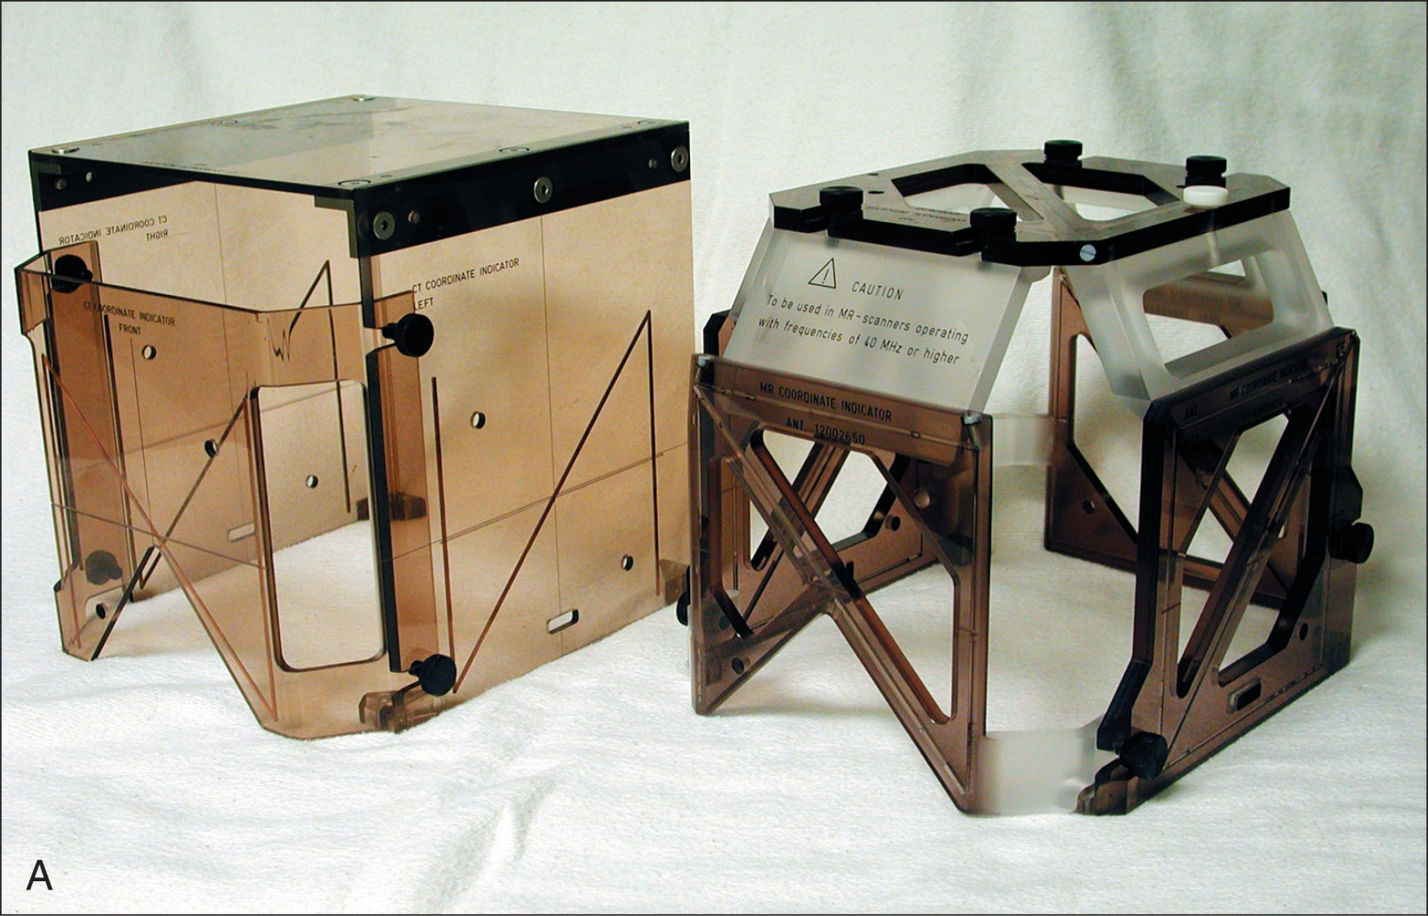
Stereotactic Frame
From Rengachary S, Ellenbogen R: Principles of neurosurgery, ed 2, St Louis, 2005, Mosby.
Notes:
Once the stereotactic head frame is in place, the patient is sent to CT or MRI where the coordinates are determined for the least damaging surgical approach.

Slide 66
Deep Brain Stimulation (DBS)
Changing the electrical activity of the brain in a controlled manner using electrodes and a pulse generator
Notes:
Deep brain stimulation is used to treat what conditions? (DBS has been used to treat movement disorders such as Parkinson disease and some pain disorders. It has been used experimentally to treat depression and Tourette syndrome, a neurological disorder characterized by uncontrollable motor movements [tics] and vocalizations.)
Describe the three components of the DBS system. (The DBS system consists of three components: the lead, the extension, and the generator.)

Slide 67
Endoscopic Ventriculoscopy
Relief of ventricular obstruction
Restore cerebrospinal fluid (CSF) circulation
Visualization of the third ventricle
Decompression or tissue removal
Notes:
Stereotactic techniques may be used for endoscopic ventriculoscopy to improve accuracy.
What are some conditions that may be treated with endoscopic ventriculostomy? (Conditions that may be treated with endoscopic ventriculostomy include intraventricular cysts and tumors and hydrocephalus.)

Slide 68
Microvascular Decompression of Cranial Nerves
Completed to prevent injury to the protective myelin sheath over the nerve
Notes:
The compression of cranial nerves can result in a variety of painful conditions.

Slide 69
Cerebral Revascularization (Cerebral Bypass)
Performed to improve blood flow to an ischemic area of the brain
Notes:
During a cerebral bypass, the surgeon performs an anastomosis between an extracranial artery and an intracranial artery.
Typically, an artery in the scalp is anastomosed to a branch of the middle cerebral artery.

Slide 70
Anterior Cervical Discectomy and Fusion
Removal of one or more cervical intervertebral discs followed by spinal fusion to restore continuity of the spine
Notes:
What is the most common indication for anterior cervical discectomy and fusion? (Herniated cervical disc)
Describe the aging process as it relates to cervical discs. (During the aging process, the discs lose fluid, fragment, and collapse. As the discs collapse, increased mechanical stress is placed on the bone, which may result in the formation of bony spurs along the spinal canal.)

Slide 71
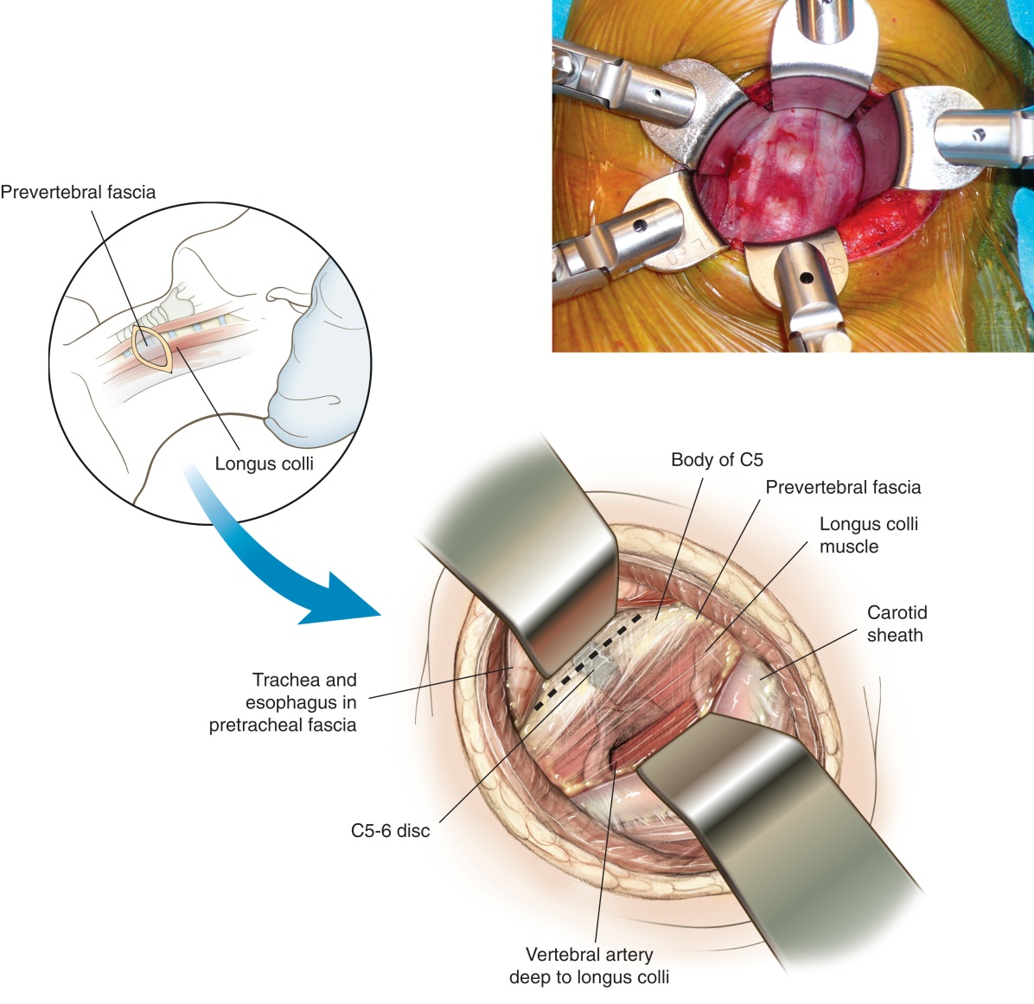
Anterior Cervical Fusion
From Miller MD, Chhabra AB, Hurwitz SR, Mihalko WM: Orthopaedic surgical approaches, Philadelphia, 2008, WB Saunders.
Notes:
Cervical traction may be applied with Gardner Wells tongs, or a chin harness attached to a weight.
Why is the right or left hip elevated? (The right or left hip is elevated on a sandbag or rolled bath blanket. This facilitates exposure of the iliac crest for removal of the bone graft.)

Slide 72
Posterior Cervical Laminectomy
Performed to access the cervical spinal cord to remove a portion of the cervical lamina
Notes:
Posterior cervical laminectomy may be required to access neurological tumors.
What is cervical stenosis? (The narrowing of the spinal cord in the neck)

Slide 73
Application of a Halo Brace
Used to provide traction and restore spinal alignment to the cervical spine
May provide initial decompression of the spinal cord following injury
Notes:
Why must a fractured cervical spine be immobilized? (Fracture of the cervical spine requires immobilization to prevent displacement of the bone and impingement on the spinal cord.)
How is the patient positioned for placement of a halo system? (The patient is positioned supine with the head extending over the edge of the bed and manually stabilized by the surgical assistant.)

Slide 74
Lumbar Laminectomy and Discectomy
Performed to access the lumbar spine and remove a portion of the lumbar lamina
Discectomy is performed to remove a portion of the intervertebral disc
Notes:
Lumbar laminectomy is most often performed to decompress the spinal column in cases of spinal stenosis, to gain access to a spinal cord tumor, or as a step in a more extensive surgery to correct a spinal deformity.
What condition is discectomy used to treat? (Discectomy is used to treat a herniation of the intervertebral disc.)

Slide 75
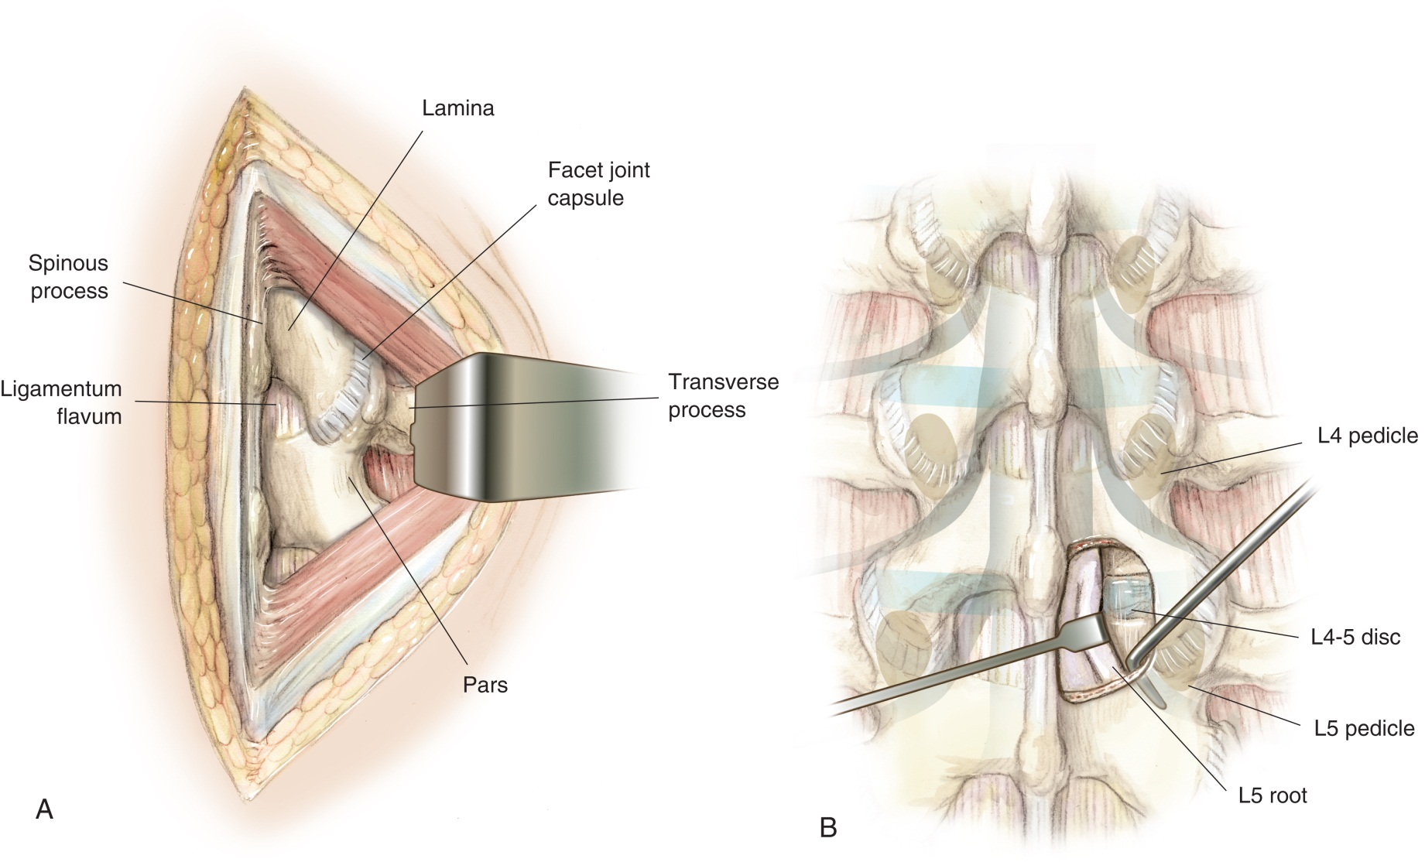
Lumbar Laminectomy
From Miller MD, Chhabra AB, Hurwitz SR, Mihalko WM: Orthopaedic surgical approaches, Philadelphia, 2008, WB Saunders.
Notes:
The scrub should have a large number of unfolded 4x4 sponges available. The surgeon will pack the sponges along the vertebra with periosteal elevators.
After the lamina is removed, cottonoid sponges are used instead of 4x4 sponges.

Slide 76
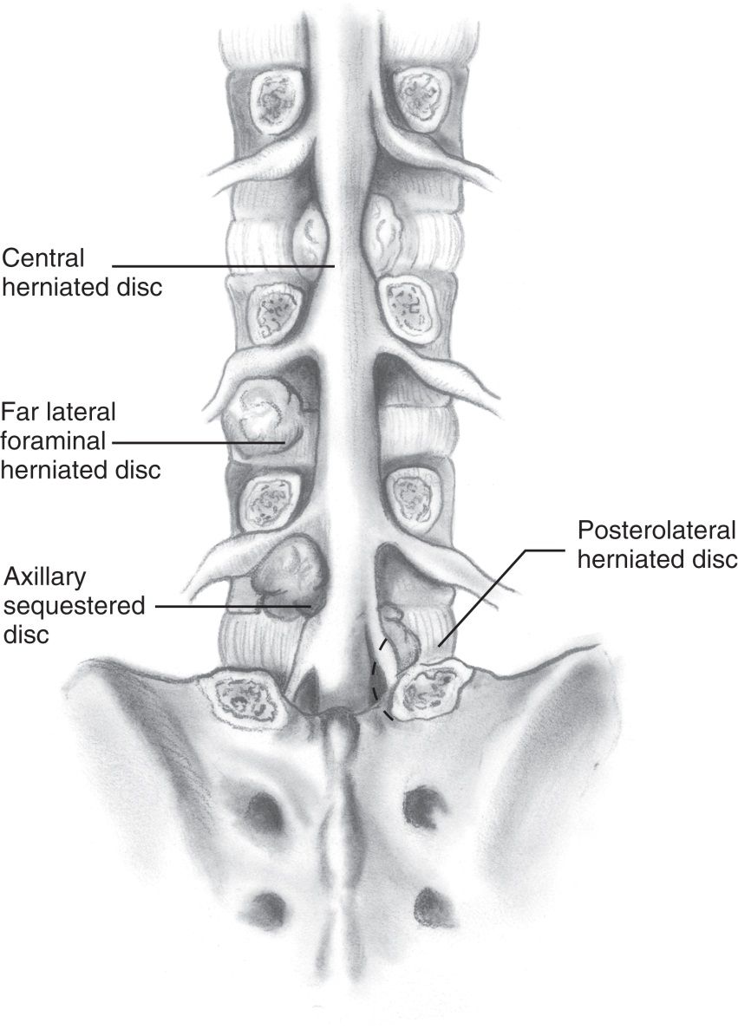
Lumbar Laminectomy (Cont.)
From Vaccaro AR, Betz RR, Zeidman SM: Principles and practice of spine surgery, St Louis, 2003, Mosby.
Notes:
Before closing the muscle layer, the surgeon may inject a local anesthetic. Why? (To control postoperative pain)

Slide 77
Foraminotomy
Procedure that is performed to relieve pressure on the spinal nerves
Often an adjunct procedure to a laminectomy
Notes:
What are the symptoms of compressed spinal nerves? (When the nerves are compressed by bone, herniated disc, scarring, or ligament hypertrophy, the patient may experience symptoms of pain, numbness, or weakness in the area served by that particular nerve.)
The surgeon widens the foramen using a high-speed drill or fine-tipped rongeurs.

Slide 78
Microdiscectomy
Creation of a small window in the lamina for access to an intervertebral disc
Considered a minimally invasive approach to lumbar laminectomy and discectomy
Notes:
Microdiscectomy may be performed under general anesthesia, local anesthesia, or local anesthesia with sedation.
How is the patient positioned for microdiscectomy? (The patient may be positioned in the lateral decubitus position, the prone position on a laminectomy frame, or in the knee-chest position on an Andrews table.)

Slide 79
Lumbar Fusion
Performed to stabilize the spine using a bone graft or metal implant
Bone graft stimulates growth of new bone between the vertebral elements
Notes:
What are some indications for lumbar fusion? (A fusion may be required after laminectomy or as a means to stabilize traumatic or pathological fractures. Fusion may also be indicated after removal of a tumor or as a corrective procedure for spinal deformities.)
Describe the two types of fusion. (Two types of fusion are commonly used in the lumbar spine, posterolateral fusion and interbody fusion. Both types may be used independently or in conjunction with one another. In posterolateral fusion, the bone graft is placed between the transverse processes and fixed in place with screws [or wire] placed through the vertebral pedicles and attached to metal rods. In interbody fusion, the surgeon places the bone graft between the vertebrae in the area normally occupied by the intervertebral disc. The graft may or may not be secured with instrumentation.)

Slide 80
Correction of Scoliosis
Restoration of anatomical alignment to the spine to prevent further curvature and provide stability
Notes:
Typically, scoliosis refers to a spinal deformity where the spine is curved from side to side in an "S" or "C" concave-convex configuration.

Slide 81
Neurosurgical Pain Management
Cordotomy
Rhizotomy
Dorsal column stimulator
Notes:
A variety of conditions may cause severe or intractable pain.
Cordotomy may be used less commonly to treat phantom limb pain, severe spinal cord injury, and pain associated with peripheral nerve injury.
How does the dorsal column stimulator work to manage chronic pain? (The surgeon injects saline into an electrode and questions the patient about sensory feelings.)

Slide 82
Ulnar Nerve Transposition
Goal is to free ulnar nerve from medial epicondyle groove, thereby restoring function and eliminating desensitization of affected arm
Notes:
How can the ulnar nerve be injured? (The ulnar nerve can be injured by trauma, elbow fractures and dislocations, and repeated bending of the elbow as part of occupational or recreational activities.)
Following the procedure, a splint or cast is applied to the arm.

Slide 83
Peripheral Nerve Repair (Neurorrhaphy)
May be caused by industrial or other type of accident
Two types of injuries are
Clean cut, such as that caused by glass
Injury that causes the nerve to shatter
Notes:
Successful repair of peripheral nerves depends on the age of the patient, the extent of injury to adjacent tissue, and the type of injury to the nerve.
Peripheral nerve repair is usually performed as an emergency. Delay can increase the risk of a poor outcome.

Slide 84
Questions?

