Slide 1
Surgical Technology
6th edition
CHAPTER 34
Cardiac Surgery

Slide 2
Anatomy and Case Planning
Lesson 34.1
Identify key anatomical features of the heart and great vessels.
Describe diagnostic procedures commonly used in cardiac medicine.
Describe specific elements of case planning for cardiac surgery.
Discuss cardiac pathology.

Slide 3
Terminology Review
Review terms and definitions listed at beginning of chapter
Use your medical dictionary if necessary
Notes:
Familiarize yourself with the chapter terminology.

Slide 4
Goals of Cardiac Surgery
To repair, replace, or correct congenital or acquired anatomical abnormalities
To improve function of cardiac systems
Notes:
Both open and minimally invasive endoscopic techniques are used to perform cardiac surgical procedures.
Cardiac surgery techniques build on those used in thoracic, general, and vascular procedures.

Slide 5
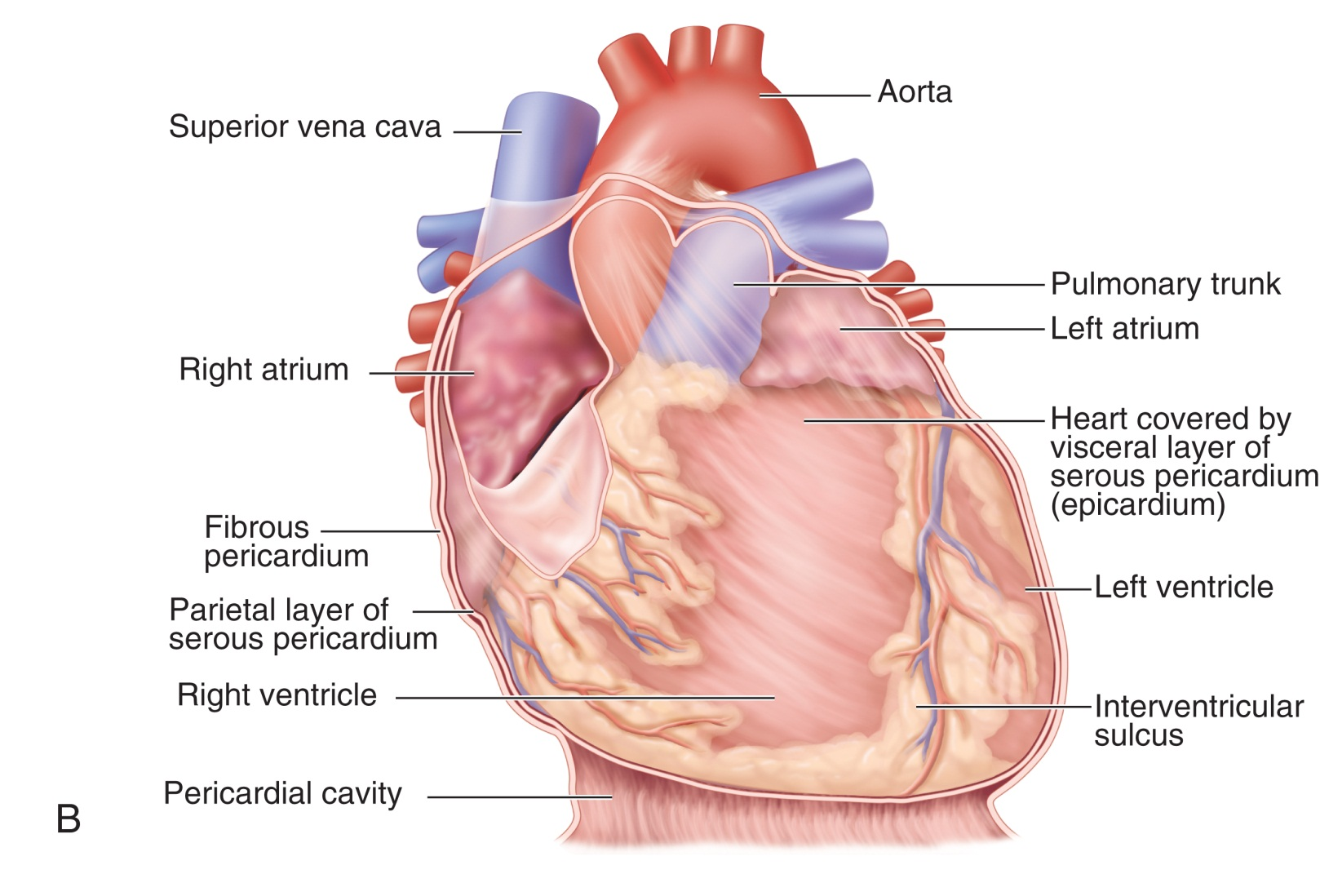
Anatomy of the Heart
From Thibodeau G, Patton K: Anatomy and physiology, ed 6, St Louis, 2007, Mosby.
Notes:
The heart is a muscular organ that lies where in the thoracic cavity? (Mediastinum)
Name the three layers of heart tissue. (The outer epicardium, the middle myocardium, and the inner endocardium)

Slide 6
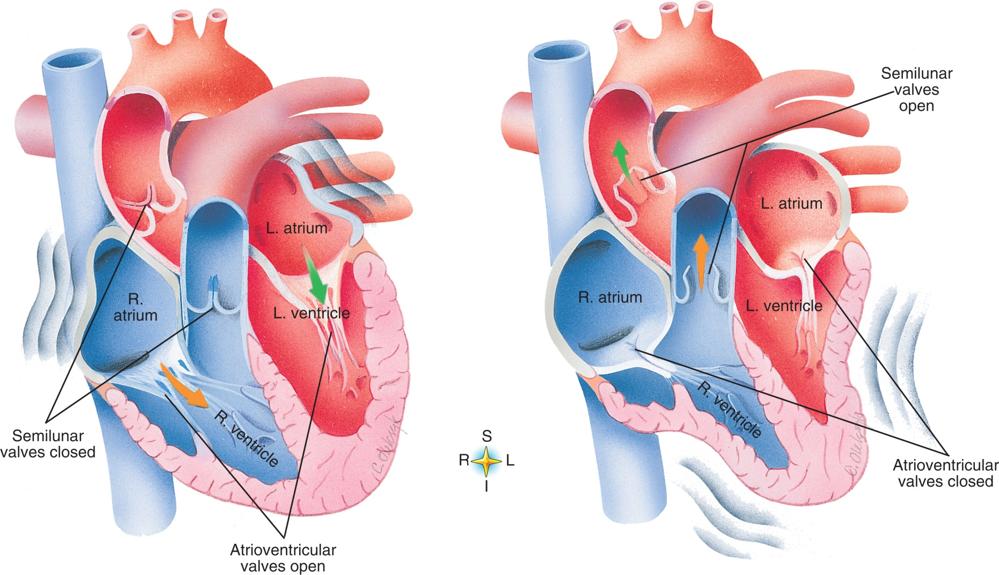
Chambers and Valves
From Thibodeau G, Patton K: Anatomy and physiology, ed 6, St Louis, 2007, Mosby.
Notes:
Name the four chambers of the heart. (Right and left atrium, right and left ventricle)
Why does the left ventricle require a larger muscle mass than the right? (It pumps blood at a higher pressure.)

Slide 7
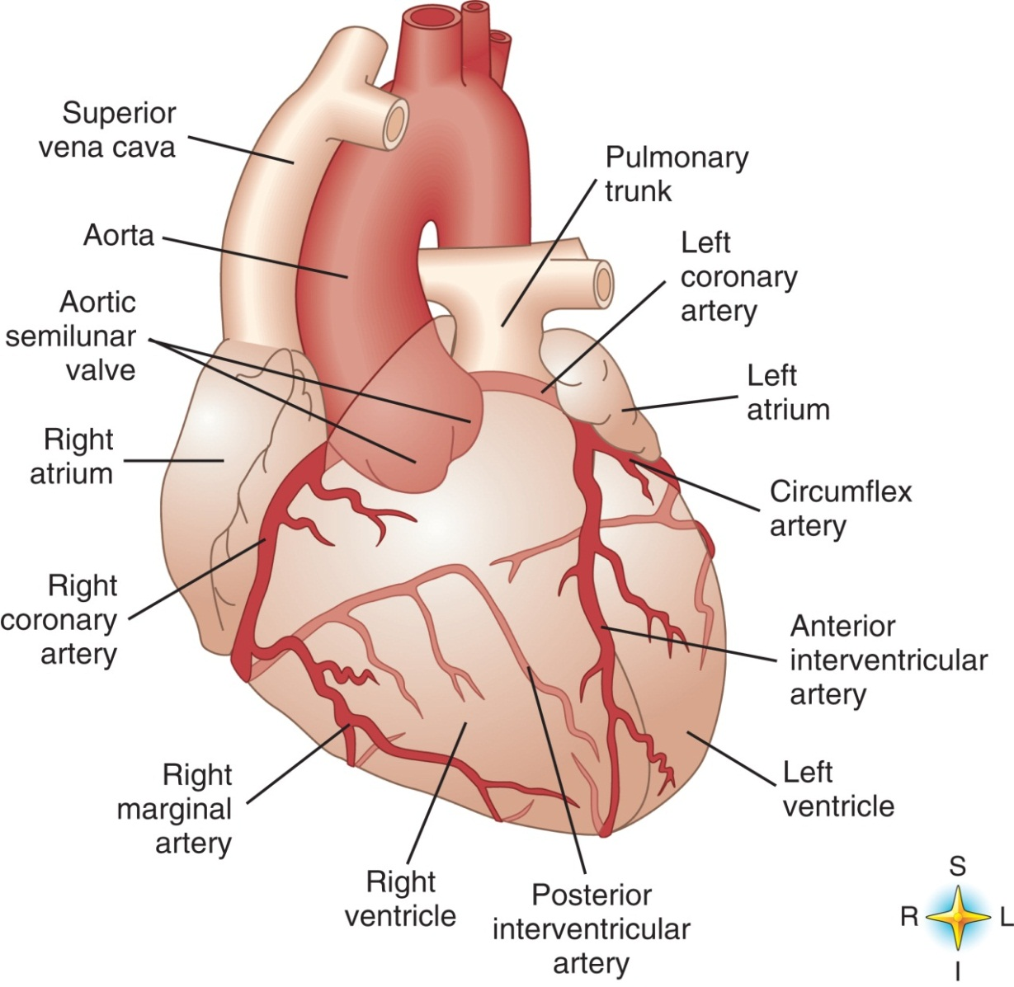
Coronary Artery Circulation
From Thibodeau G, Patton K: Anatomy and physiology, ed 6, St Louis, 2007, Mosby.
Notes:
The right and left coronary arteries divide into how many main branches? (3)
What is the coronary sinus? (A large venous channel in the heart wall that receives blood via the coronary veins and empties into the right atrium)

Slide 8
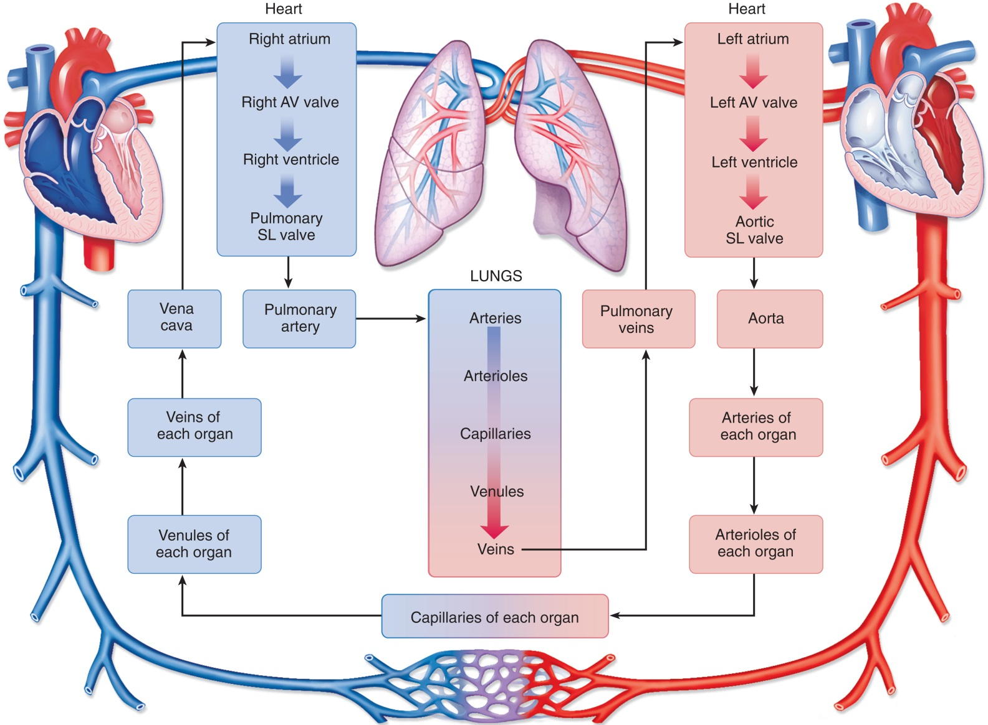
The Cardiac Cycle
From Thibodeau G, Patton K: Anatomy and physiology, ed 6, St Louis, 2007, Mosby.
Notes:
Describe the difference between systole and diastole. (During systole, the ventricles contract; in diastole, they relax and fill with blood.)
What is cardiac output? How is it measured? (The volume of blood pumped by the left ventricle of the heart in one minute. It is measured by multiplying the heart rate [beats per minute] by the stroke volume [volume of blood].)

Slide 9
Diagnostic Procedures
Performed in interventional radiology
Surgical technologist may assist
Cardiac function tests may require
Sophisticated imaging techniques
Injection of a radionuclide
Physical stress test
Notes:
Routine lab tests are performed to identify abnormalities of blood, urine, cardiac enzymes, and waste products.

Slide 10
Cardiac Catheterization
Interventional radiology procedure
Left heart catheterization
Assessment of the coronary arteries
Right heart catheterization
Assessment of the right atrium and ventricle
Notes:
The SA node will set the heart rate at approximately 75 beats per minute.
The atrioventricular (AV) node will pace the heart at approximately 60 beats per minute.

Slide 11
General Augmented Set Instruments
Cardiac instruments
Thoracic instruments
Stapling devices
Lung instruments
Coronary artery instruments
Notes:
Cardiac catheterization is an interventional radiology procedure.
Why is left heart catheterization most commonly performed? (Left heart catheterization most often is performed to assess the coronary arteries, systemic vascular resistance, aortic and mitral valve function, and left ventricular pressure.)
Why is right heart catheterization performed? (Right heart catheterization is performed to assess the right atrium and ventricle and the pulmonary artery.)

Slide 12
Cardiac Instruments
Rumel tourniquet
Coronary artery instruments
Valve instruments
Aneurysm instruments
Endoscopic instruments
Notes:
The Rumel tourniquet and its stylet must be included as counted items for the procedure.
Reference Chapter 32, Thoracic and Pulmonary Surgery, for endovascular instruments.
Reference Chapter 21, Minimally Invasive, Endoscopic, and Robotic Assisted Surgery, for endoscopic instruments.

Slide 13
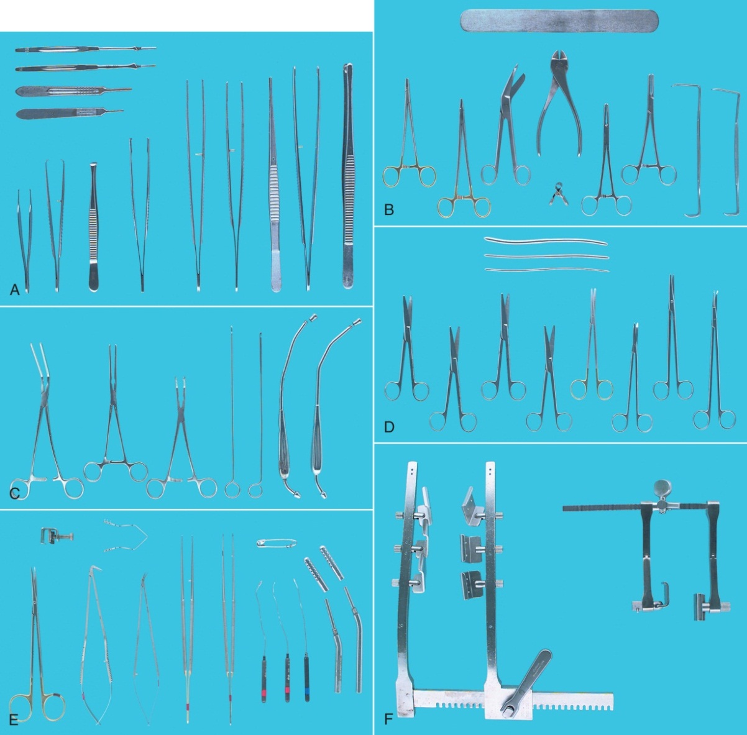
Cardiac Instruments (Cont.)
From Tighe SM: Instrumentation for the operating room, ed 6, St Louis, 2003, Mosby.
Notes:
What cardiac instrument sets are available at your clinical affiliates? (Answers will vary.)
Coronary artery instrumentation is fine and delicate; great care must be used when handling these instruments.

Slide 14
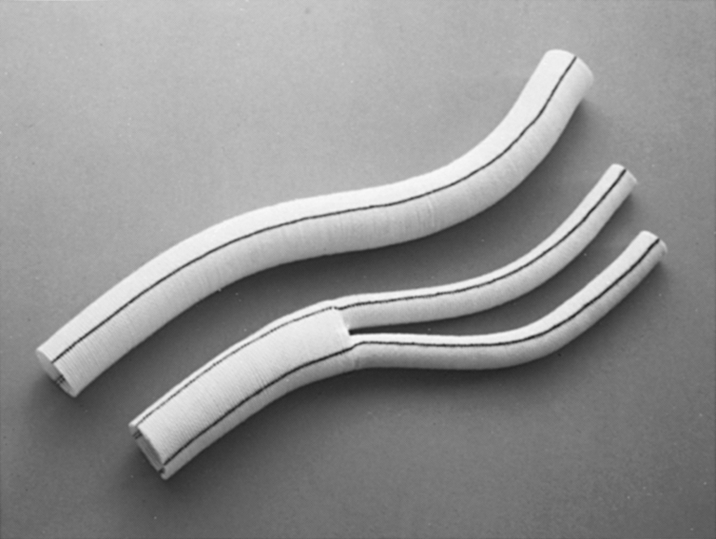
Patch and Vessel Grafts
From Rothrock JC: Alexander’s care of the patient in surgery, ed 12, St Louis, 2003, Mosby.
Notes:
What type of grafting material is used for small-artery anastomosis? For large-artery placement? (Knitted grafts are used for small arteries and woven grafts are used for large arteries.)

Slide 15
Preclotting
A method of preparing a graft to prevent it from leaking
Flush the graft with blood obtained from the patient
Place in a small basin until needed
Notes:
Why is preclotting of grafting material seldom needed? (Preclotting is a method of preparing a graft to prevent leakage. In this process, the graft is flushed with blood, which provides a seal between the fibers of the graft.)

Slide 16
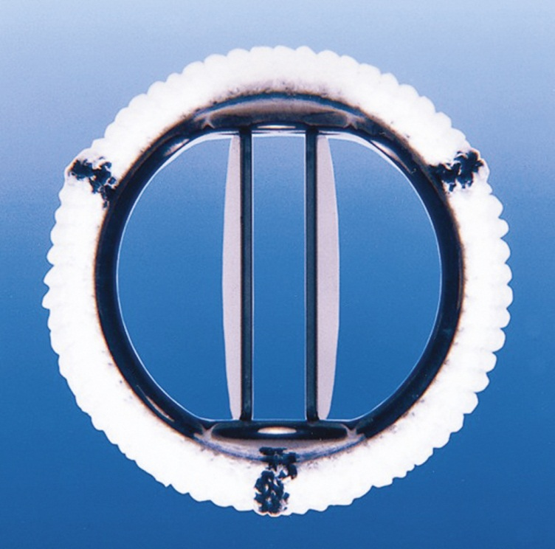
Prosthetic Valves
From Rothrock JC: Alexander’s care of the patient in surgery, ed 12, St Louis, 2003, Mosby.
Notes:
What are the two most commonly used valve replacements? (Mechanical valves and tissue valves)
What information must the scrub and the circulator verify about the valve before opening the valve's package? (The scrub and the circulator must verify the type, size, and identification number of the valve.)

Slide 17
Pacemakers
External device used to ensure that heart muscle remains stimulated
Notes:
Pacing batteries may be temporary (external) or permanent (internal).
What are the two types of permanent electrodes? (Endocardial and epicardial electrodes)

Slide 18
Defibrillators
Application of electricity to shock the cells of the heart muscle, through the use of external or internal paddles, in an effort to convert the heart back to a normal rhythm
Notes:
When the defibrillator is in use, all personnel must stand clear of the patient to avoid receiving an electric shock.

Slide 19
Fibrillators
Used for temporary pacing, or in combination with a defibrillator to create fine fibrillation of the heart
Notes:
How is the fibrillator used during repair of a leaking anastomosis? (The wires are connected to the fibrillator power source and the heart is fibrillated [causing it to quiver] during repair of a leaking anastomosis.)

Slide 20
Drugs Used in Cardiac Surgery
Heparin sodium
Protamine sulfate
Lidocaine
Epinephrine
Cardioplegia
Notes:
Heparin dosage is calculated according to the patient's body weight.
Protamine sulfate is administered after the patient has been removed from the heart-lung bypass machine.

Slide 21
Surgical Procedures
Lesson 34.2
List and describe common cardiac procedures.

Slide 22
Median Sternotomy
Midline incision used for surgical procedures of the heart and great vessels
Notes:
The surgeon makes a midline incision from the sternal notch to 2 to 3 inches below the xyphoid.
If the procedure requires bypass, traction sutures may be placed through the edges of the pericardium and sewn to the periosteum.

Slide 23
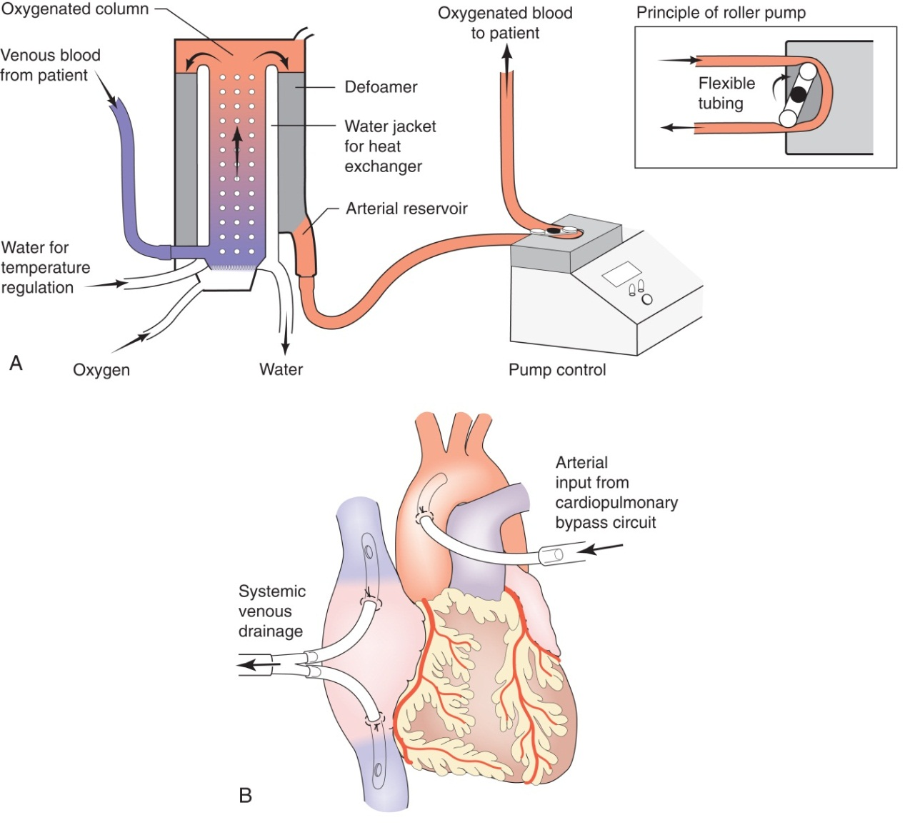
Heart-Lung Machine
From Garden O, Bradbury A, Forsythe J, Parks R: Principles and practice of surgery, ed 5, Edinburgh, 2007, Elsevier/Churchill Livingstone.
Notes:
What types of surgery require the use of cardiopulmonary bypass? (Valve replacement and aneurysm repair)
Partial bypass is used for aortic valve replacement.

Slide 24
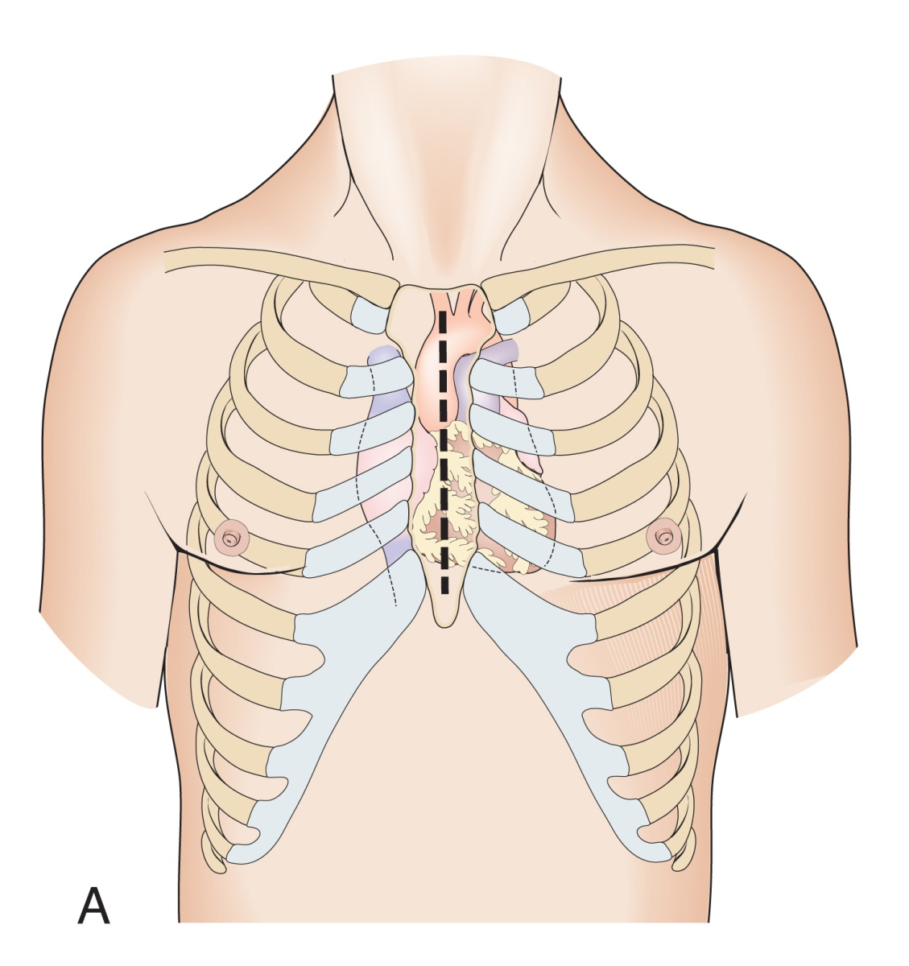
Median Sternotomy (Cont.)
From Garden O, Bradbury A, Forsythe J, Parks R: Principles and practice of surgery, ed 5, Edinburgh, 2007, Elsevier/Churchill Livingstone.
Notes:
Reference Figure 34-12, Median sternotomy, in the textbook.
The scrub should be prepared to institute bypass if the patient's condition deteriorates.

Slide 25
Cardiopulmonary Bypass
Diverts blood from heart and lungs
Femoral vein and femoral artery used occasionally
Total or partial bypass
Watch for presence of air
Notes:
Discuss total and partial bypass. (The surgeon performs total bypass by tightening umbilical tapes around the venae cavae and cannulas. This forces all blood returning to the right side of the heart into the cannula and pump. It also prevents air from entering the venous line and obstructing the flow of blood to the pump when the right side of the heart is open. In partial bypass, blood can escape around the cannula and enter the heart.)
What causes the blood to go back into circulation after bypass? (A centrifugal pump)

Slide 26
Cannula Methods
Femoral arterial cannula
Coronary antegrade perfusion cannula
Left ventricular sump
Right superior pulmonary vent catheter
Notes:
The coronary antegrade perfusion cannula is used to infuse pulmonary bypassplegic solution directly into the heart.
The left ventricular sump catheter drains air and blood within the heart.

Slide 27
Cardioplegia Infusion
Solution used to stop the heart and reduce the energy required by the cardiac muscle
Protects the cardiac muscle from damage while the aorta is occluded and the blood supply is interrupted
Notes:
Cardioplegic solution may contain a mixture of potassium chloride, lidocaine, dextrose, insulin, albumin, tromethamine, and Plasmanate.

Slide 28
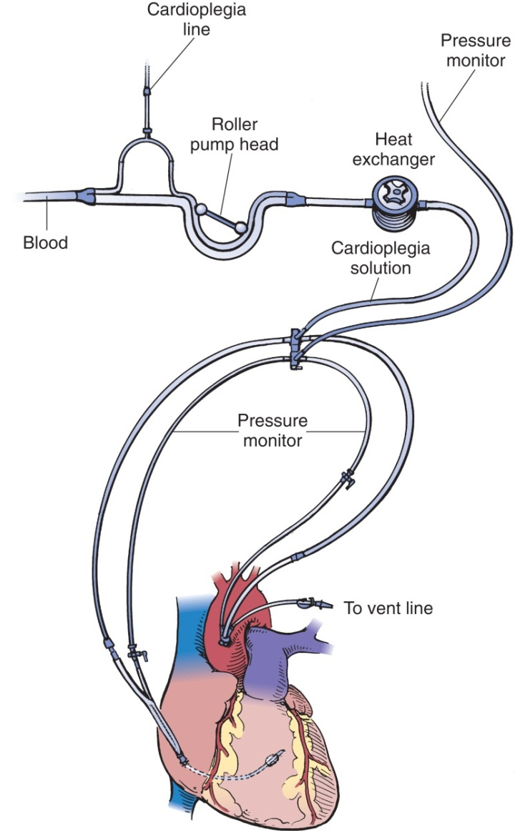
Cardioplegia Infusion (Cont.)
Modified from Waldhausen JA, Pierce WS, Campbell DB: Surgery of the chest, ed 6, St Louis, 1996, Mosby.
Notes:
The solution may be cooled or warmed for administration.

Slide 29
Infusion Methods
Direct coronary artery infusion (antegrade)
Indirect coronary artery infusion (antegrade)
Transatrial cardioplegia via the coronary sinus (retrograde)
Notes:
Describe the difference between antegrade and retrograde cardioplegic infusion. (Antegrade infusion involves the insertion of an indwelling catheter in the aortic root. That catheter is then filled with the solution needed for the procedure. Retrograde cardioplegia catheter is passed through the atrial stab wound, inserted into the opening of the coronary sinus, and positioned in the coronary vein. The proximal end of the catheter is connected to a line leading to the source of the cardioplegic solution. The cardioplegic solution is infused to stop the heart. When cardioplegia is no longer needed, the catheter is removed and the purse-string is tied to close the wound. Cardioplegic solution often is infused by the retrograde route [into the coronary venous system] rather than by the arterial antegrade route. The cardioplegic solution flows from the coronary veins through the capillaries and into the coronary arteries, stopping the heart.)

Slide 30
Decannulation
Removal of the cannulas for the purpose of restoration of blood flow through the heart and lungs.
Notes:
What are some causes of postoperative bleeding or hemorrhage following decannulation? (Bleeding or hemorrhage can occur in the postoperative period if cannulation sites have not been closed securely, if heparin has not been adequately reversed with protamine, if dissection of the cannulated blood vessel occurs, or if surrounding tissue has been damaged.)

Slide 31
Coronary Artery Bypass Grafting (CABG)
Bypasses narrowed segment of coronary arteries
Improves circulation of heart
Notes:
The surgeon performs a median sternotomy and cannulates for cardiopulmonary bypass.
Which internal mammary artery is often used for grafting during CABG? (The left one)
Video-assisted endoscopic vein harvesting may be performed.

Slide 32
Graft Vessels
Greater saphenous
Left or right radial artery
Internal mammary artery
Notes:
Reference Chapter 32, Peripheral and Vascular Surgery, in the textbook.
After the surgeon cuts the vein to the appropriate length, he or she bevels the end with Potts scissors.

Slide 33
Off-Pump Coronary Artery Bypass (OPCAB)
Performed through a median sternotomy
Heart is stabilized
Anastomosis is completed with the internal mammary artery
Notes:
The Octopus retractor and left ventricular suction apparatus are commonly used to expose the coronary arteries.
A special rib retractor with endoscope is used to harvest the left internal mammary artery.

Slide 34
Transmyocardial Vascularization
Procedure in which series of small-bore, transmural channels are created with laser
Carbon dioxide laser or holmium: yttrium-aluminum-garnet [YAG] laser
Allows oxygenated blood from left ventricle to perfuse myocardium
Notes:
Transmyocardial revascularization is indicated in what types of patients? (When bypass or medical management isn't feasible.)
Transmyocardial revascularization may be used in conjunction with standard coronary artery bypass.

Slide 35
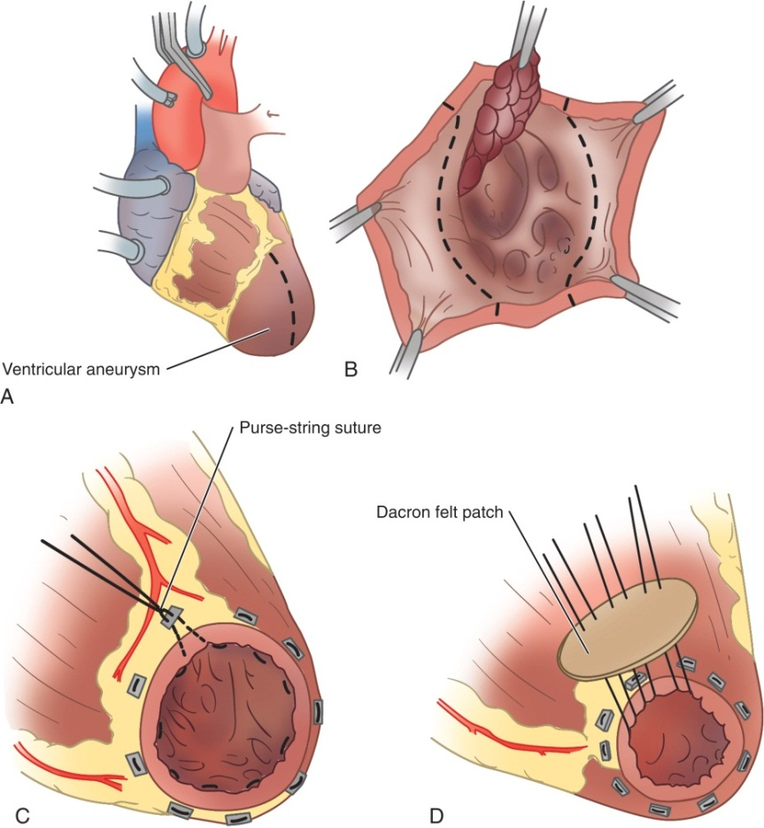
Left Ventricular Aneurysm Resection
Completed to reduce risk of rupture and embolism
Modified from Waldhausen JA, Pierce WS, Campbell DB: Surgery of the chest, ed 6, St Louis, 1996, Mosby.
Notes:
What causes aneurysm of the left ventricle? (An aneurysm of the left ventricle most often is caused by a reduced blood supply from an infarcted coronary artery.)
A Dacron patch is used to repair the ventricle.

Slide 36
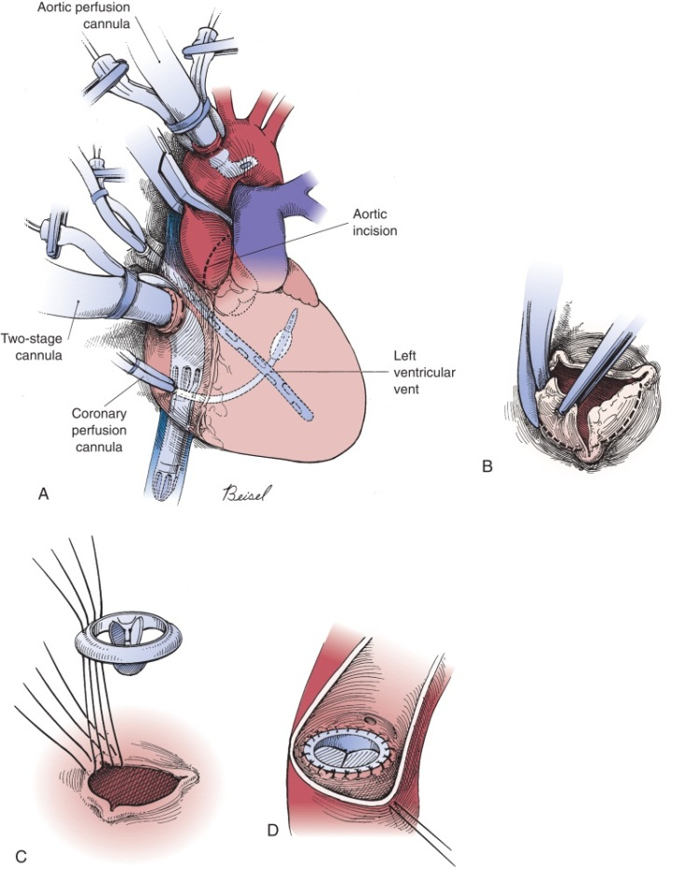
Aortic Valve Replacement
Maintain one-way flow of blood to the heart
Modified from Waldhausen JA, Pierce WS, Campbell DB: Surgery of the chest, ed 6, St Louis, 1996, Mosby.
Notes:
What are common causes of valve insufficiency? (Common causes of valve insufficiency are endocarditis, congenital anomalies, and calcification.)
What are the symptoms of a leaking valve? (Calcification of the valves also can occur. The valve leaflets may become stiff because of calcification or other thickening. This can reduce the opening of the valve to a small slit. The ventricle must work harder to pump a sufficient amount of blood through the narrowed orifice of the stenotic valve. This can lead to ventricular failure and insufficient blood flow to the brain, coronary arteries, and other organs.)

Slide 37
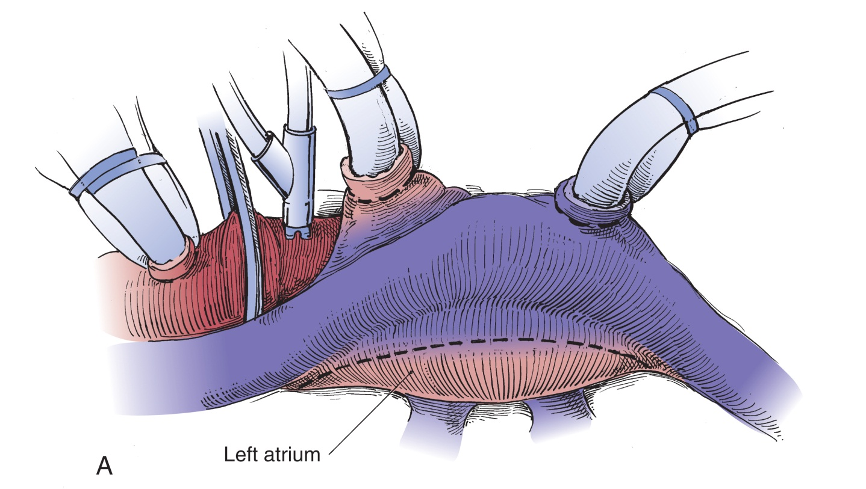
Mitral Valve Repair and Replacement
May be constricted (stenosis) or need replacement
Modified from Waldhausen JA, Pierce WS, Campbell DB: Surgery of the chest, ed 6, St Louis, 1996, Mosby.
Notes:
Where is the mitral valve located in the heart? (The mitral valve is situated between the left atrium and left ventricle.)
What commonly causes mitral valve disease? (Mitral valve disease may be caused by rheumatic heart disease, dilation of the annulus, ischemic heart disease, trauma, or changes in the tissue that produce regurgitation.)

Slide 38
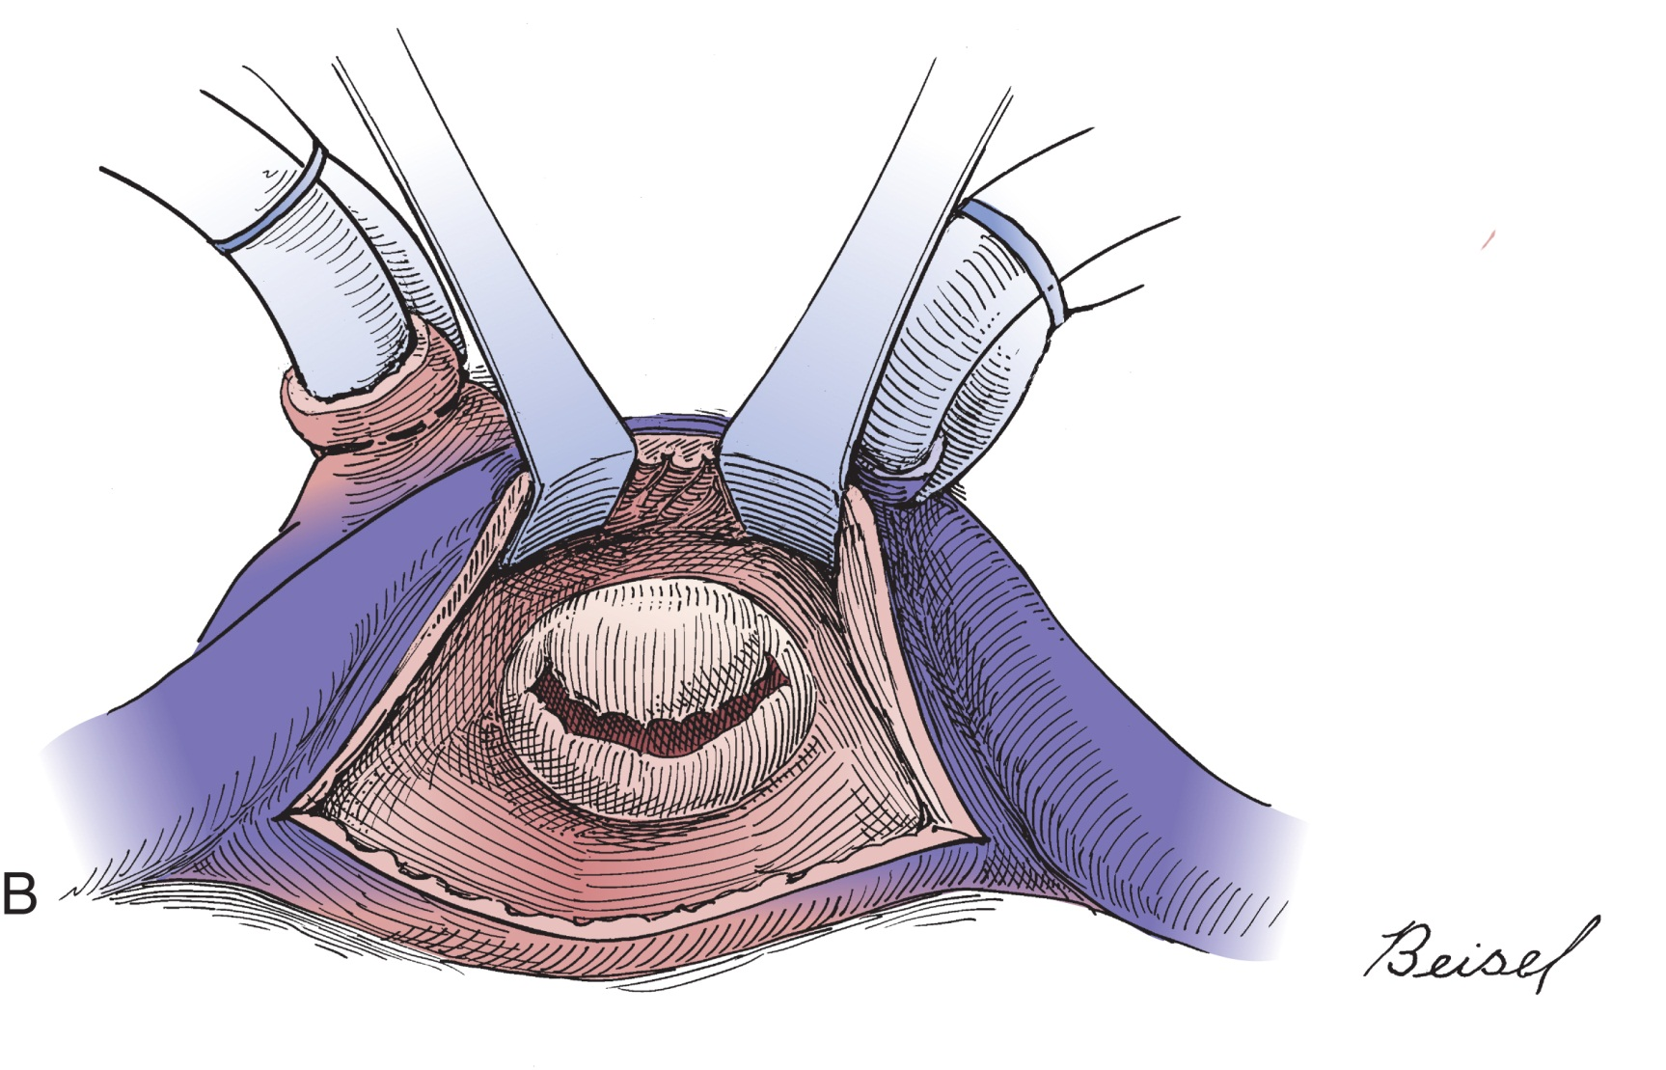
Mitral Valve Repair and Replacement (Cont.)
Modified from Waldhausen JA, Pierce WS, Campbell DB: Surgery of the chest, ed 6, St Louis, 1996, Mosby.
Notes:
A median sternotomy is performed, and the patient is placed on cardiopulmonary bypass.
Blood is allowed to spill out of the heart after the valve has been replaced to remove air bubbles.

Slide 39
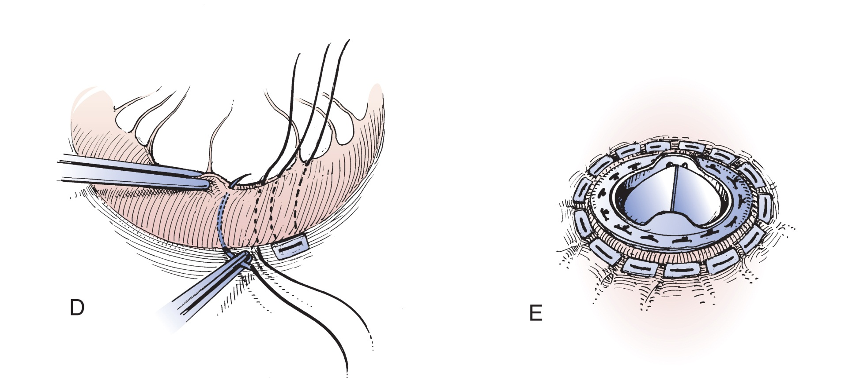
Mitral Valve Repair and Replacement (Cont.)
Modified from Waldhausen JA, Pierce WS, Campbell DB: Surgery of the chest, ed 6, St Louis, 1996, Mosby.
Notes:
A temporary pacemaker electrode may be sutured to the heart.

Slide 40
Mitral Commissurotomy
Occasionally performed instead of a valve replacement
Notes:
A commissurotomy is performed to relieve stenosis when the valve leaflets are sufficiently flexible.
The commissures are incised or broken with a mitral valve dilator to separate the cusps.

Slide 41
Tricuspid Valve Replacement
The valve is excised and replaced with a prosthetic valve through a right atriotomy
Notes:
A leaky tricuspid valve causes tricuspid regurgitation.
Tricuspid ring annuloplasty is often preferred over replacement.

Slide 42
Repair: Ascending Aortic Aneurysm
Prevent rupture
Restore function to a valve
Notes:
What conditions cause an aneurysm to form in the ascending aorta? (Cardiovascular disease, atherosclerosis, and arteriosclerosis)
Describe the two classifications of aneurysms. (A saccular aneurysm is a ballooning out of a localized area in the artery. A fusiform aneurysm involves the entire circumference of the artery.)

Slide 43
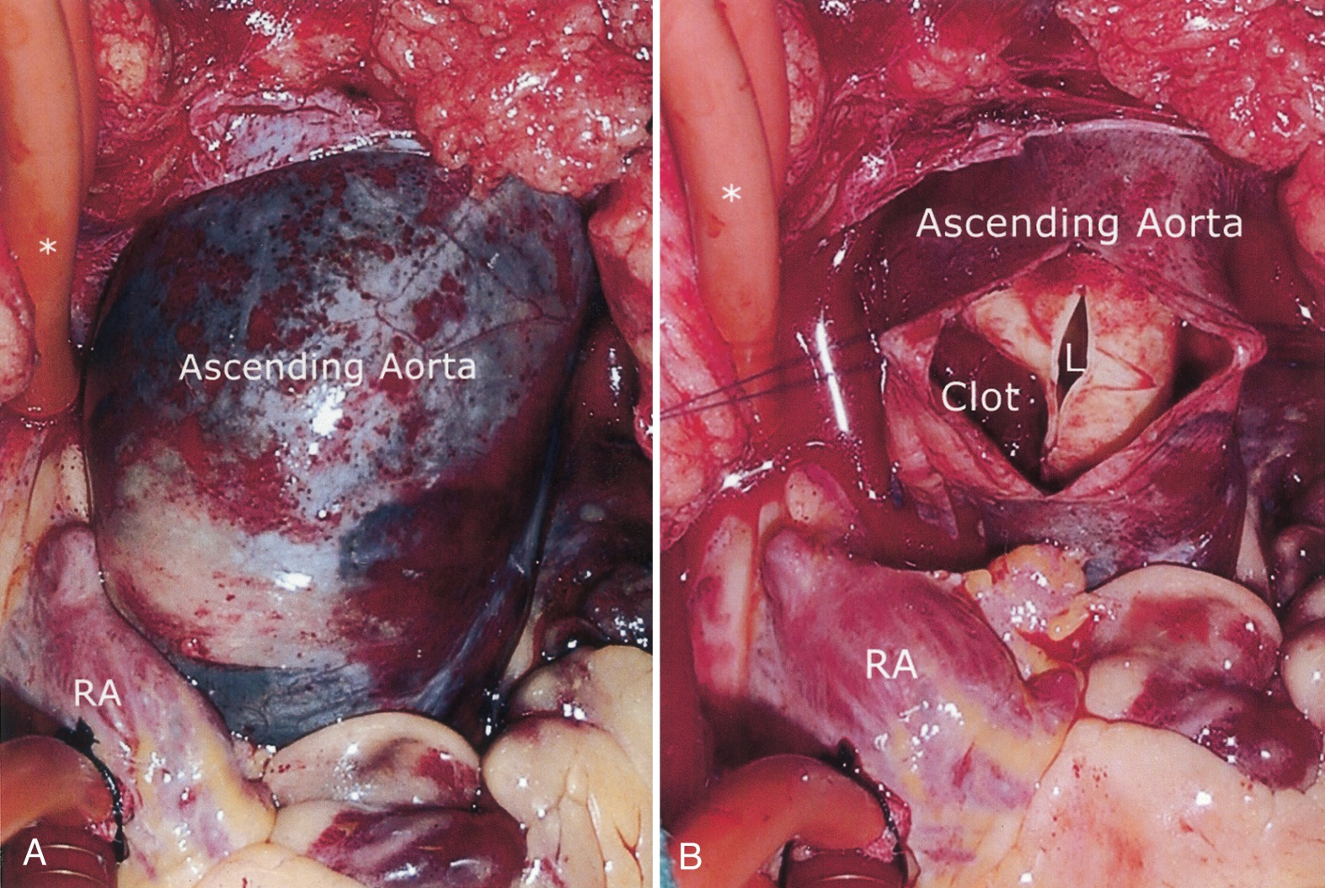
Repair: Ascending Aortic Aneurysm (Cont.)
From Townsend CM: Sabiston textbook of surgery, ed 17, Philadelphia, 2001, WB Saunders.
Notes:
What is a dissecting aneurysm? (As the disease progress, the walls of the aorta become increasingly stiff and blocked by fatty deposits. The walls of the segment distal to the blockage [in the direction of blood flow] become weak and distended. Finally, the ballooning vessel begins to delaminate [the intimal layer separates] and blood is forced between the layers, resulting in rupture. This delamination is called dissection and the aneurysm then is referred to as a dissecting aneurysm.)

Slide 44
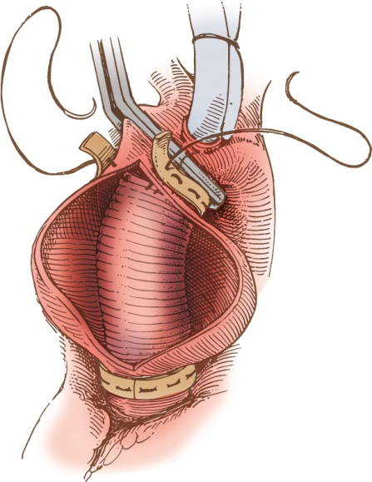
Resection and Graft Repair: Ascending Aortic Aneurysm
From Rothrock J: Alexander’s care of the patient in surgery, ed 17, Philadelphia, 2007, Mosby.
Notes:
The femoral artery and vein will be isolated if there is a risk of rupture of the aneurysm upon opening of the chest.
The surgeon occasionally must replace both the aorta and the aortic valve.

Slide 45
Repair: Aortic Arch Aneurysm
Repair aneurysm and restore the flow of blood to
The brachiocephalic artery
The left carotid artery
The left subclavian artery
Notes:
An aneurysm of the aortic arch may require resection and anastomosis of both the aorta and its branching arch vessels using a graft.

Slide 46
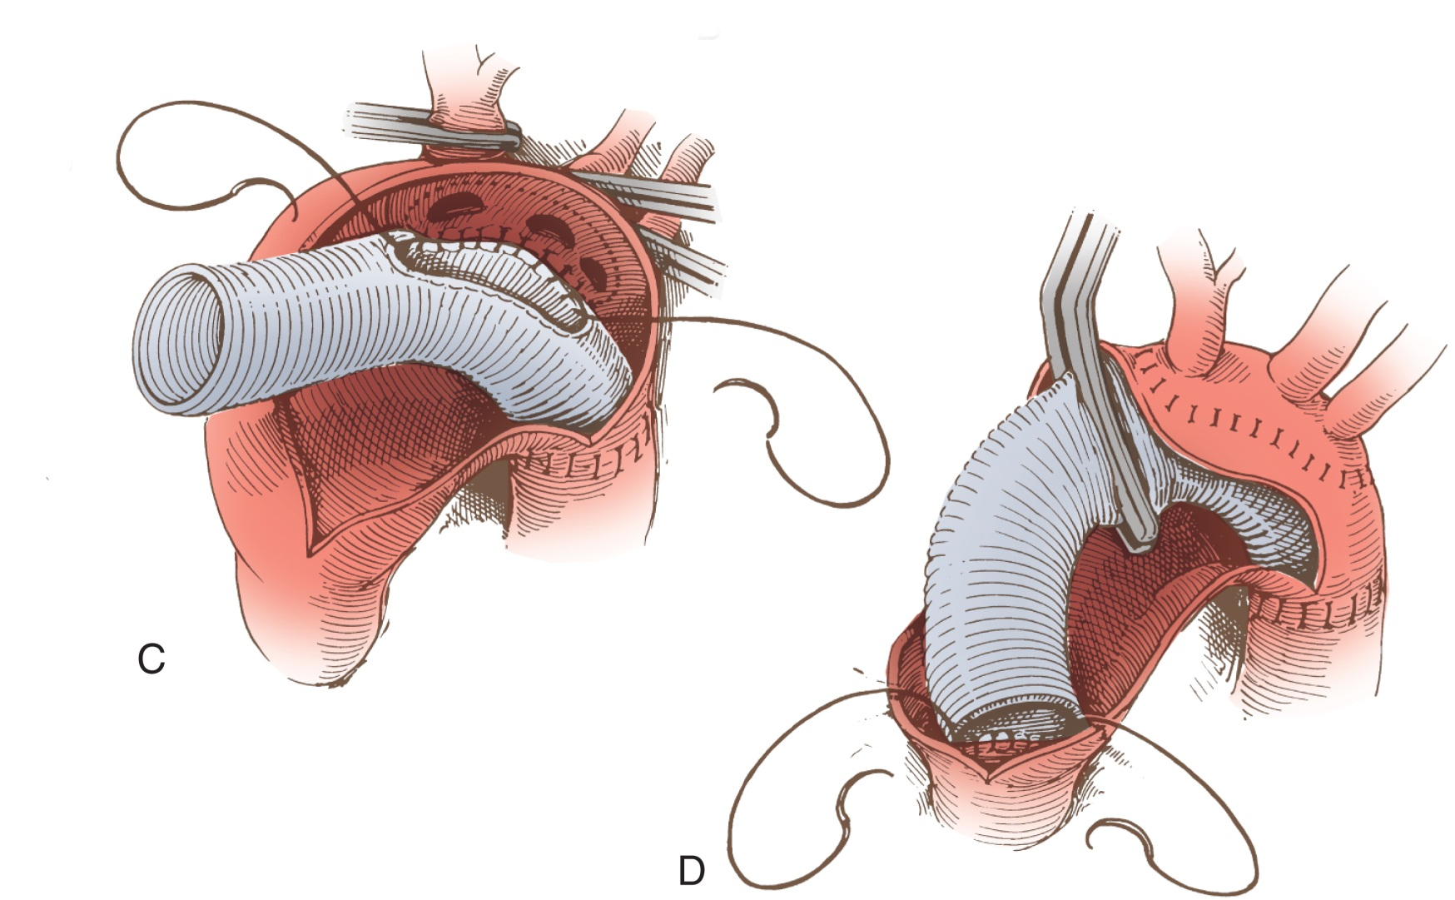
Repair: Aortic Arch Aneurysm (Cont.)
Modified from Waldhausen JA, Pierce WS, Campbell DB: Surgery of the chest, ed 6, St Louis, 1996, Mosby.
Notes:
In some cases, the branch vessels cannot be clamped because of their location or involvement. What might the surgeon do in this situation? (In these cases, the surgeon may elect to turn off the pump for the period required to anastomose the arch vessels.)

Slide 47
Resection: Aneurysm of the Descending Aorta
To prevent rupture and a life-threatening hemorrhage
Notes:
When the chest has been opened and the retractors placed, the surgeon retracts the edges of the pleura with size 2-0 sutures.
The surgical technologist should have a small basin to receive loose debris and blood clots and a moist sponge to wipe debris from the surgeon's instruments.

Slide 48
Endovascular Resection of Aneurysm in the Descending Thoracic Aorta
This procedure is performed through an incision into the femoral artery using guidewires, dilators, and one or more stent grafts
Notes:
The surgeon uses fluoroscopy to guide the placement of the stent graft.
What are the potential complications of endovascular resection of aneurysm? (Possible complications include bleeding and migration of the device, requiring adjustment and/or insertion of another device.

Slide 49
Pacemaker Insertion
A device that produces electrical impulses that stimulate the heart muscle
Other heart arrhythmias
Ventricular tachycardia
Atrial flutter
Ventricular fibrillation
Atrial fibrillation
Notes:
A permanent pacemaker consists of a pulse generator and electrodes.
Conduction problems in the heart can be caused by a number of factors. What are some of these? (Answers will vary.)

Slide 50
Permanent Pacemaker Implantation
Transvenous, epicardial, subxiphoid
Transvenous and subxiphoid procedures do not require thoracotomy and can be performed successfully with local anesthesia
When transvenous approach is used, electrodes are placed with aid of fluoroscopy
Notes:
A pacemaker implantation can be temporary or permanent. Identify some indications for the use of a temporary pacemaker.
Regardless of the approach used for permanent implantation, the patient will be placed in the Trendelenburg position for insertion of the electrodes.

Slide 51
Pacemaker Battery Replacement
Replacing a malfunctioning pacemaker generator so continuous pacing can be achieved
Notes:
Once the generator is removed and the electrodes are disconnected, the surgeon connects the electrodes to the alligator cable of an external pace generator.

Slide 52
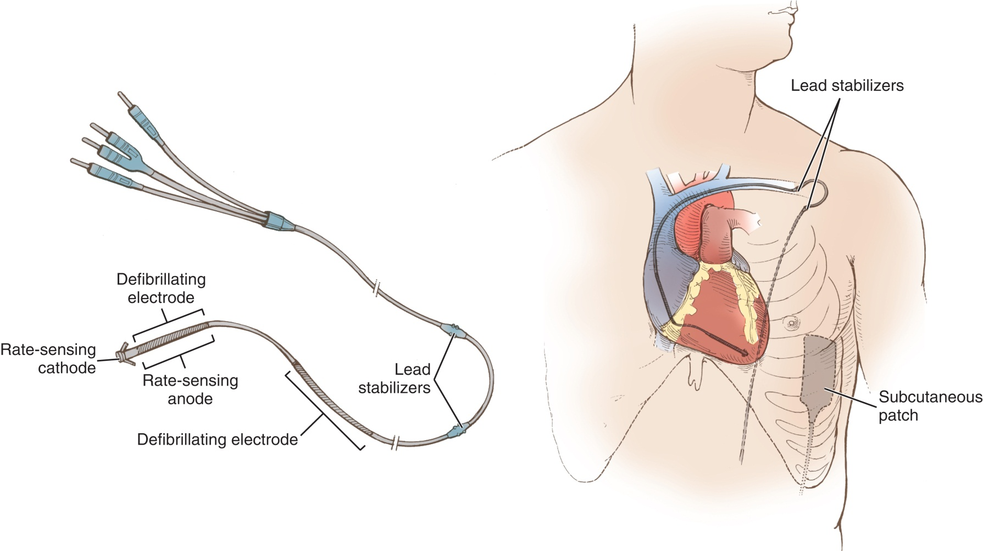
Pacemaker Battery Replacement (Cont.)
From Rothrock J: Alexander’s care of the patient in surgery, ed 17, Philadelphia, 2007, Mosby.
Notes:
Implantable cardioverter-defibrillators (ICDs) are implanted to correct what type of arrhythmia(s)? (An electronic cardiac defibrillating and monitoring device is used in patients susceptible to ventricular fibrillation or ventricular tachycardia. Most ICDs also have pacing functions to treat bradycardia, which may occur after an episode of defibrillation.)
The majority of ICDs are inserted transvenously.

Slide 53
Cardiac Ablation
Selective destruction of diseased conductive tissue to correct atrial fibrillation
Wolff-Parkinson-White syndrome
Completed with radiofrequency (RF) energy or cryoenergy
Notes:
Ablation is commonly performed through a cardiac catheter. The procedure may also be performed through an open sternotomy.

Slide 54
Pericardial Window
Removal of an accumulation of blood or fluid in the pericardium to improve cardiac function
Notes:
What are some causes of pericardial effusion? (Pericardial effusion is caused by inflammation related to an infectious disease or a tumor. It may also be a result of a fluid shift related to homeostasis.)

Slide 55
Pericardectomy
Removal of the adherent scar tissue surrounding the heart as a result of chronic inflammation of the pericardium
Notes:
What causes chronic inflammation of the pericardium? (Constrictive pericarditis may develop because of viral infection, tuberculosis, or chronic pericarditis. The heart becomes encased within an adherent layer of scar tissue.)
Dissection of the dense adhesions can cause increased bleeding; suture ligatures of 4-0 or 5-0 polypropylene or silk may be used.

Slide 56
Intra-Aortic Balloon Catheter
Used to reduce the workload of the heart after myocardial infarction or in those who cannot come off the bypass machine
Notes:
When prepping a patient for insertion of an intra-aortic balloon catheter, the patient is prepped and draped for a bilateral femoral incision.

Slide 57
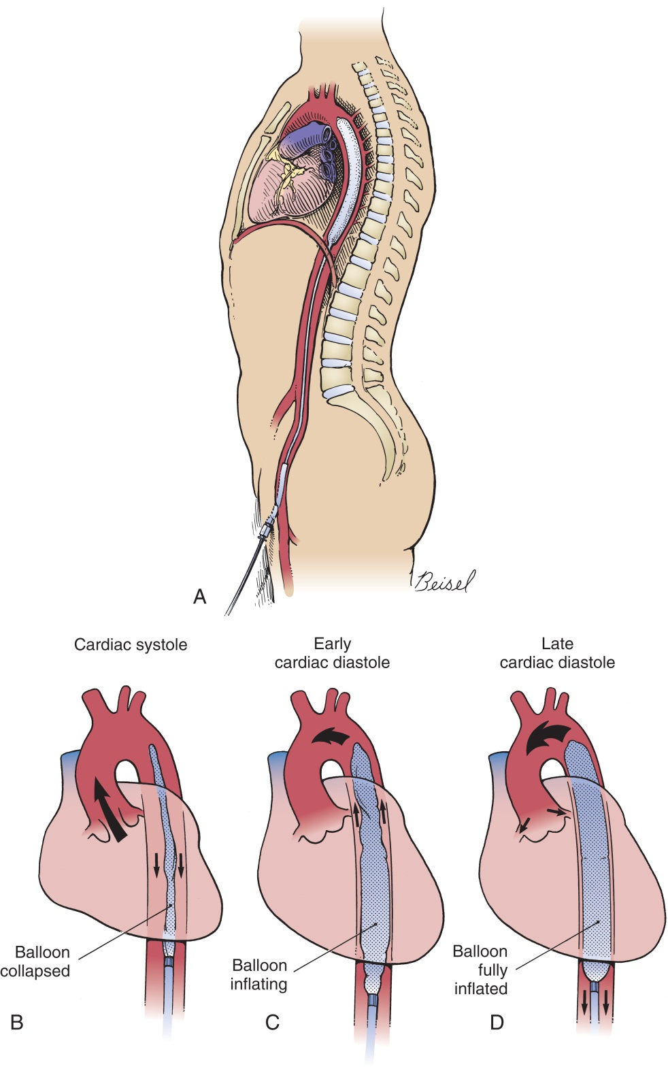
Intra-Aortic Balloon Catheter: Insertion and Removal
Modified from Waldhausen JA, Pierce WS, Campbell DB: Surgery of the chest, ed 6, St Louis, 1996, Mosby.
Notes:
The distal tip of the catheter is positioned just below the left subclavian artery.
How does the balloon increase the supply of oxygen to the heart? (The balloon increases the supply of oxygen to the heart by increasing coronary blood flow during diastole and improves distal perfusion of the body's organs.)

Slide 58
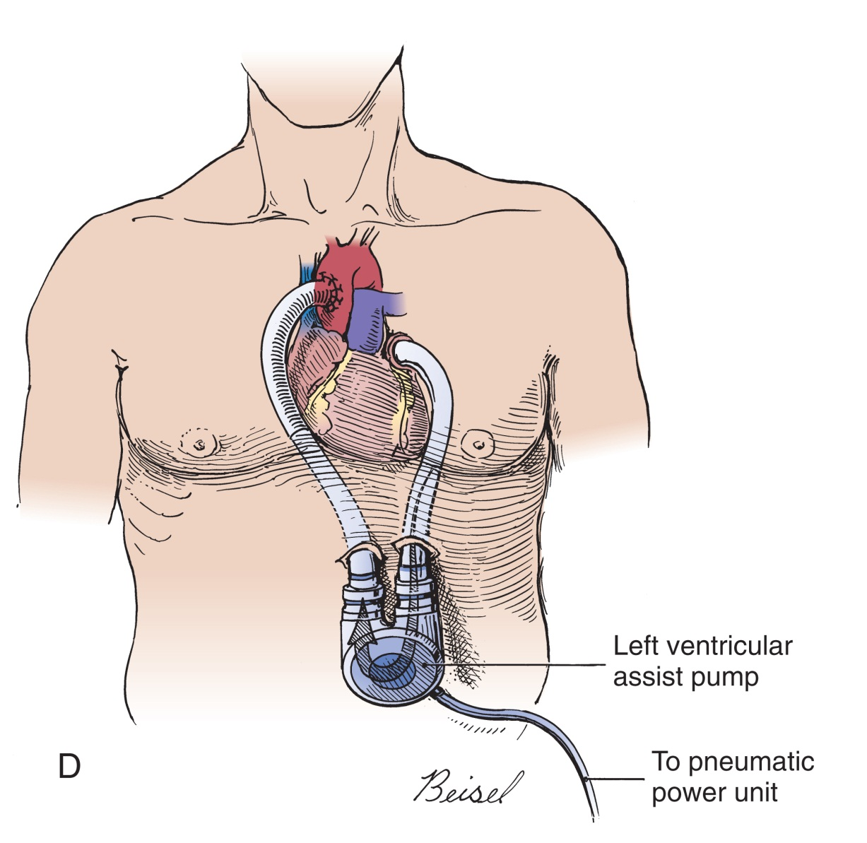
Ventricular Assistive Device
Modified from Waldhausen JA, Pierce WS, Campbell DB: Surgery of the chest, ed 6, St Louis, 1996, Mosby.
Notes:
Patients waiting for a heart transplant may be placed on a ventricular assistive device (VAD).
Ventricular assistance can be used on the right ventricle, left ventricle, or both ventricles.

Slide 59
Heart Transplantation
Removal of the native heart and replacement with a donor heart
Notes:
Describe the difference between orthotopic and heterotopic transplantation. (Two types of cardiac transplantation can be performed: orthotopic transplantation is performed more often and is the replacement of one heart with another [Figure 34-27]; heterotopic [piggyback] transplantation is the insertion of a second [donor] heart into the recipient patient's right pleural cavity. The hearts work in tandem.)

Slide 60
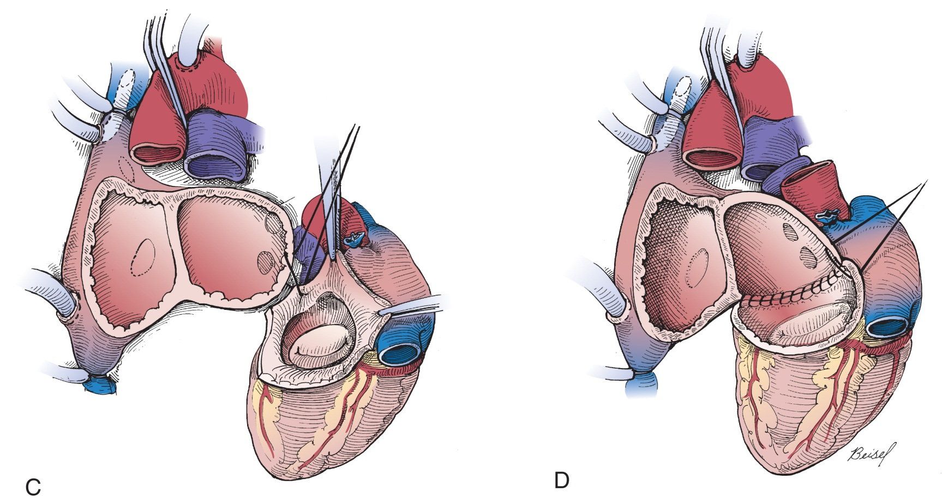
Orthopedic Heart Transplantation
Modified from Waldhausen JA, Pierce WS, Campbell DB: Surgery of the chest, ed 6, St Louis, 1996, Mosby.
Notes:
It is not uncommon to perform a lung transplant at the same time a heart is being transplanted because the respiratory system and the cardiac system are so tightly intertwined.

Slide 61
Questions?

