Slide 1
Surgical Technology
6th edition
CHAPTER 30
Plastic and Reconstructive Surgery

Slide 2
Anatomy and Case Planning
Lesson 30.1
Identify key anatomical features of the integumentary system and face.
Discuss specific elements of case planning for plastic and reconstructive surgery.
Discuss techniques used in plastic and reconstructive surgery.

Slide 3
Terminology Review
Review terms and definitions listed at beginning of chapter
Use your medical dictionary if necessary
Notes:
Familiarize yourself with the chapter terminology.

Slide 4
Introduction
Correction of congenital defects or deformities
Alteration of patient’s appearance for cosmetic purposes
Special psychological needs must be met
Notes:
Plastic surgery is performed for either reconstructive or cosmetic purposes.
Many plastic surgery procedures are performed in outpatient centers or in the surgeon’s office.

Slide 5
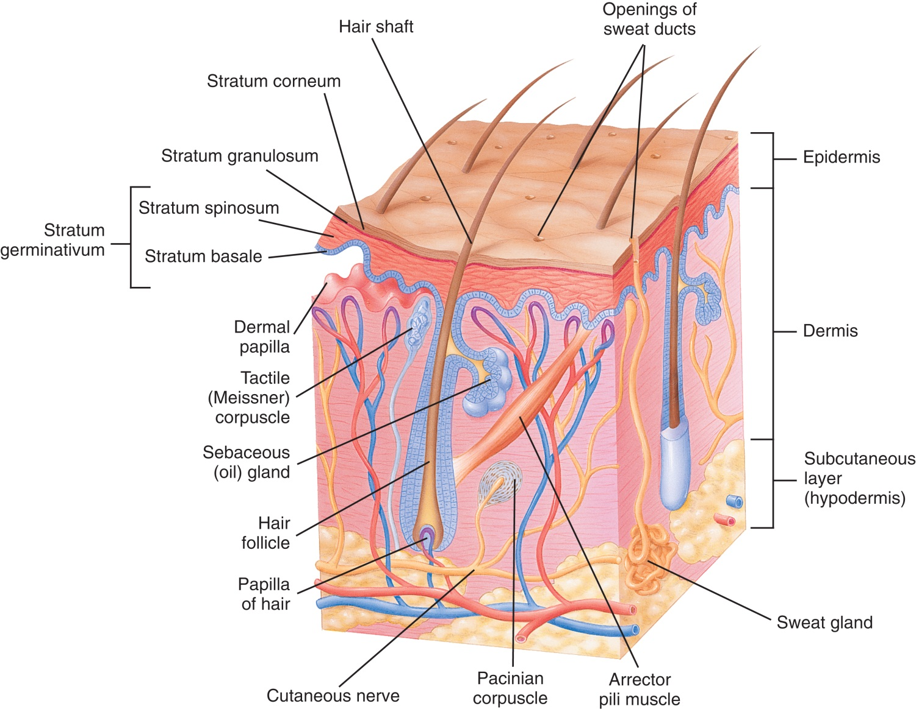
The Epidermis and Dermis
From Thibodeau GA, Patton KT: Anthony’s textbook of anatomy and physiology, ed 17, St Louis, 2003, Mosby
Notes:
What function does the skin serve? (The skin protects tissues and organs, gets rid of waste, stores nutrients, excretes water, and dissipates heat.)
The skin is composed of how many layers? (3)

Slide 6
The Dermis
Lies directly beneath the epidermis
Contains nervous and blood supply of skin
Contains hair follicles and sebaceous and sweat glands
Notes:
What structures are found within the dermis? (A large portion of the vascular plexus in the dermis bypasses the capillaries through an arteriovenous network in which small arteries flow directly into venules.)
How do sweat glands regulate body temperature? (Sweat helps regulate the body temperature by cooling it through evaporation.)
The dermis has numerous sensory receptors, which inform the brain about environmental change or danger.

Slide 7
The Skin Appendages
Hair
Sweat glands
Sebaceous glands
Notes:
The skin contains several specialized structures called appendages.
Hair covers most areas of the body except palms of the hands and soles of the feet.
There are two types of sweat glands: apocrine and eccrine.
Sebaceous glands produce sebum – an oil – found everywhere except palms of the hands and soles of the feet.

Slide 8
Prepping and Draping
Prep solutions of choice
Betadine
Used for liposuction or burns
pHisoHex and Hibiclens
Used on face
Notes:
Do not allow any prep solution to pool in the eyes or ears. Some prep solutions may cause severe corneal abrasions if allowed to pool in the eyes.
The prep and drape depend on the area of the body being worked on.
For facial cases, a head drape is used along with a long body drape.

Slide 9
Application of a Head Drape
Handle corners carefully to avoid contamination
Allows direct visualization of the face
Ears are covered and protected
Notes:
Why is it necessary to cover the patient’s hair? (Hair on the sterile field would cause contamination.)
When placing the towel clip, take care not to pinch the patient’s skin.

Slide 10
Equipment and Instruments
Dermabrader
Liposuction instruments
CO₂ laser
Facial implants
Dermatome
Mesher
Endobrow instruments
Notes:
Many hospitals have plastic instrument sets. Others may use a minor general tray and add smaller instruments, such as mosquito forceps and plastic surgery scissors.
Some plastic surgery procedures require special instrumentation, such as facelift scissors or a CO₂ laser.

Slide 11
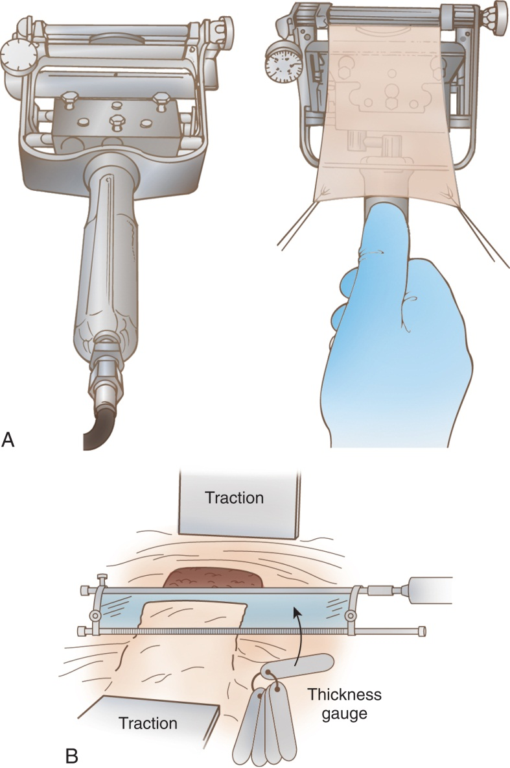
Brow Dermatome and Graft Knife
From Fortunato N, McCullough SM: Plastic and reconstructive surgery, St Louis, 1998, Mosby.
Notes:
The surgeon will determine the width of the dermatome blade and the depth to which the dermatome is set.
The surgical technologist must make certain the safety is engaged when the dermatome is not in immediate use.

Slide 12
Pneumatic Power Drill
Model bone tissue
Create anchor holes for wire or screw
Cut through bone with an oscillating saw blade
Notes:
They are available in a wide variety of sizes and designs.
The surgical technologist is responsible for proper assembly and safe management of the drill.

Slide 13
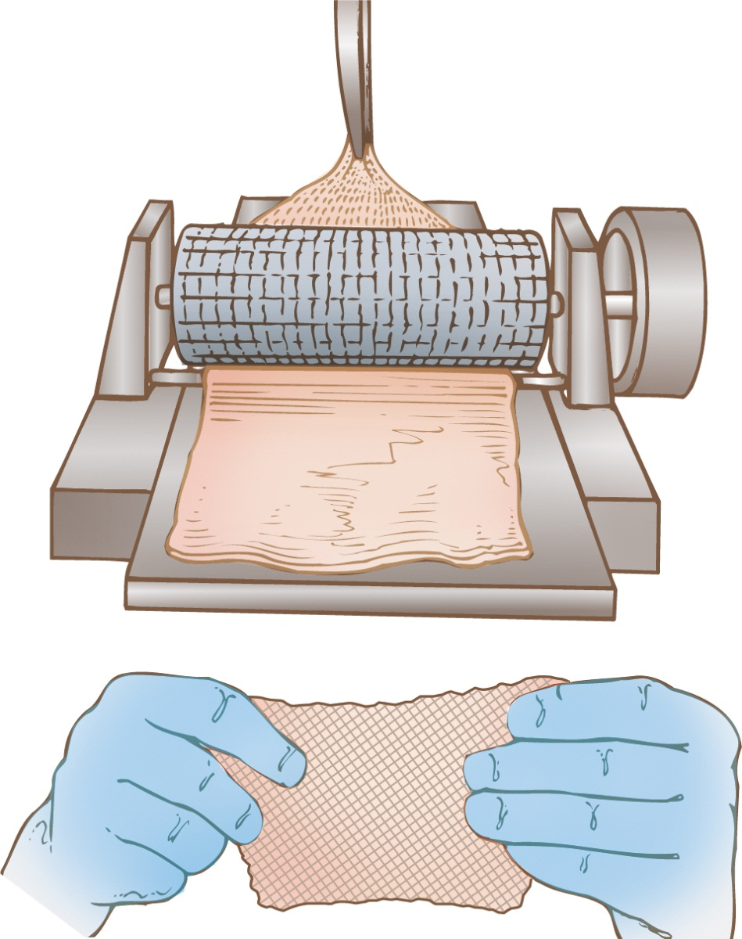
The Mesher
From Rothrock J: Alexander’s care of the patient in surgery, ed 13, Philadelphia, 2007, Mosby.
Notes:
A mesher is used to expand the size of a split-thickness skin graft.
The surgeon will feed the skin through the mesher. Once this is done, the skin then can be “stretched” to cover a larger surface area.

Slide 14
Endobrow Instruments
Include variety of periosteal elevators and instruments for blunt and sharp dissection
Usually are included in a set
Many are adapted to cautery to aid in hemostasis
Set also includes a cannula for endoscope to be passed through
The endoscope may or may not be included in the set of instruments; 4- or 5-mm endoscopes in 0- and 30-degree angles are the endoscopes of choice
Notes:
What instruments are included in an endobrow set? (Endobrow instruments include a 4- or 5-mm endoscope in 0- and 30-degree angles, cannulas, and a variety of periosteal elevators and instruments for blunt and sharp dissection.)
Do any of your clinical affiliate sites have an endobrow set? (Answers will vary.)

Slide 15
Surgical Techniques in Plastic and Reconstruction
Débridement
Grafting
Implants
Notes:
Diseased and traumatized tissue must be removed in order to heal. The process of removing the diseased, damaged, or infected tissue is called débridement. There are several methods of débridement: chemical, surgical, or with pressurized saline.
Grafting is the surgical implantation of biological or manufactured material into the body. There are two fundamental types of grafts: biological and synthetic.
An implant is a synthetic, natural, or biosynthetic substance used to fill in or replace an anatomical structure.

Slide 16
Surgical Procedures
Lesson 30.2
List and describe common plastic and reconstructive surgical procedures.

Slide 17
Excision of Superficial Lesions
Removed for diagnostic purposes
Removed to prevent or treat malignancy
Notes:
What are the most common types of lesions? (The most common types of lesions are basal cell carcinoma, squamous cell carcinoma, and malignant melanoma.)
Discuss the surgical approach to remove superficial lesions. (During Mohs surgery, a malignant skin lesion is removed and divided into quadrants before frozen section. These quadrants are used to map the tumor and determine the exact location of malignant margins. Further excision is performed until the specimen is clear of all malignancy.)

Slide 18
Scar Revision
Performed on scars that have not healed properly
Includes keloid or hyperpigmented scars
Notes:
What are keloids? (A hypertrophic scar occurring in dark-skinned individuals. The scar may become bulbous and usually does not reduce over time.)
Depending on hospital policy, the scar tissue specimen is usually not required to go to pathology as a specimen.

Slide 19
Débridement for Burns
Performed to excise burned and damaged tissue
Burns caused by transfer of heat from external source to the body
Burns are classified by depth of tissue affected
Notes:
The temperature in the OR is raised to reduce the risk of hypothermia.
The patient is positioned to allow for exposure of the burns.
The surgeon will remove all nonliving skin with a debrider until only living tissue remains.
After hemostasis is achieved, an allograft may be applied by stapling.
Patients may recover in a burn intensive care unit.
Multiple surgeries and grafts may be required before rehab can begin.

Slide 20
Burn Classifications
Superficial partial thickness (1st degree)
Partial thickness (2nd degree)
Full thickness (2nd degree)
Full thickness (3rd degree)
Notes:
Burns are caused by what external forces? (Burns are caused by flame, scalding [liquid], electrical current, radiation, or chemicals.)
Burns are classified by the depth of the tissue affected.

Slide 21
First-Degree Burns
Only the outer layer of the epidermis is injured. The skin is red or pink, dry, and painful to touch
Notes:
A sunburn is an example of a first-degree burn.

Slide 22
Second-Degree Burns
The epidermis and various degrees of the dermis are injured. The skin is blistered, red, and moist
Full thickness, second degree
The epidermis and full dermis are injured. These burns are characterized by a white, smooth, shiny surface with dry blisters and edema
Notes:
Blister formation occurs in second-degree burns.
Touching a hot object, such an iron or an oven rack, will cause a second-degree burn.

Slide 23
Third-Degree Burns
The skin, the subcutaneous tissue, the muscle, and the bone are burned
The third-degree burn is centered in an area of second-degree injury
The skin may be white, brown, or black and will look waxy
Nerves have been destroyed
Notes:
Why is there little pain associated with a third-degree burn? (The nerves are dead.)
Why does the pain increase as the patient heals? (Eschar can damage the deep layers of tissue.)

Slide 24
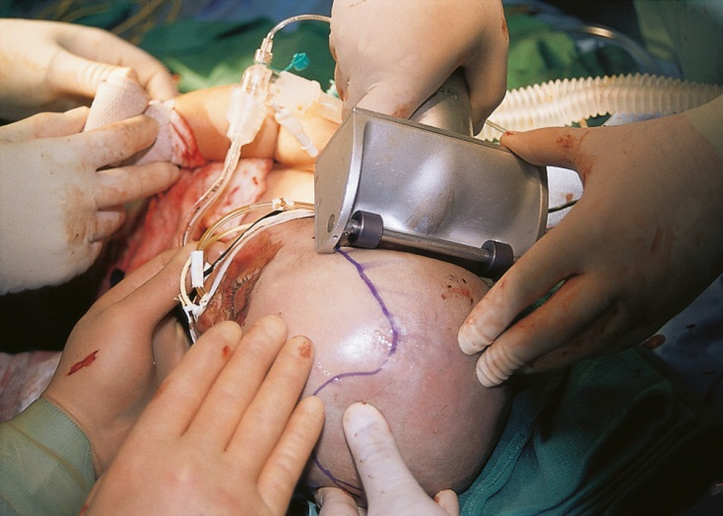
Skin Grafts
A dermatome taking a skin graft
From Barret JP, Herndon DN: Color atlas of burn care, Philadelphia, 2001, WB Saunders.
Notes:
What is the difference between a split-thickness graft and a full-thickness graft? (Full-thickness skin grafts consist of the epidermis and the whole thickness of the dermis. Split-thickness grafts consist of the epidermis and a variable portion of the dermis.)
The donor site is not prepped with Betadine; instead, Hibiclens or pHisoHex is used. Why? (Answers will vary.)

Slide 25
Pedicle Graft
Provides coverage of a soft tissue defect
Classification
Near graft
Distant graft
From Garden O, Bradbury A, Forsythe J, Parks R: Principles and practice of surgery, ed 5, Edinburgh, 2007, Churchill Livingstone/Elsevier.
Notes:
Also called a flap graft – is raised from the donor site but not immediately severed free.
A near graft is created in adjacent tissue. Distant grafts are created from the trunk or other areas for use on a limb.

Slide 26
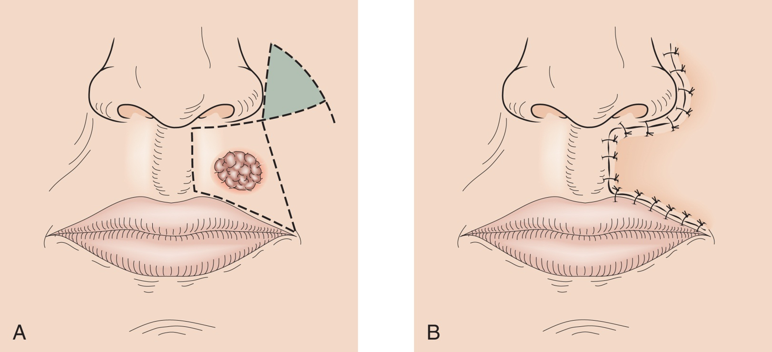
Rotational Flap
From Garden O, Bradbury A, Forsythe J, Parks R: Principles and practice of surgery, ed 5, Edinburgh, 2007, Churchill Livingstone/Elsevier.
Notes:
Pedicle grafts are used to cover a soft tissue defect.
A rotation flap is a type of pedicle flap where the flap is rotated into position from a pivot point.

Slide 27
Blepharoplasty
Resection of the eyelid to improve vision
From Chen W, Khan J, McCord C: Color atlas of cosmetic oculofacial surgery, Edinburgh, 2004, Butterworth-Heinemann.
Notes:
Blepharoplasty is performed mostly on the aging adult. Why? (With advancing age, the eyelids lose elasticity and tone and may obscure vision.)
The surgeon determines how much skin needs to be removed by pinching the skin of the upper lid between forceps.

Slide 28
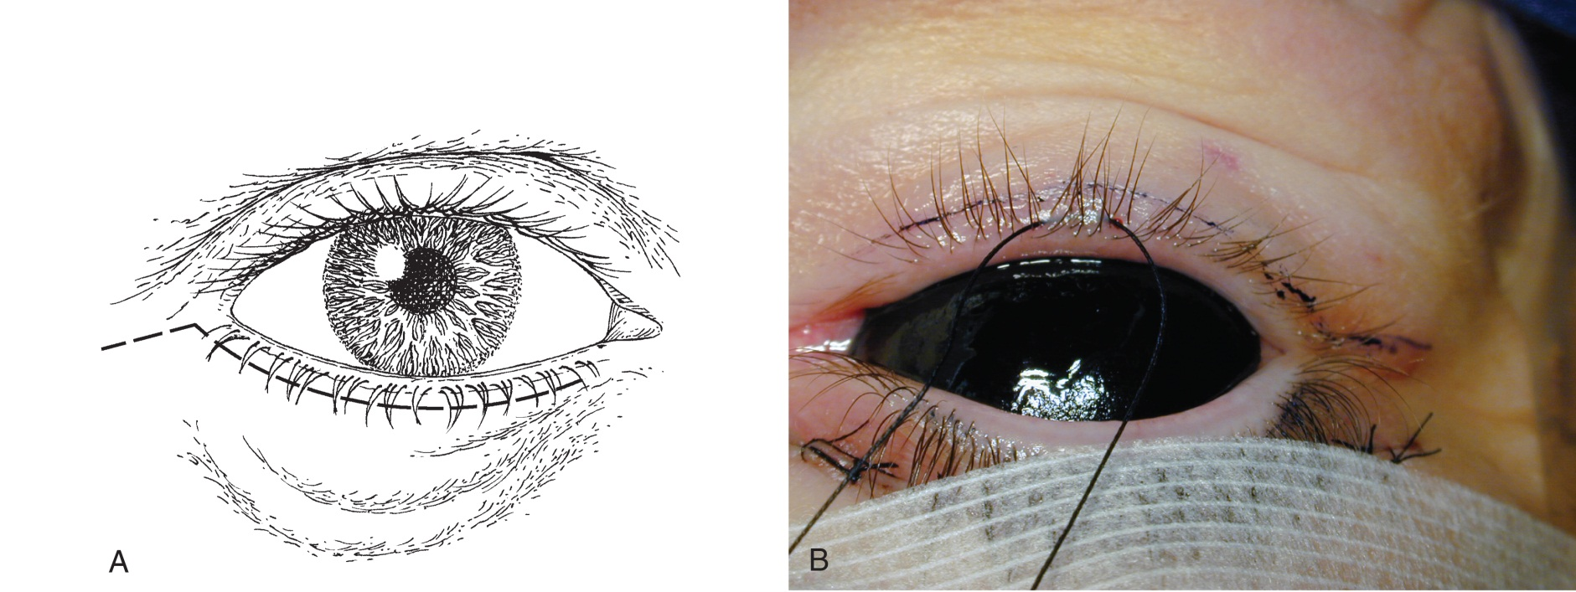
Lower-Lid Blepharoplasty
From Chen W, Khan J, McCord C: Color atlas of cosmetic oculofacial surgery, Edinburgh, 2004, Butterworth-Heinemann.
Notes:
The surgeon will mark the incision area before surgery and extend the lateral margin past the outer canthus of the eye.
An incision is made with a #15 blade.

Slide 29
Brow Lift
Procedure done to lift the supportive structures of the brow and alleviate drooping of the skin, muscle, and fascia
Can be done as an open or endoscopic procedure
Notes:
The brow may droop with age and deepen the furrows over the eyes. This may lead to eyebrow ptosis and upper-lid hooding of the eye.

Slide 30
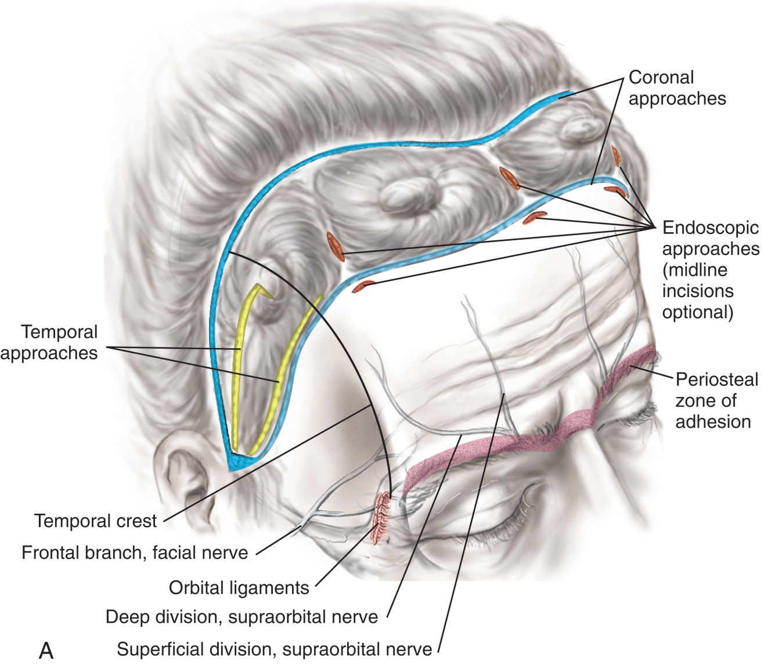
Open Brow Lift
From LaTrenta G: Atlas of aesthetic face and neck surgery, Philadelphia, 2004, WB Saunders.
Notes:
The brow lift is performed to rejuvenate the upper third of the face.
A brow lift is often performed before a blepharoplasty.

Slide 31
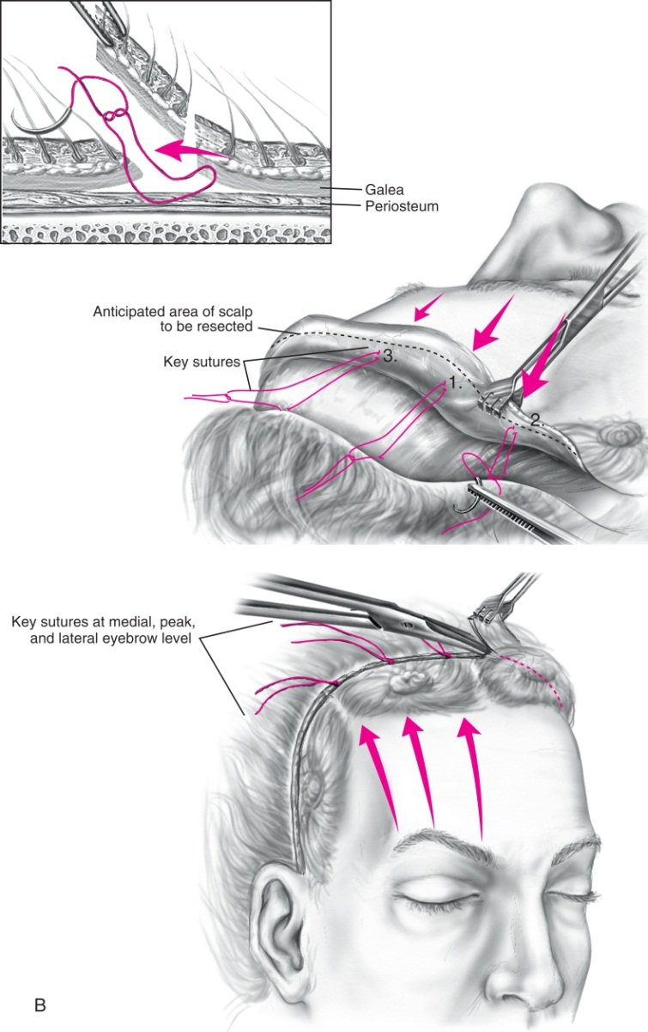
Open Brow Lift (Cont.)
From LaTrenta G: Atlas of aesthetic face and neck surgery, Philadelphia, 2004, WB Saunders.
Notes:
This is the removal of redundant scalp tissue.

Slide 32
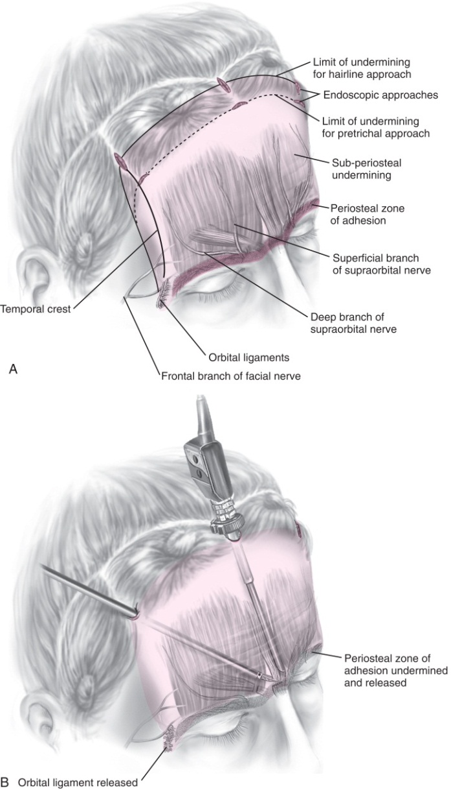
Endoscopic Brow Lift
From LaTrenta G: Atlas of aesthetic face and neck surgery, Philadelphia, 2004, WB Saunders.
Notes:
Intraoperatively, the patient is placed in the lounge chair position.
What are the three sites used for the scalp incisions?
The 30-degree endoscope is used for this procedure.

Slide 33
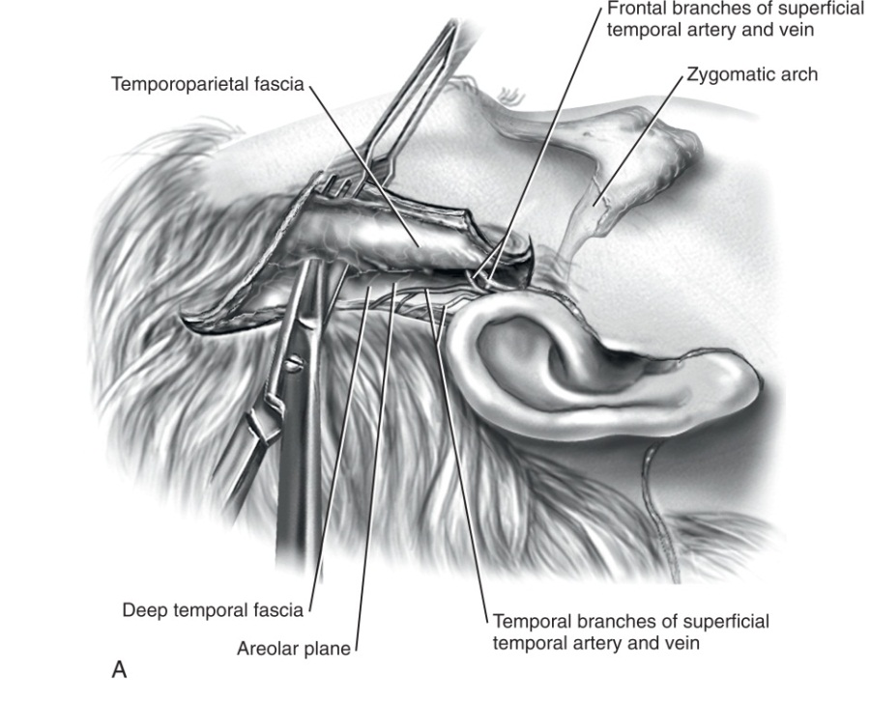
Rhytidectomy
Redundant and sagging supportive tissue of the face is reduced and modified to provide a more aesthetic appearance
From LaTrenta G: Atlas of aesthetic face and neck surgery, Philadelphia, 2004, WB Saunders.
Notes:
A rhytidectomy is commonly referred to as a facelift.
In this procedure, the superficial muscular aponeurotic system (SMAS) will be elevated off the parotid gland and neck for a deep-layer rhytidectomy.

Slide 34
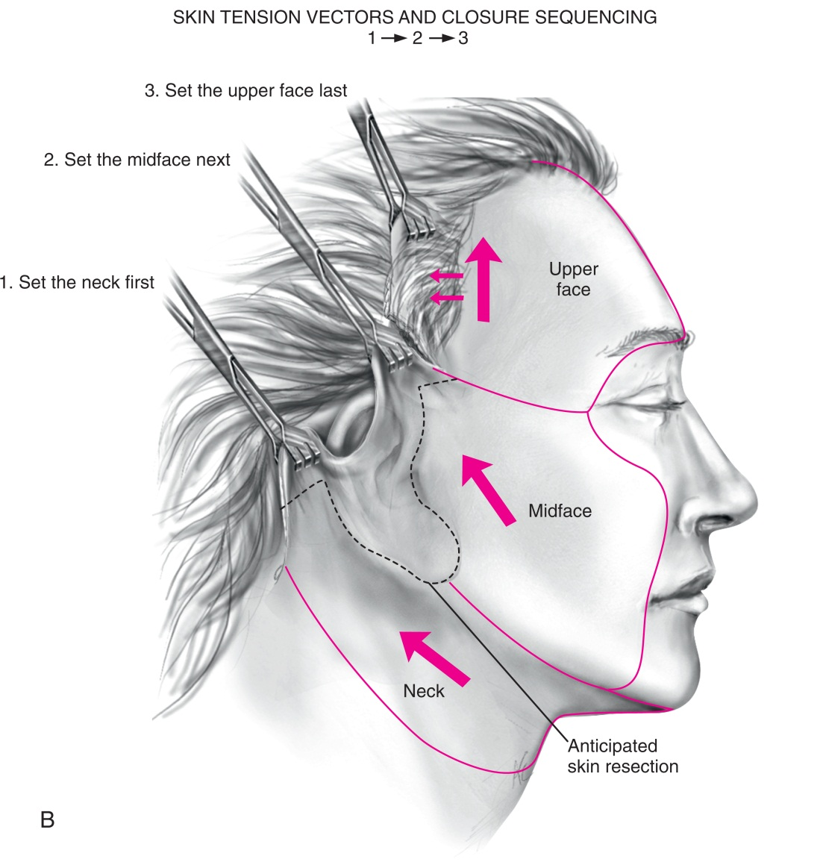
Rhytidectomy (Cont.)
From LaTrenta G: Atlas of aesthetic face and neck surgery, Philadelphia, 2004, WB Saunders.
Notes:
A drain may be placed in the postauricular incision.
A supportive dressing or fascioplasty splint is applied after the incision is closed.

Slide 35
Laser Skin Resurfacing
Performed to reduce effects of aging or photo damage
Skin is resurfaced using a laser
Notes:
Removes the epidermis and a portion of the dermis to reduce facial lines and wrinkles.

Slide 36
Facial Augmentation
Mentoplasty (chin augmentation)
Cheek augmentation
Cheiloplasty (lip augmentation)
Notes:
Implants for facial augmentation are made from many different materials. Name some. (silicone, acrylic polymers, polyethylene, Gore-Tex, and mesh.)
The type of implant used depends on the deformity being corrected.

Slide 37
Otoplasty
Surgical recreation of the external ear
Performed to correct a congenital malformation
Primary deformity is absence of the antihelix and/or the conchal bowl
Notes:
Often involve multiple surgeries. These procedures are complex and many approaches can be used.

Slide 38
Augmentation Mammoplasty
Performed to increase the size and improve the shape of the breast
Notes:
The implants used for breast augmentation may be filled with either saline or silicone, or a combination of the two.
When a saline implant is used, the surgical technologist must inform the circulator so that amount of saline used can be documented on the patient’s chart.

Slide 39
Reduction Mammoplasty
Performed to remove breast tissue with reconstruction to provide a more aesthetic appearance
Notes:
What are some symptoms of macromastia? (Macromastia [excessively large breasts] is related to the weight and size of the breast. The increased forward weight can cause cervical and thoracic pain. Patients also may suffer socially and psychologically.)
Any tissue removed from the breast must be weighed. Why? (This is done to ensure that approximately the same amount of tissue is removed from each breast.)

Slide 40
Transverse Rectus Abdominis Myocutaneous (TRAM) Flap
Breast reconstruction without the use of implants
Nipple reconstruction
Grafting sites
Medial thigh crease
Postauricular region
Labia
Notes:
A TRAM flap is used to reconstruct the breast without the use of implants.
A TRAM flap is performed after mastectomy.
A flap of tissue and muscle is removed from the lower abdomen and transferred to the mastectomy site.

Slide 41
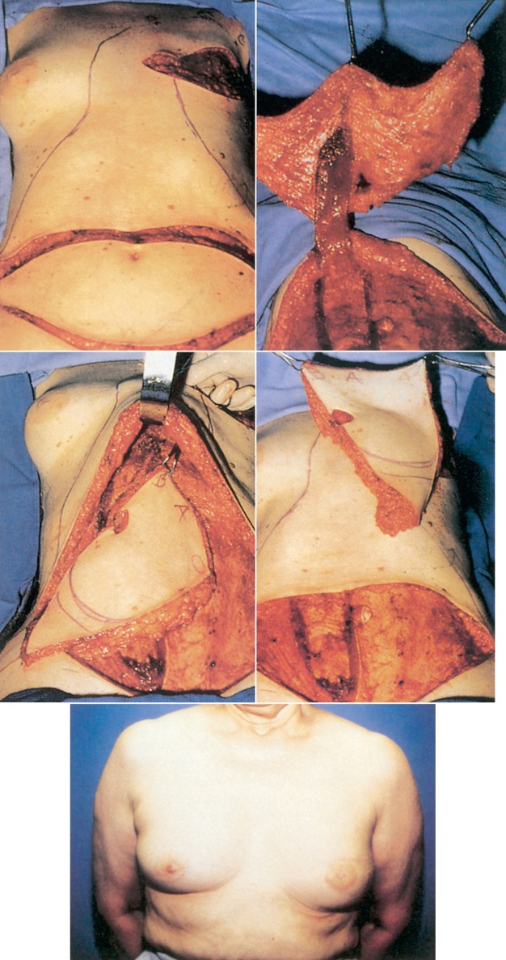
TRAM Flap (Cont.)
From Fortunato N, McCullough SM: Plastic and reconstructive surgery, St Louis, 1998, Mosby.
Notes:
The areola is reconstructed from a graft taken from the thigh or the postauricular region.
A nipple can be created from a full-thickness graft from the labia. Nipples can also be reconstructed from the skin and tattooed later to more closely resemble the other existing nipple.

Slide 42
Liposuction
Performed to remove excess deep fat
Notes:
Why is the area targeted for liposuction injected with lidocaine and epinephrine mixed with lactated Ringer’s solution? (Answers will vary.)
Cannulas that are 4- to 5-mm in diameter are used on deep areas. Superficial areas require 2- to 3-mm cannulas.

Slide 43
Panniculectomy (Abdominoplasty)
Performed to remove excess abdominal wall skin and adipose tissue and tighten abdominal wall muscles
Notes:
Panniculectomy is the removal of excess abdominal tissue (skin and adipose tissue).
The tissue apron (pannus) can be very uncomfortable for patients. Often patients complain of constant rashes and sores under the excess tissue.
The patient must be placed in a high Fowler's position for 24 hours postoperatively.

Slide 44
Questions?

