Slide 1
Surgical Technology
6th edition
CHAPTER 29
Oral and Maxillofacial Surgery

Slide 2
Anatomy, Planning, and Procedures
Lesson 29.1
Identify key anatomic structures of the face and oral cavity.
Discuss diagnostic procedures in the maxillofacial specialty.
Discuss specific elements of case planning for oral and maxillofacial surgery.
Discuss pathology of the facial bones and oral cavity.
List and describe common oral and maxillofacial procedures.

Slide 3
Introduction
The face is vulnerable to injury in motor vehicle and industrial accidents.
Long-term physiological effects
Psychological effects
Procedures performed by surgeons specializing in oromaxillofacial, plastic, or otorhinolaryngology surgery
Notes:
What are the long-term effects of injury to the face? (The long-term physiological effects of injury or congenital anomalies can affect speech, mastication [chewing], and development of the teeth.)
Why are the psychological effects important? (The psychological effects are equally important, because disfigurement often results in social and emotional isolation.)

Slide 4
The Cranium
From Thibodeau GA, Patt KT: Anthony’s textbook of anatomy and physiology, ed 17, St Louis, 2003, Mosby.
Notes:
The design of the midface not only protects the orbits and the cranium, it also resists vertical forces.

Slide 5
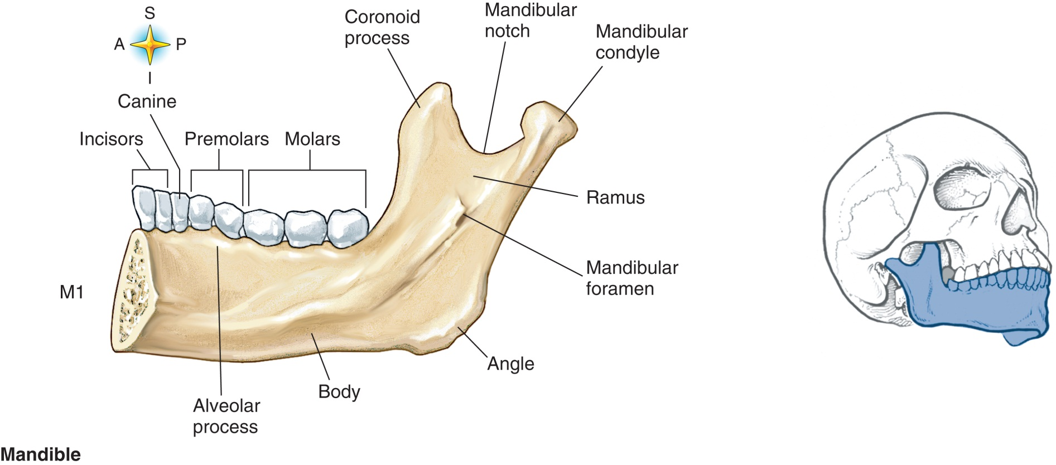
Anatomy of the Mandible
From Thibodeau GA, Patt KT: Anthony’s textbook of anatomy and physiology, ed 17, St Louis, 2003, Mosby.
Notes:
What nerve provides sensation to the teeth? (Trigeminal nerve)
Why do patients with mandibular fractures often have chin numbness? (Answers may vary.)
The bones of the face are divided into three regions – upper face, midface, and lower face.
The upper face consists of: the frontal bone – part of the cranium.
The midface is composed of: the ethmoid, nasal, zygoma, and maxillary bones – the zygomatic arch is the cheekbone.
The lower face consists of: the mandible – the only movable bone of the face.

Slide 6
Diagnostic Procedures
Radiographs
Computed tomography
Notes:
Facial fractures and structural deformities are assessed by imaging studies such as plain X-rays and CT scans.
X-rays are taken for assessment or for simple fractures.
CT scans are taken for complex facial fractures and reconstruction procedures.

Slide 7
Power Drills
Stryker micro-drill (TPS)
Drill bits and screws are included in the modules of the plate system being used
Notes:
Plates and screws are commonly used to fix fractures of the bones of the face and the frontal sinuses. Power drills are needed to place the screws.
Any screw that has entered a patient may not be resterilized and reused. It must be disposed of.

Slide 8
Instruments Used in Facial Fracture Repair
From Tighe SM: Instrumentation of the operating room, ed 6, St Louis, 2003, Mosby.
Notes:
OMFS retractors and micro-fixation system instrumentation.

Slide 9
Prepping and Draping
Facial fractures are prepped with Betadine and draped
Entire face is prepped, from hairline to sternal notch
Split sheet is draped over patient and around face
If mouth will be wired, teeth may be brushed as part of prep
Notes:
Facial fractures are prepped with Betadine. The endotracheal tube is included in the prep.
If a bicoronal incision is made, the patient’s head must be shaved. Often the eyes are lubricated before the prep begins to protect the corneas.
Often a throat pack may be placed after the patient is under general anesthesia. The packing MUST be charted, and must be counted in with the sponge and sharps count.

Slide 10
Medications, Sponges, and Dressings
No medications used for facial fractures
Some surgeons may use antibiotic ophthalmic ointment if eye is involved
Sponges used include 4x4s and cottonoids
Should be counted before, during, and after procedure
Typically, no dressings are used for facial fractures
Notes:
Epinephrine may be added to local medications.
External incisions are coated with an antibiotic solution even if no dressing is applied.

Slide 11
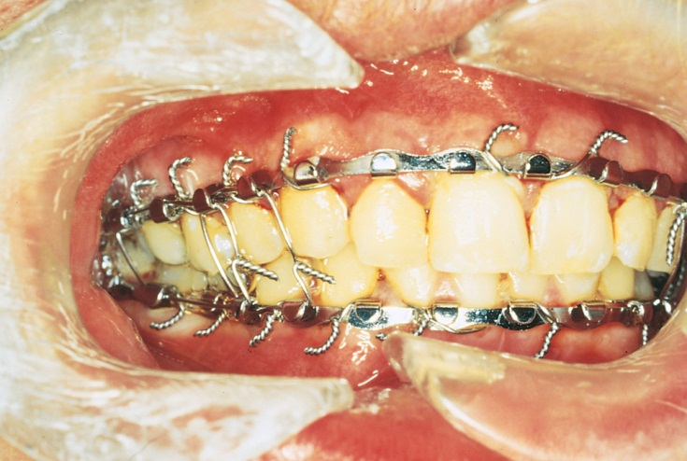
Maxillomandibular Fixation (MMF)
From Dingman RO, Natvig P: Surgery of facial fractures, Philadelphia, 1964, WB Saunders.
Notes:
General anesthesia is given through a nasal RAE (Ring-Adair-Elwyn) tube. Why?
In case of an emergency, wire cutters must accompany the patient to the postanesthesia care unit (PACU) and to his or her room.

Slide 12
Open Reduction and Internal Fixation (ORIF)
Midface fracture
Screw fixation
Arch bars may be removed
Notes:
The ORIF is performed to reduce the fracture and restore facial width and projection.
What does a Le Fort I fracture involve? (This is a horizontal fracture of the maxilla that causes the hard palate and alveolar process to become separated from the rest of the maxilla. The fracture extends into the lower nasal septum, lateral maxillary sinus, and palatine bones.)

Slide 13
Le Fort Fractures: ORIF
Level I
Level II
Level III
Notes:
Fractures are reduced and fixed in place.
Most fractures are classified as Le Fort I, II, or III; although most fracture lines exceed these boundaries.
Le Fort I: horizontal fracture of the maxilla between the teeth and the nose
Le Fort II: is pyramidal in shape and extends from the nasal bone to the frontal processes of the maxilla
Le Fort III: separation of all facial bones from their cranial base – includes fractures of the zygoma, maxilla, and nasal bones

Slide 14
ORIF: Frontal Sinus
Performed to repair cerebrospinal fluid (CSF) leak
Provide aesthetic contour to forehead
Prevent long-term complication of obstructed frontal sinus ducts
Notes:
A result of direct trauma to the frontal bone – due to intentional trauma and motor vehicle accidents.
Discuss the surgical technique used. (Using a #10 blade or the electrosurgical unit [ESU] with a Colorado needle tip, the surgeon makes the incision from the root of the helix of one ear to the root of the helix of the other ear. The surgeon makes a small incision [approximately 2 to 3 mm] in the abdomen with a #15 blade. A small portion of fat tissue is excised using a #15 blade and hemostat or a toothed Adson forceps is used to tease out and grasp the tissue. The anterior wall of the frontal wall is repaired with micro- mesh plates. Commonly used sizes are 1 or 1.3 mm. The free portions of the bone are secured to the mesh before it is secured to the stable portions of the bone.)

Slide 15
Orbital Fractures
Reducing an orbital fracture
A, 2- to 3-cm incision is made below and parallel to the lash line, following a natural crease
Notes:
Orbital fractures are associated with traumatic events – such as assault and being struck by a high-velocity object.
Surgery is performed to reduce a fracture of the orbital floor, prevent entrapment of the extraocular muscles, and support the orbital contents.
These are also known as “blow-out fractures.”

Slide 16
Orbital Fractures (Cont.)
The incision is deepened through the orbicularis muscle to the orbital septum to the level of the orbital rim
The orbit is retracted, and the periosteum is pulled tightly against the underlying muscle
Notes:
What types of materials are used to recreate the floor of the orbit? (After assessment, the surgeon may reconstruct the floor of the orbit using nylon sheeting, mesh, Gelfilm, Silastic sheeting, or an orbital floor plate.)
Transconjunctival incisions are not closed.

Slide 17
Dental Implants
Used to replace injured or lost dentition
May replace single tooth or multiple teeth
Notes:
Describe an endosteal implant. (An endosteal implant is a threaded screw, cylinder, or flat blade that is implanted in the alveolus of the maxilla or mandible and then covered with soft tissue.)
Subperiosteal implants are used when the bone will not support an endosteal implant.
When are transosteal implants used? (This type of implant is used only when the patient has severe loss of bone in the mandibular alveolar ridge.)

Slide 18
Odontectomy
Performed to remove affected teeth
Damaged teeth
Decayed teeth
Impacted teeth
Notes:
For what indications is an odontectomy performed? (Odontectomy, or tooth extraction, may be performed for a variety of reasons, including damaged or decayed teeth or impaction, which often affects the third molars [wisdom teeth].)
If dental packs are placed, they must be documented in the chart and the information conveyed to the PACU and the nursing unit.

Slide 19
Orthognathic Procedures
Mandibular advancement
Midface (maxillary) advancement
Temporomandibular joint (TMJ) arthroplasty
Notes:
Mandibular and maxillary advancement surgery is not performed until the patient has most of his or her permanent teeth.
Oral surgeons often bring their own scrub person with them to assist during the case.

Slide 20
Questions?

