Slide 1
Surgical Technology
6th edition
CHAPTER 32
Peripheral Vascular Surgery

Slide 2
Anatomy, Case Planning, Techniques, and Pathology
Lesson 32.1
Identify key anatomical features of the peripheral vascular system.
Discuss diagnostic procedures of the vascular system.
Discuss specific elements of case planning in orthopedic surgery.
Describe surgical techniques used in vascular surgery.
Discuss vascular pathology.

Slide 3
Terminology Review
Review terms and definitions listed at beginning of chapter
Use your medical dictionary if necessary
Notes:
Familiarize yourself with the chapter terminology.

Slide 4
Introduction
Encompasses procedures of arteries and veins
Excludes those involving heart, brain, and cranial vessels
Requires focused concentration and preparation for surgical emergency
Notes:
Vascular surgeries are performed to treat arteriosclerosis, atherosclerosis, and thromboembolic disease.
Timing is extremely important to minimize the risk of ischemia.

Slide 5
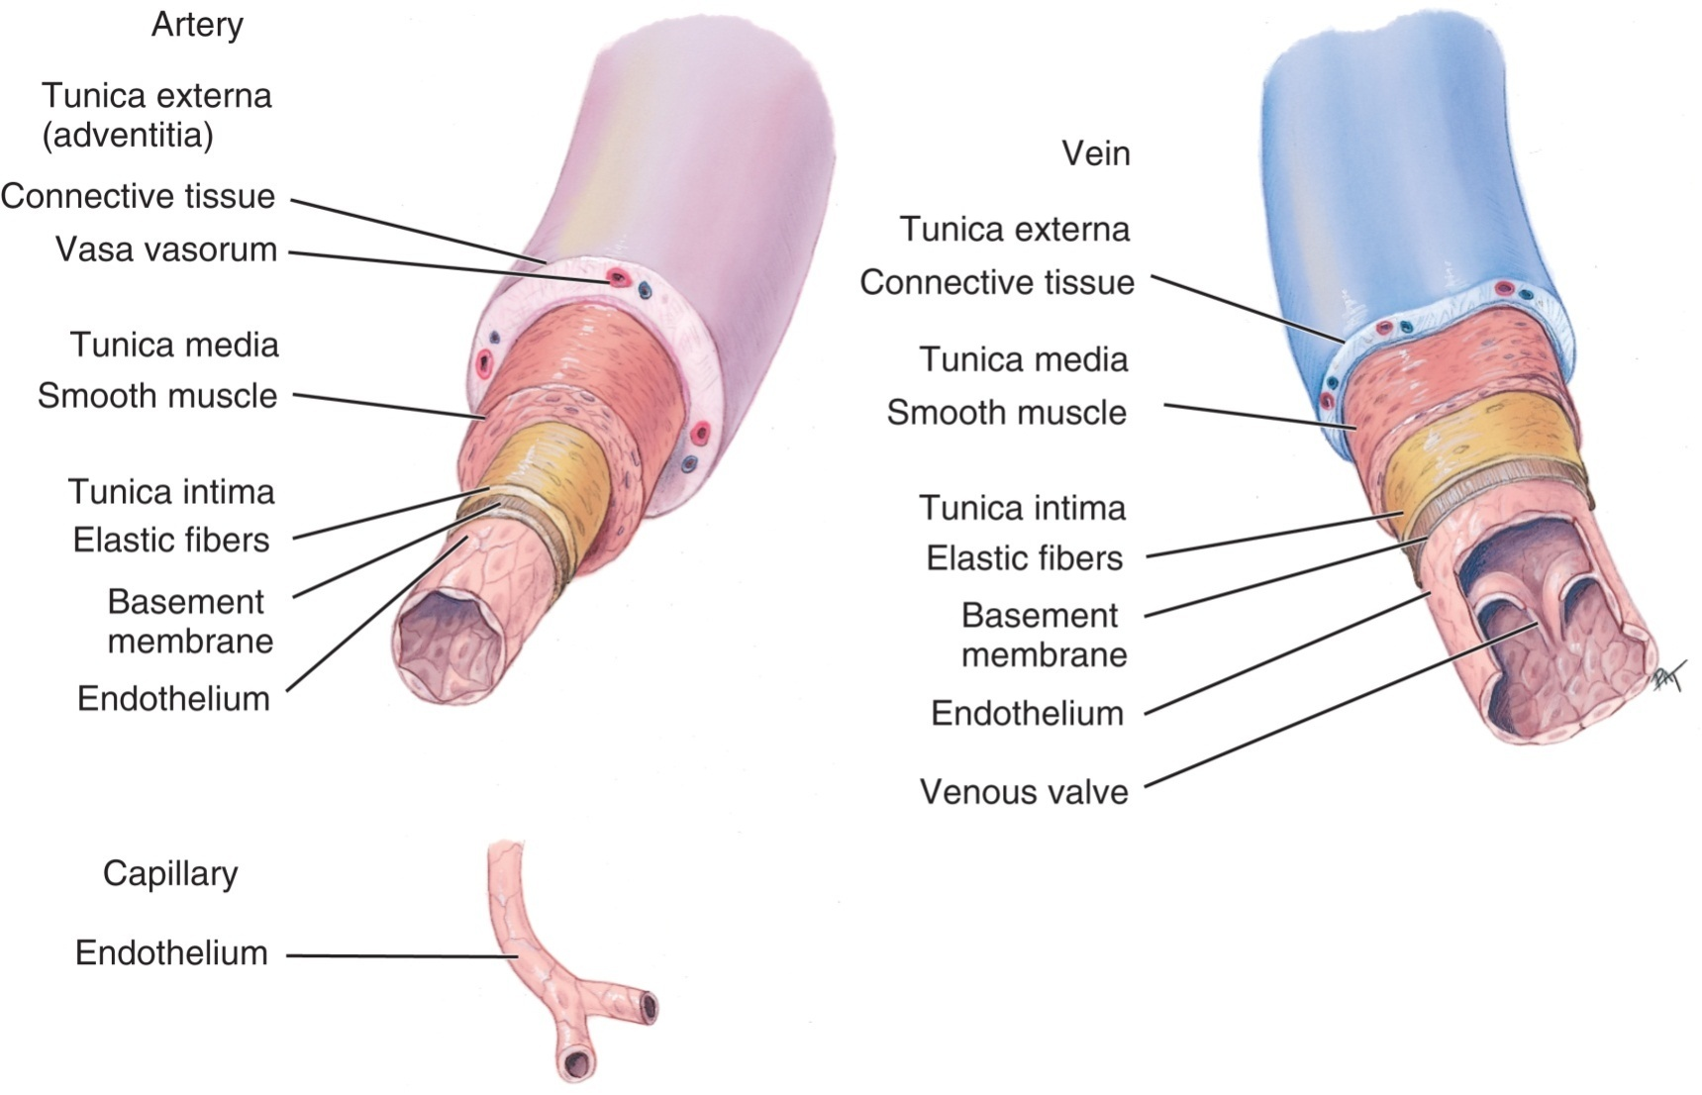
Blood Vessel Structure
From Applegate E: The anatomy and physiology learning system, ed 2, St Louis, 2000, WB Saunders.
Notes:
Name the three layers of blood vessels. (Tunica externa, tunica media, and tunica intima)
Vasodilating medications act on which layer of tissue? (Tunica intima)

Slide 6
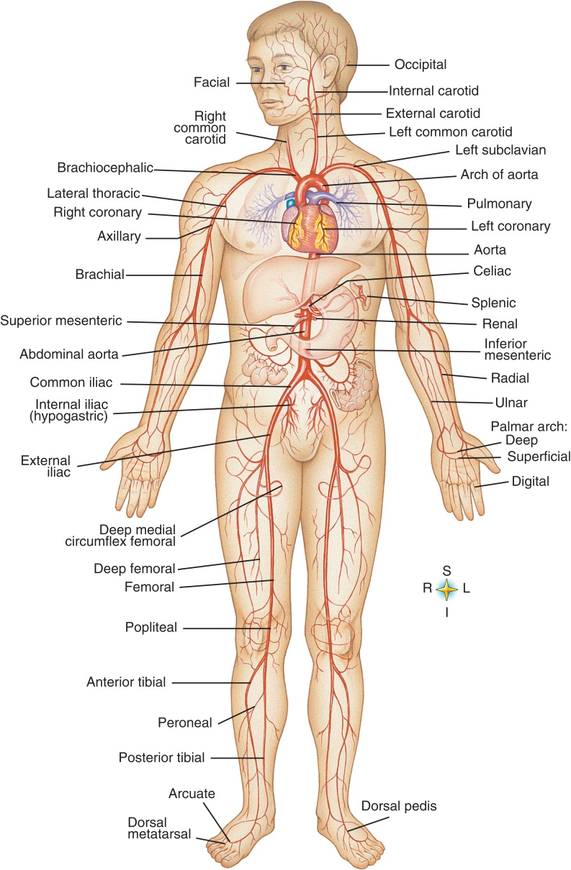
Arteries
From Thibodeau G, Patton K: Anatomy and physiology, ed 6, St Louis, 2007, Mosby.
Notes:
The arteries dilate and contract to accommodate the metabolic needs of the body.
Some tissues such as the liver and the spleen have a rich supply of capillary networks, causing them to bleed easily and profusely when injured.

Slide 7
Arteries (Cont.)
Carry oxygenated blood from lungs to rest of body
Are pressurized
Are much thicker than veins
Are more elastic than veins
Notes:
Reference Figure 32-1, Structure of blood vessels, in the textbook.
Arteries have a thicker muscle layer and more elastic fibers than do veins.

Slide 8
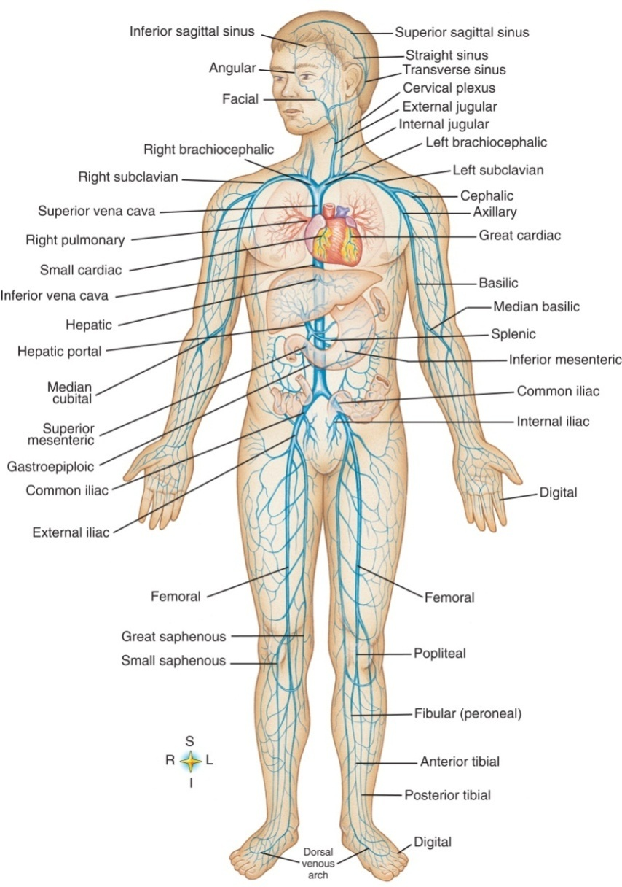
Veins
From Thibodeau G, Patton K: Anatomy and physiology, ed 6, St Louis, 2007, Mosby.
Notes:
Unlike arteries, veins contain one-way valves, which prevent blood from backing up.
What is the term for the smallest arteries in the body? (Capillaries)
What is the term for the smallest veins in the body? (Arterioles)

Slide 9
Veins (Cont.)
Carry deoxygenated blood from body tissues back to heart
Have small valves
Blood within veins moves by pumping action of skeletal muscles
Venous blood pressure is lower than arterial pressure
Notes:
Veins are more fragile than arteries. Venous bleeding can be difficult to control.

Slide 10
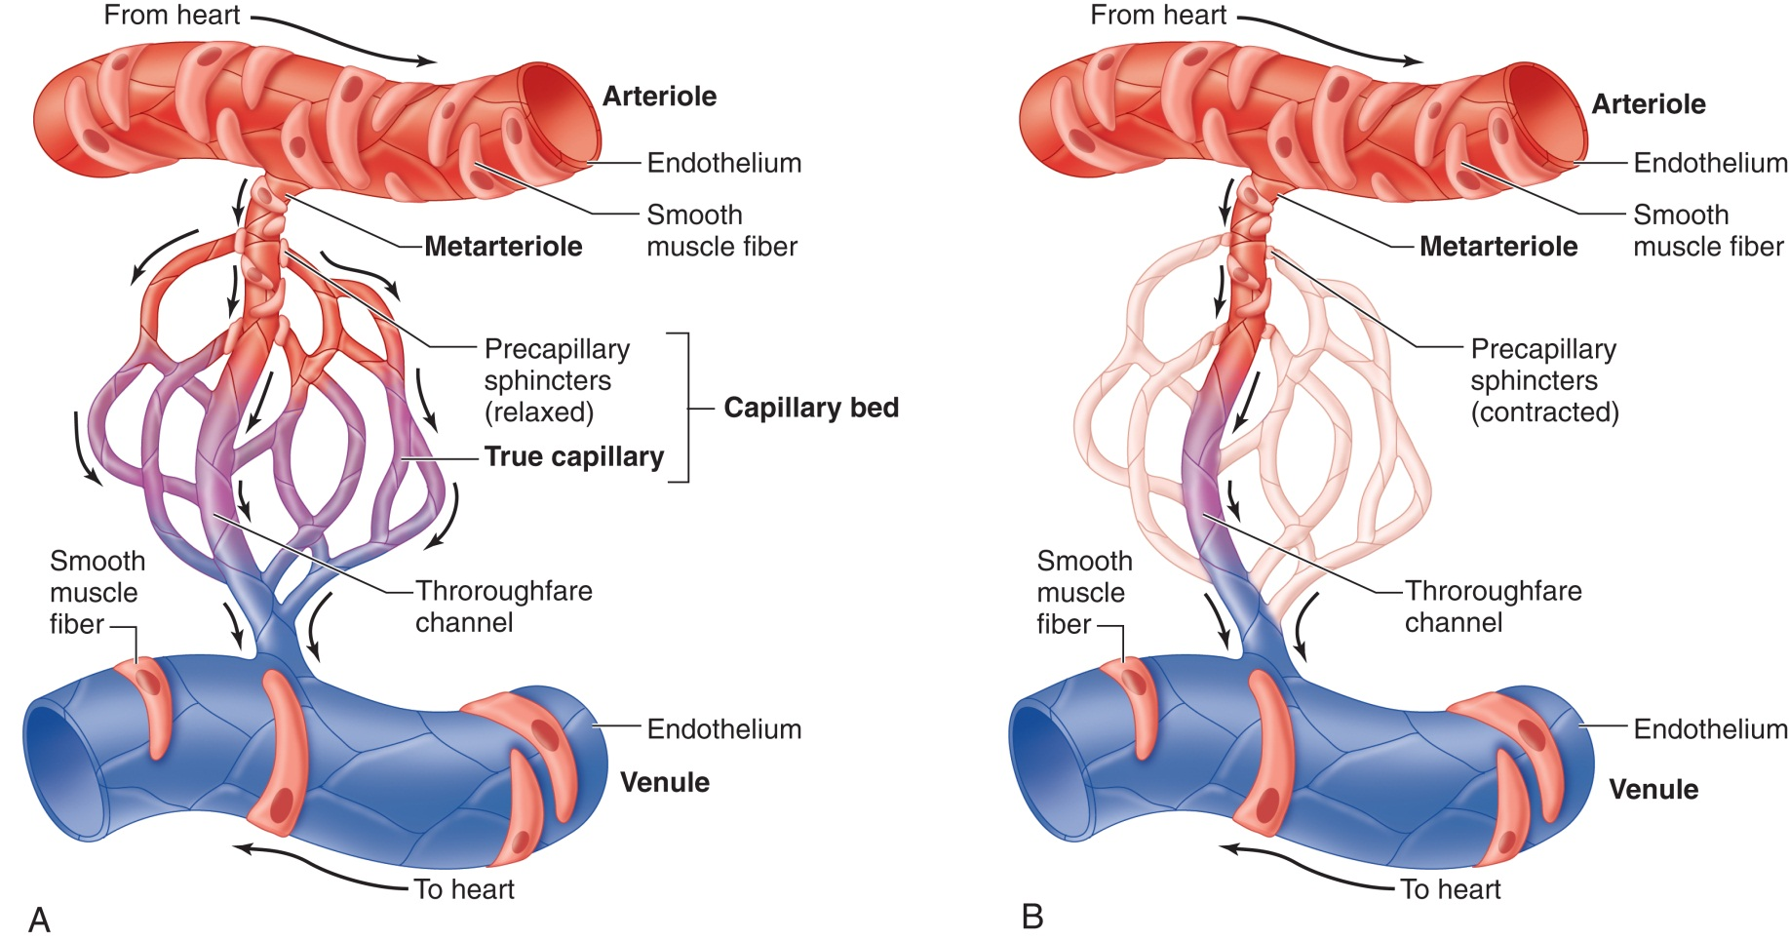
Microcirculation in the Capillary Network
From Thibodeau G, Patton K: Anatomy and physiology, ed 6, St Louis, 2007, Mosby.
Notes:
Describe the organization of the vascular system, including the capillary beds. (Arterioles transition to the capillaries, which transition to venules and veins. Capillaries are composed of endothelial cells and have no muscle fibers. Precapillary sphincters control the flow of oxygenated blood into the capillary. The walls of the capillary are one cell thick and allow selected substances, including oxygen, to diffuse through the capillary membrane into the tissue.)
What is the largest artery in the body? (Aorta)
What is the largest vein in the body? (Vena cava)

Slide 11
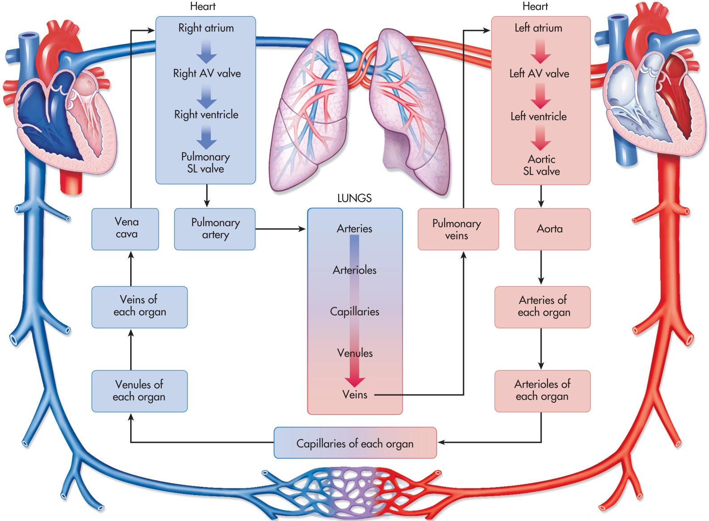
Pulmonary and Systemic Systems
From Thibodeau G, Patton K: Anatomy and physiology, ed 6, St Louis, 2007, Mosby.
Notes:
Where does the pulmonary system begin? (Deoxygenated blood in the right ventricle is pumped through the pulmonary arteries [the only arteries that carry deoxygenated blood] to the lungs. Blood is oxygenated in the capillaries of the alveoli [lungs] and returns to the left ventricle through the pulmonary veins.)
Where does the systemic vascular system begin? (Oxygenated blood in the left ventricle is pumped through the ascending aorta to the rest of the body. Blood returning from the body passes from the capillaries into the venous system and returns to the left atrium through the venae cavae.)

Slide 12
Blood Pressure: Affecting Factors
Sex
Age
Weight
Exercise
Diurnal fluctuation
Notes:
What is blood pressure? (Blood pressure is the force exerted on the arterial wall by the pumping action of the heart.)
Blood pressure is influenced by physiological conditions such as body position, temperature, pain, and emotion.

Slide 13
Physiological Influences of Blood Pressure
Elasticity of the arterial walls
Total blood volume
Peripheral vascular resistance
Blood viscosity
Notes:
What are some causes of hypertension? (Hypertension, or abnormally high blood pressure, often is caused by cardiovascular disease, such as arteriosclerosis, but it also occurs with chronic renal failure and hypermetabolic conditions.)
What are some causes of hypotension? (Negative alterations in blood pressure [hypotension] can be caused by hypovolemia [a precipitous drop in blood or fluid volume], fluid shifts between the spaces in the body, shock, or infection.)

Slide 14
Diagnostic Procedures
Doppler duplex ultrasonography
Arterial plethysmograph
Doppler scanning
Arteriography
Intravascular ultrasound
Notes:
Diagnosis of peripheral disease is based first on patient history, physical, and routine blood tests.
Interventional arteriography is performed in conjunction with insertion of stents and other devices.

Slide 15
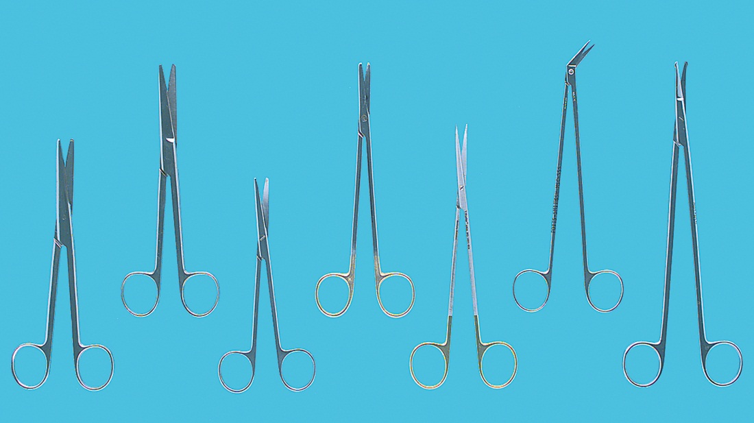
Instruments
From Tighe SM: Instrumentation for the operating room, ed 7, St Louis, 2007, Mosby.
Notes:
Reference Figure 32-8, Instruments used in vascular surgery, in the textbook.
Dissection requires sharp, delicate scissors. Blunt and sharp dissection scissors are used to gain access to blood vessels.

Slide 16
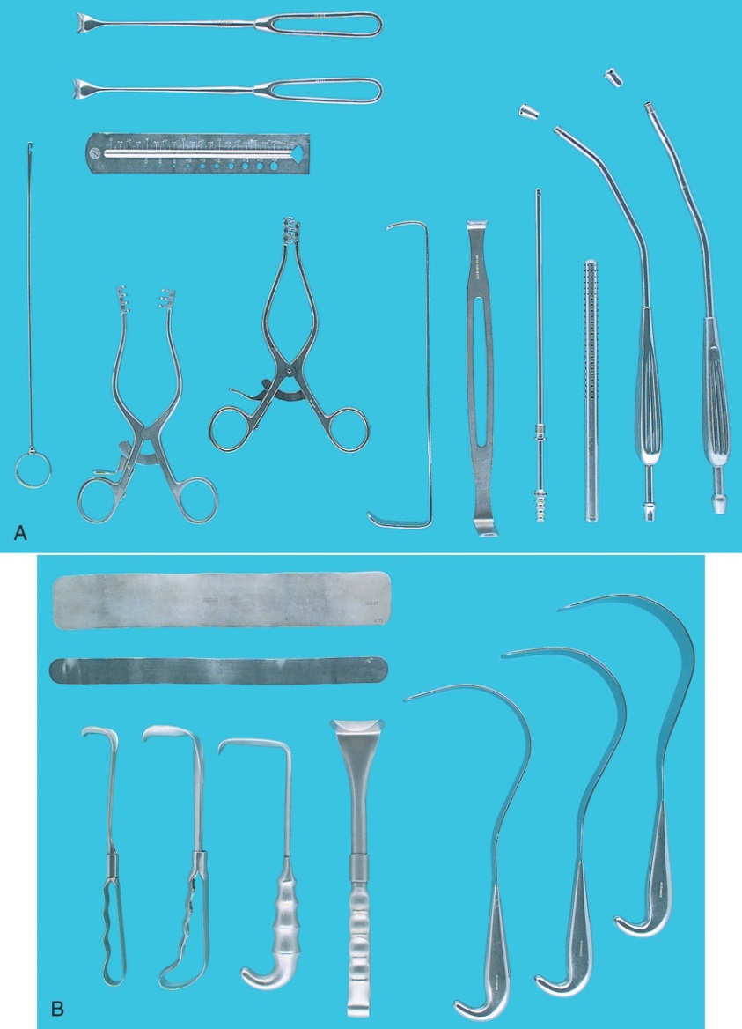
Instruments (Cont.)
From Tighe SM: Instrumentation for the operating room, ed 7, St Louis, 2007, Mosby.
Notes:
What are some factors that determine what instruments will be needed for the peripheral vascular case? (Answers will vary.)
Vascular instrumentation is fragile. Great care must be taken when handling these instruments to avoid damaging their fine tips or causing accidental bending.

Slide 17
Sutures
Materials and design
Nonabsorbable sutures
Sizes range from 3-0 to 8-0
Atraumatic, round, tapered, or beveled needles are used
Double-armed sutures are commonly used
Notes:
Why are nonabsorbable sutures used on vessels? (Answers will vary.)
Why are double-armed sutures used on blood vessels? (Passing of double-arm sutures may be problematic. As the loaded needle holder is passed, the other end may be easily snagged on drapes and instruments.)
When double-armed sutures are used, the surgical technologist must keep track of both needles. The needles are small and fine and can be easily lost.

Slide 18
Handling Suture Material in the Field
Should be removed from packet carefully and lightly stretched
GORE-TEX must not be stretched
Rubber shods may be used
Notes:
Stretching GORE-TEX suture can cause a weakness in its continuity.
A rubber shod holds the unused needle of a double-armed suture, allowing it to apply traction to the suture line and preventing the needle from getting lost.
What purpose do the felt pledgets attached to vascular suture serve? (The pledget prevents the stitch from tearing through the arterial wall.)

Slide 19
Vascular Grafts
Synthetic grafts
Dacron
Polyester
GORE-TEX (Polytetrafluoroethylene or PTFE)
Natural materials
Banked human umbilical cord
Bovine grafts
Autograft
Notes:
Vascular grafts can be made from what materials? (Polyester, Dacron, GORE-TEX)
When would a bifurcated graft be used? (Answers will vary.)

Slide 20
Patch Grafts
Vascular grafts are extremely expensive.
They must not be opened until the surgeon is sure of the length and the size required.
Notes:
All commercially prepared grafts include a set of instructions for use.
These instructions must be strictly followed to ensure a successful graft.

Slide 21
Patch Grafts (Cont.)
A patch graft is sewn into place using a moistened double-armed suture.
The surgeon will need irrigation squirted into his or her hand to tie the suture.
The suture can be difficult to work with when dry. Moistening the hands and the suture allows for easier manipulation of the suture.

Slide 22
Fogarty-Type Embolectomy Catheter
Length varies
Size ranges 1-6 Fr
Tuberculin syringe needed
Notes:
The most common method of removing thrombi is with a Fogarty type of embolectomy catheter.
The balloon must be tested before use and never overinflated.

Slide 23
Stents
Small metal implant designed to fit against the artery wall
Materials
Stainless steel
Titanium
Nitinol
Notes:
Most stents are implanted permanently.
What are two commonly used types of stents? (Stainless steel, titanium)

Slide 24
Drugs
Anticoagulation
Heparinized saline
Coagulation
Collagen or fibrin products
Topical thrombin
Notes:
Why is heparinized saline used as an irrigation solution in peripheral vascular cases? (During vascular surgery, heparinized saline solution is used to prevent coagulation in the area of the operative vessels.)
Systemic heparin is given intravenously to the patient by the anesthesia provider. What medication is given to reverse the effects of heparin? (Protamine sulfate)

Slide 25
Hemostasis
Maintaining a dry surgical site, which is critical in vascular surgery
Notes:
Suction is used more than sponges in peripheral vascular surgery to maintain a dry surgical site.
Hemostasis can be maintained at vessel anastomosis sites by using which hemostatic agents? (Hemostasis is maintained at anastomosis sites with collagen or fibrin products, such as microfibrillar collagen hemostat [Gelfoam, Avitene] or topical thrombin.)

Slide 26
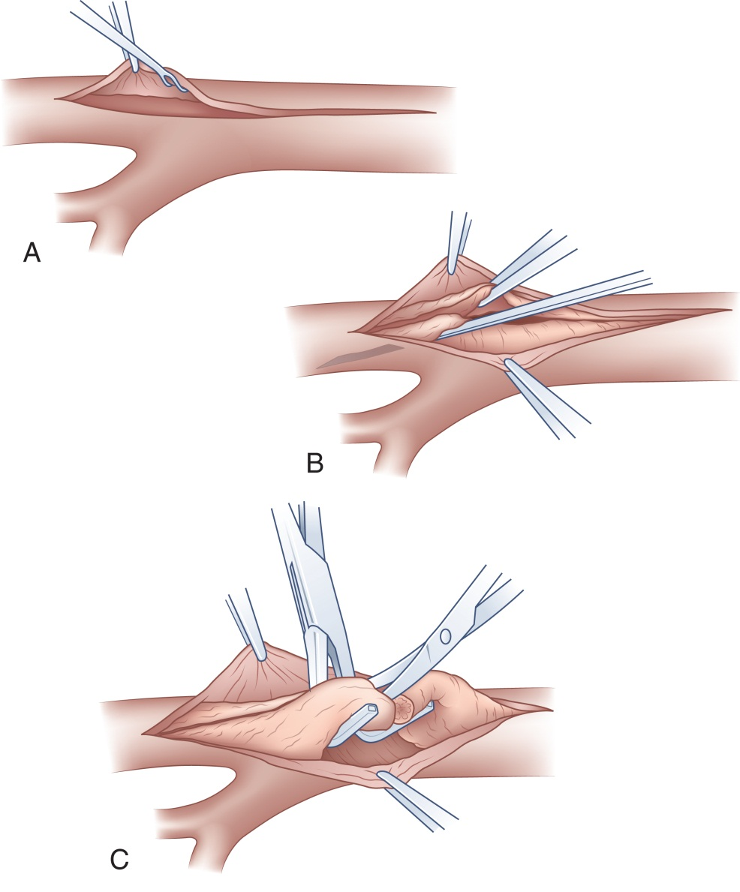
Endarterectomy
From Ouriel K, Rutherford R: Atlas of vascular surgery: operative procedures, Philadelphia, 1998, WB Saunders.
Notes:
During an endarterectomy, the plaque can be removed in one piece or in smaller bites.
A Freer or Penfield elevator is used to free the plaque from the vessel wall.

Slide 27
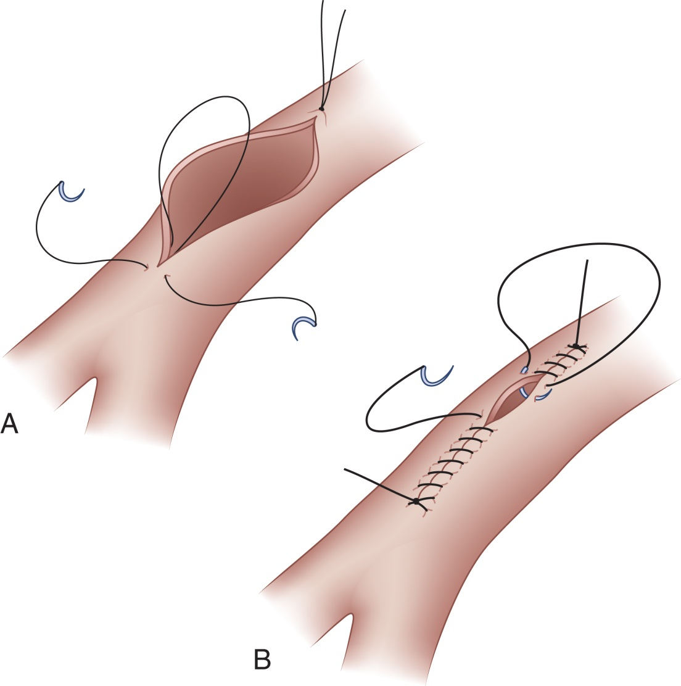
Vessel Closure
From Ouriel K, Rutherford R: Atlas of vascular surgery: basic techniques and exposures, Philadelphia, 1993, WB Saunders.
Notes:
Incisions are closed with a double-armed suture.
Reference Figures 32-13, 32-14, and 32-15 in the textbook. They illustrate suturing technique, end-to-end anastomosis, and patch graft placement technique.

Slide 28
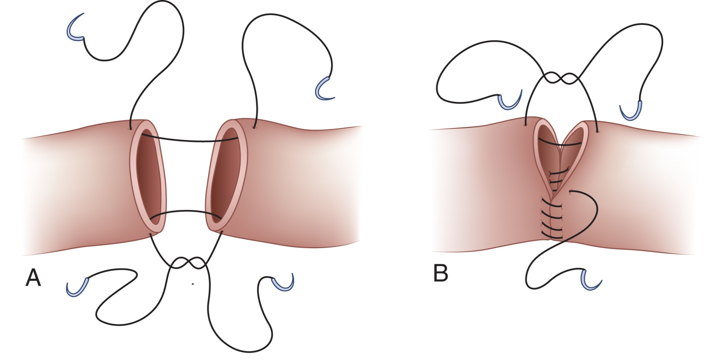
Vessel Anastomosis
From Ouriel K, Rutherford R: Atlas of vascular surgery: basic techniques and exposures, Philadelphia, 1993, WB Saunders.
Notes:
When performing a circumferential anastomosis, the two sutures are placed 180 degrees apart from each other.
The sutures are then sewn toward each other.
The suture line will be drawn taut and checked for leaks before tying.

Slide 29
Graft Tunneling
Establishment of a tunnel through subcutaneous tissue for placement of a graft
Techniques
Use of surgeon’s fingers
Use of tunneler (long metal shaft or instrument)
Notes:
The surgeon usually threads the graft through the subcutaneous tissue by inserting a long clamp such as a Péan into the tunnel and grasping the graft from the entry site.

Slide 30
Common Surgical Procedures
Lesson 32.2
List and describe common vascular procedures.

Slide 31
Intraoperative Angiography
Preoperatively, injection of contrast media into selected artery and its branches
Used with angioplasty to determine exact location of strictures, occlusion, or malformation
Notes:
Intraoperative angiography is performed with intravascular ultrasound and other imaging techniques. Why? (Intraoperative angiography is performed with intravascular ultrasound and other imaging techniques because it allows the surgeon to see obstructions or emboli distal and proximal to the operative area.)
When angiography is planned, all personnel must wear a lead shield over their scrub attire.

Slide 32
Angioplasty
Term describes methods of remodeling inner surface of artery narrowed because of stricture or atherosclerosis
Goal is to reestablish patency and circulation of arterial blood
Notes:
Areas of plaque are most dense near arterial bifurcations.

Slide 33
Balloon Angioplasty
Arterial stricture is expanded with balloon catheter
When inflated, balloon pushes plaque against vessel wall and releases stricture
Notes:
Angioplasty balloons are available in graduated lengths and widths.

Slide 34
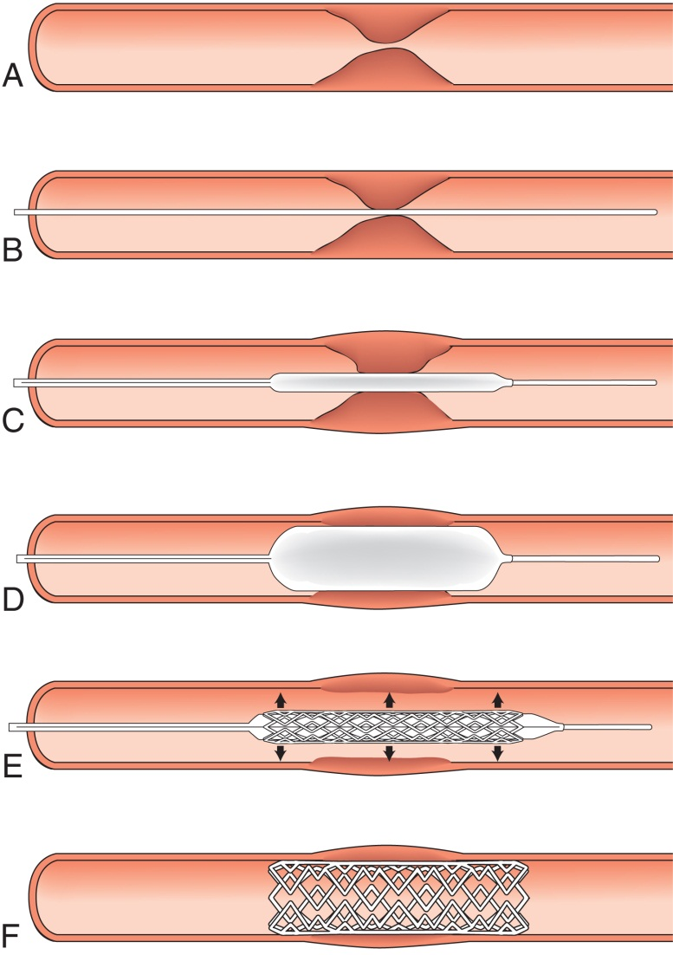
Stent Placement in Angioplasty
From Garden O, Bradbury A, Forsythe J, Parks R: Principles and practice of surgery, ed 5, Edinburgh, 2007, Churchill Livingstone/Elsevier.
Notes:
What position is the patient placed in for implantation of a balloon stent? (Supine position)
Describe the Palmaz stent. (The self-expanding stent is placed in the same manner except that the stent is preloaded into a delivery system that is passed over the guidewire.)

Slide 35
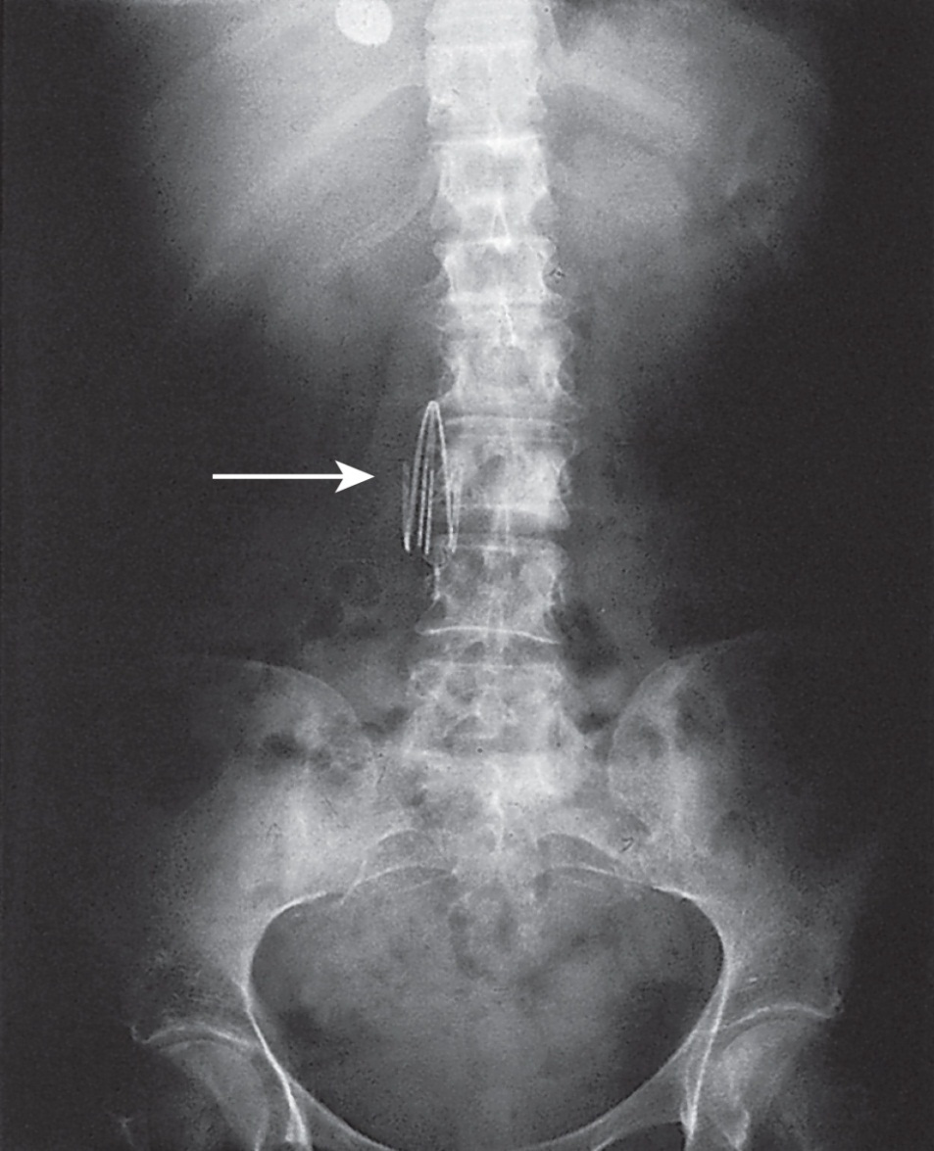
Insertion of a Vena Cava Filter
From Garden O, Bradbury A, Forsythe J, Parks R: Principles and practice of surgery, ed 5, Edinburgh, 2007, Churchill Livingstone/Elsevier.
Notes:
What are the indications for placement of a vena cava filter? (Patients who have a venous thrombus but cannot tolerate anticoagulant therapy; these include patients who have had recent surgery or have a history of hemorrhagic stroke. Patients who have had a massive pulmonary embolism and survived but for whom a subsequent embolism would be fatal. Patients with chronic or venous thromboemboli in spite of anticoagulant therapy.)
A vena cava filter can be placed by either a vascular surgeon or a specially trained interventional radiologist.

Slide 36
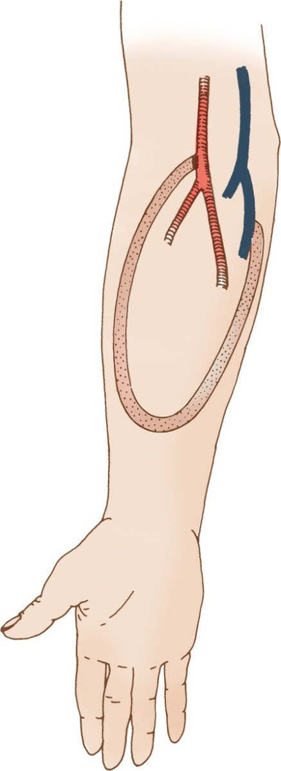
Vascular Access for Renal Hemodialysis
From Wilson SE: Vascular access: principles and practice, ed 3, St Louis, 1996, Mosby.
Notes:
What is hemodialysis? (The pressure, flow, and resistance of the cardiovascular system)
What type of patient requires hemodialysis? (Patients with severe or end-stage renal disease require frequent hemodialysis.)

Slide 37
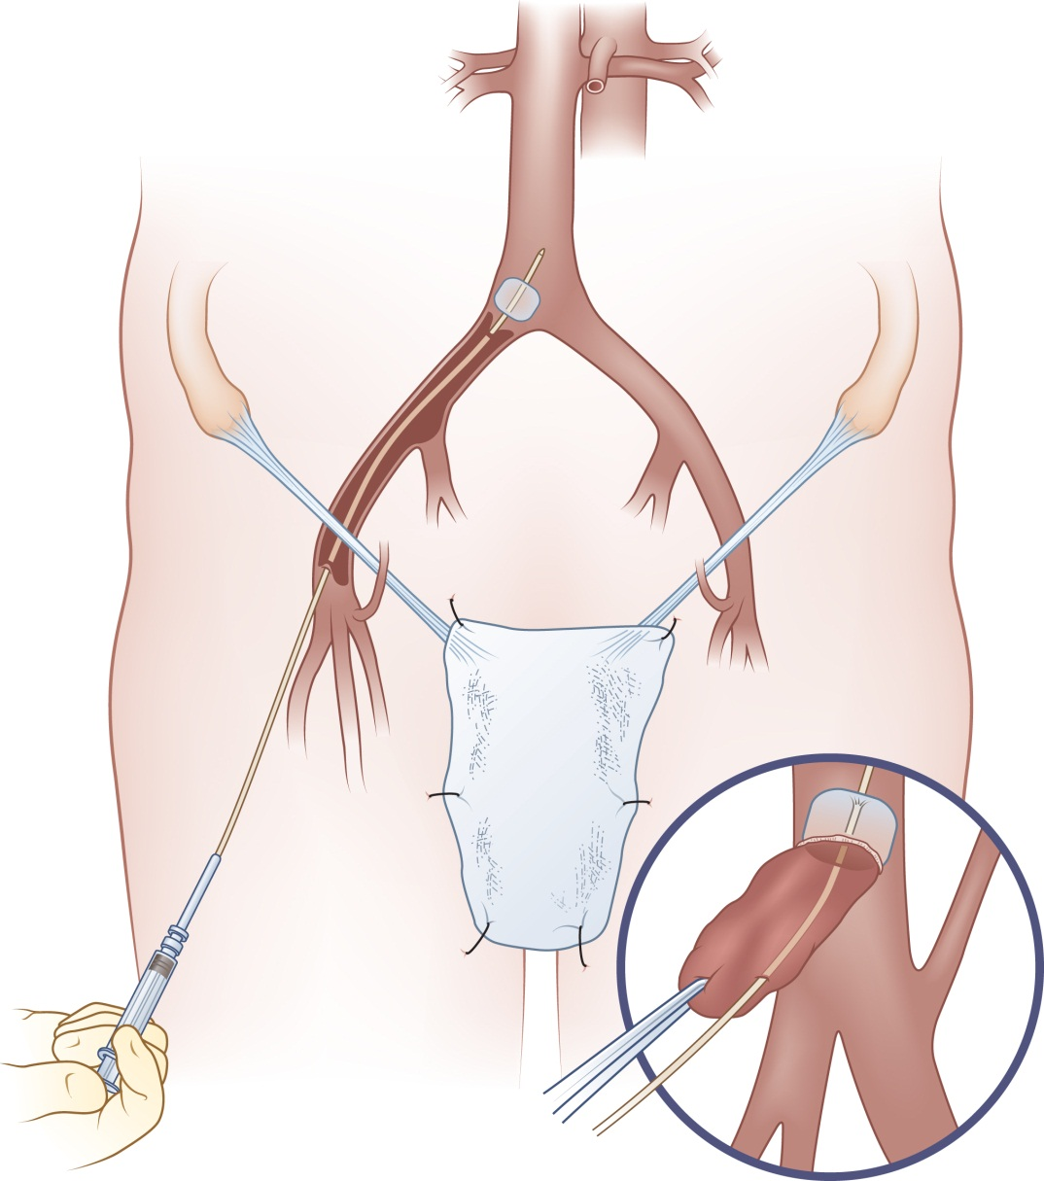
Thrombectomy
From Ouriel K, Rutherford R: Atlas of vascular surgery: operative procedures, Philadelphia, 1998, WB Saunders.
Notes:
What is a thrombus? What are the symptoms of a thrombus? (A thrombus is a stationary clot in the arterial or venous system. Symptoms include: atherosclerosis, orthopedic trauma, surgery, and emboli.)
Embolectomy catheters and balloons are available in a variety of sizes. The surgeon will choose one based on the size of the blood vessel requiring the embolectomy.

Slide 38
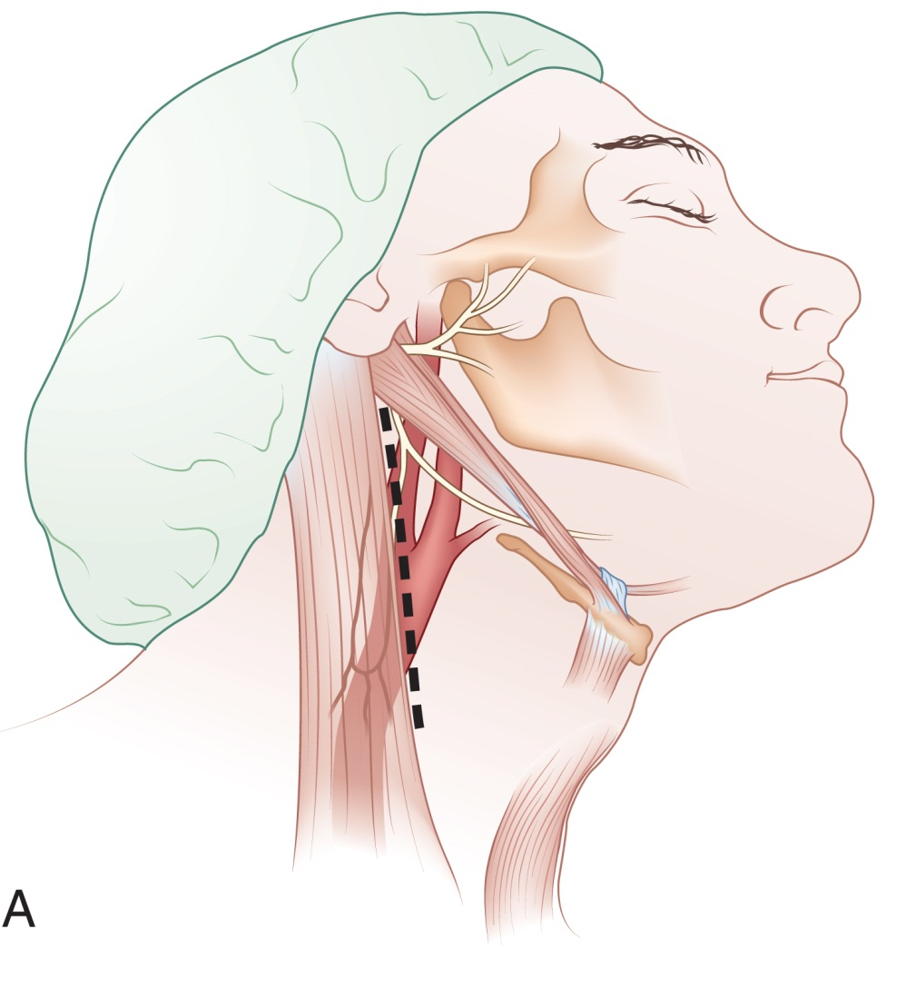
Carotid Endarterectomy
From Ouriel K, Rutherford R: Atlas of vascular surgery: operative procedures, Philadelphia, 1998, WB Saunders.
Notes:
Where do most carotid artery obstructions occur? (A stroke can occur when a carotid artery becomes blocked as a result of the buildup of fatty deposits [atherosclerotic plaque].)
What instruments should the scrub have ready before the actual endarterectomy? (All essential instruments, catheters, and vascular clamps must be prepared and in view. Attention to the surgical wound is important throughout the procedure.)

Slide 39
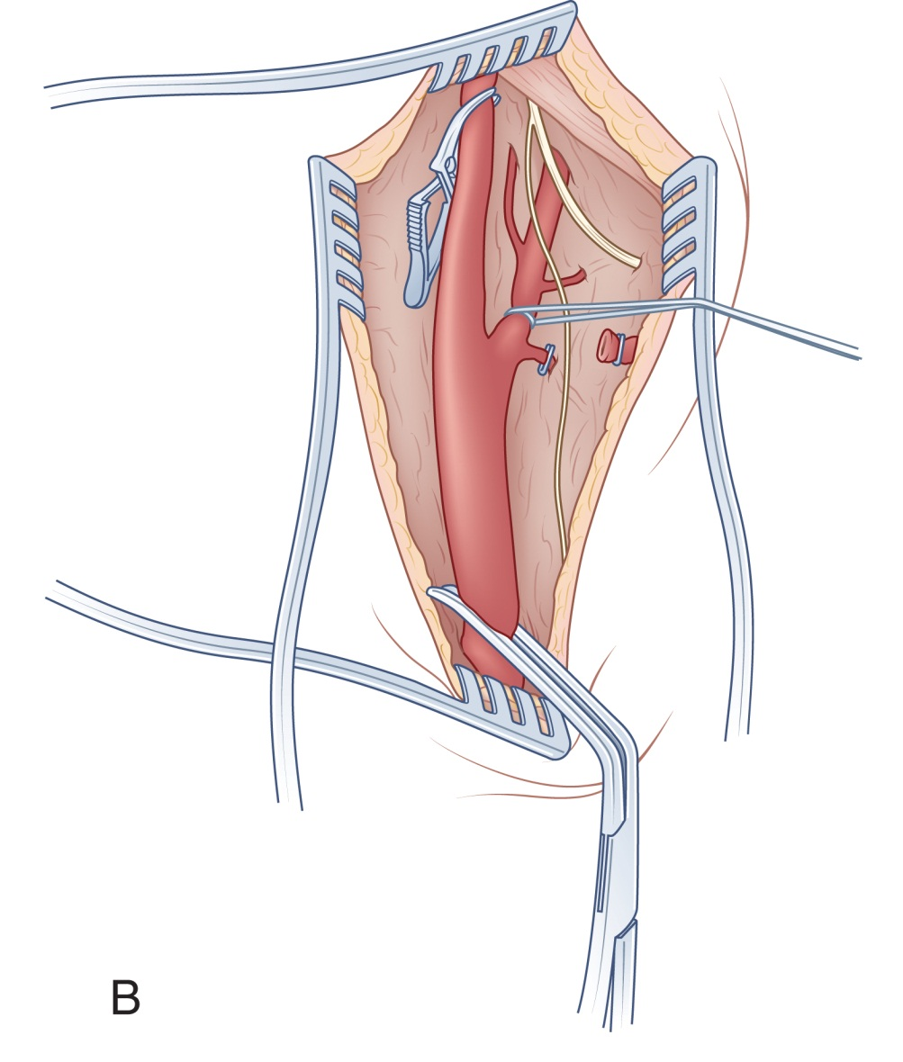
Carotid Endarterectomy (Cont.)
From Ouriel K, Rutherford R: Atlas of vascular surgery: operative procedures, Philadelphia, 1998, WB Saunders.
Notes:
The patient is placed supine on the table with arms tucked at the sides, the neck hyperextended, and the head tilted away from the operative site.
Retractors should have dull ends to prevent injury to surrounding tissue.

Slide 40
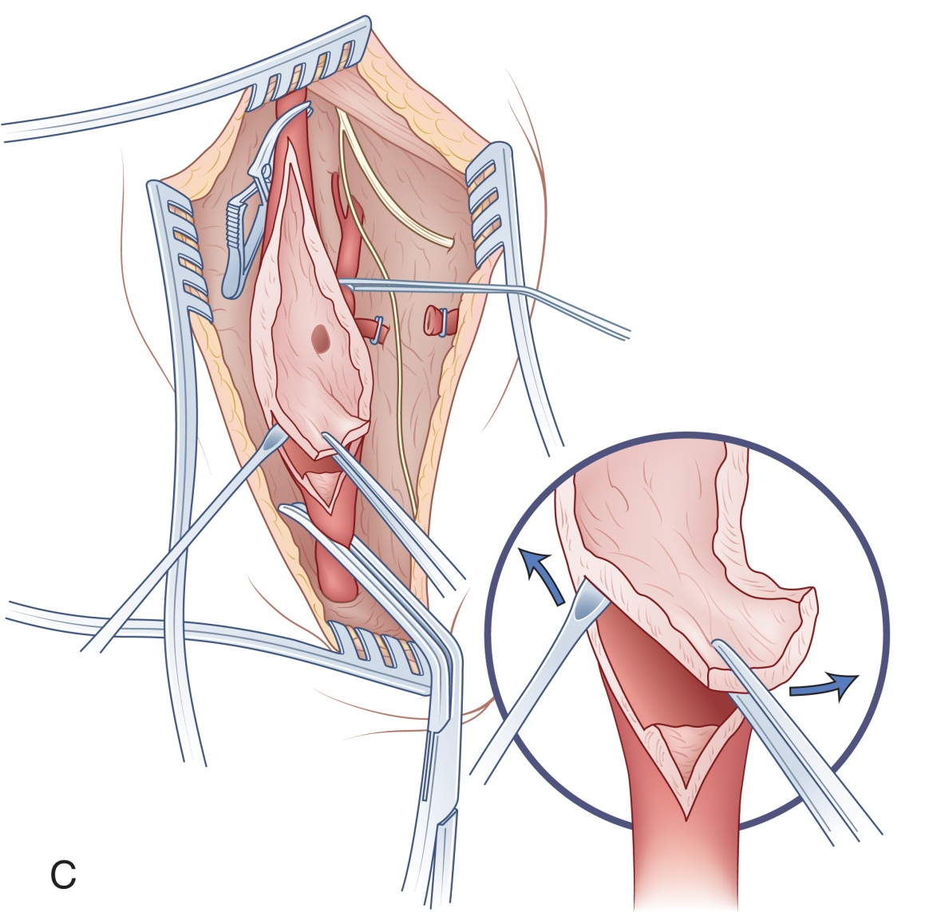
Carotid Endarterectomy (Cont.)
From Ouriel K, Rutherford R: Atlas of vascular surgery: operative procedures, Philadelphia, 1998, WB Saunders.
Notes:
Before the carotid is incised, the anesthesia provider will administer what medication? (Systemic heparin)
There should be 1% lidocaine available in the surgical field.

Slide 41
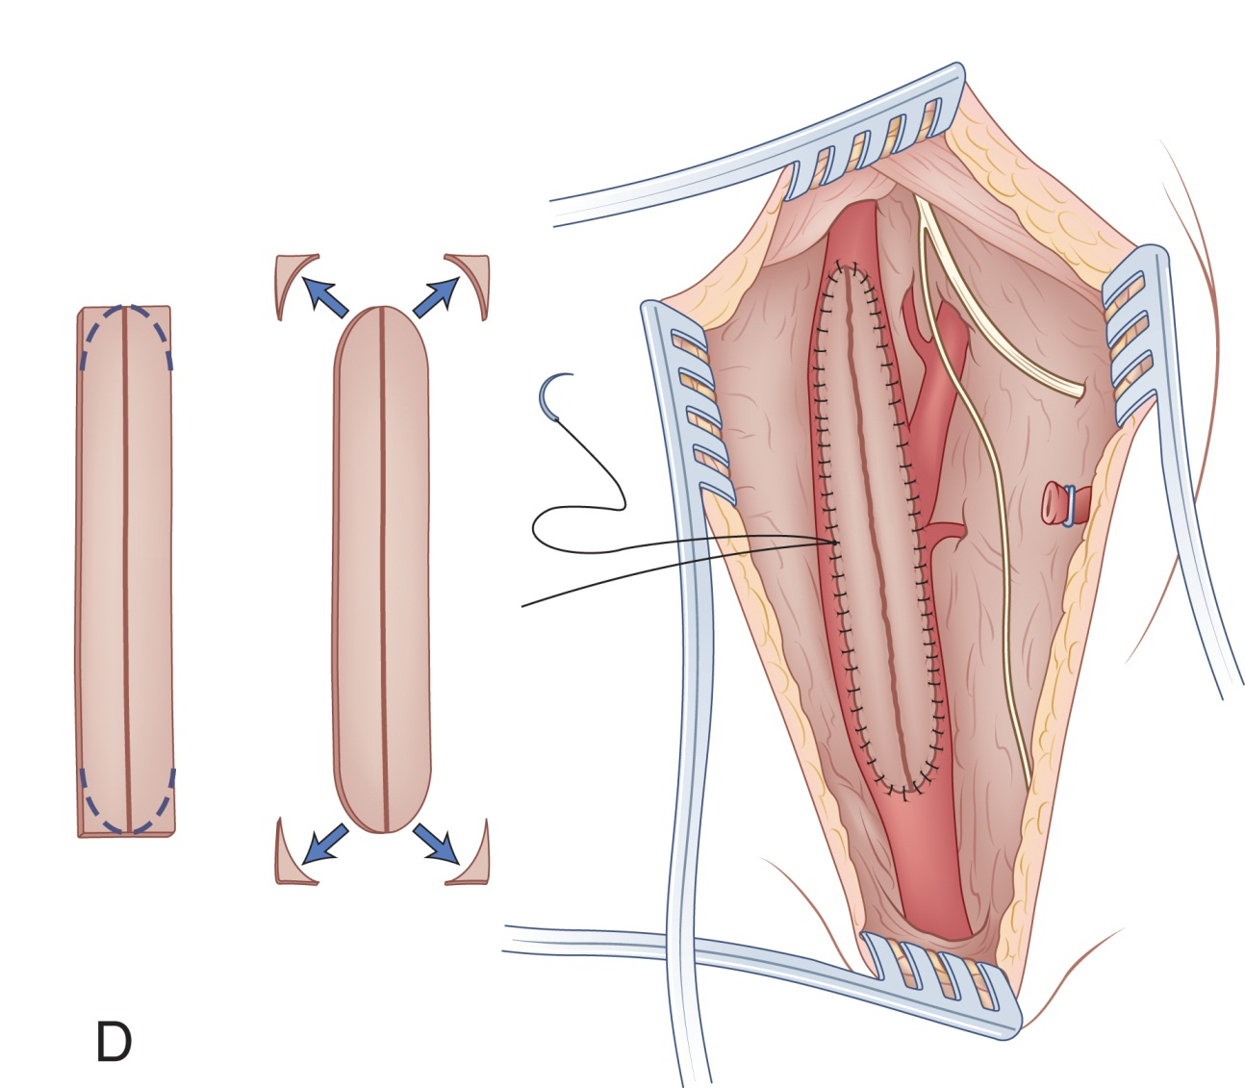
Carotid Endarterectomy: Patch Closure
From Ouriel K, Rutherford R: Atlas of vascular surgery: operative procedures, Philadelphia, 1998, WB Saunders.
Notes:
What is the function of an intraluminal shunt? (This shunt is placed to provide continuous cerebral blood flow.)
Which end of an intraluminal shunt is placed inside the vessel first—the proximal or distal end? (Distal)

Slide 42
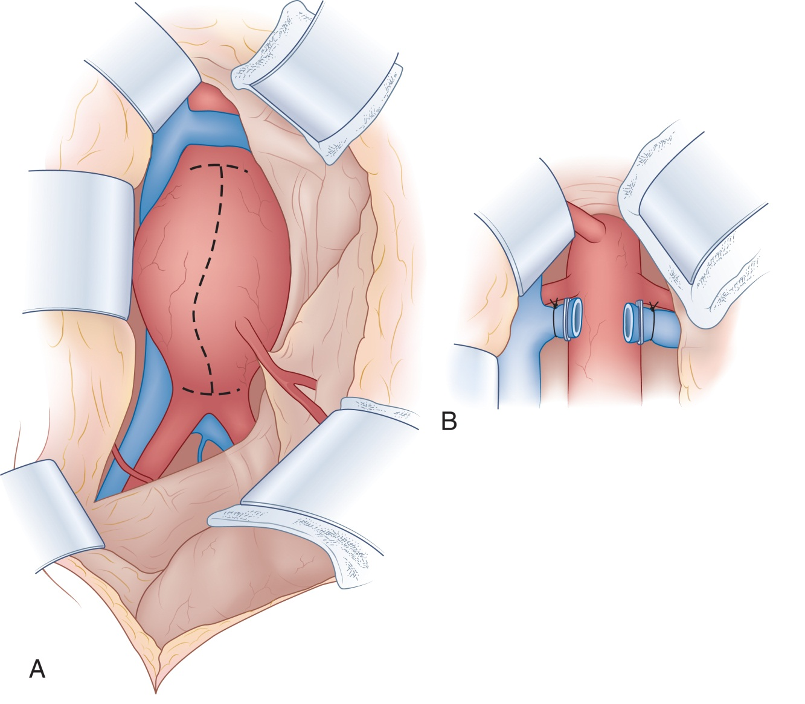
Abdominal Aortic Aneurysm Repair
From Ouriel K, Rutherford R: Atlas of vascular surgery: operative procedures, Philadelphia, 1998, WB Saunders.
Notes:
Where do abdominal aortic aneurysms typically occur? (They usually occur just below the renal arteries and extend to the bifurcation of the common iliac arteries or just above it.)
A blood-recovery system usually is used in emergency surgery.

Slide 43
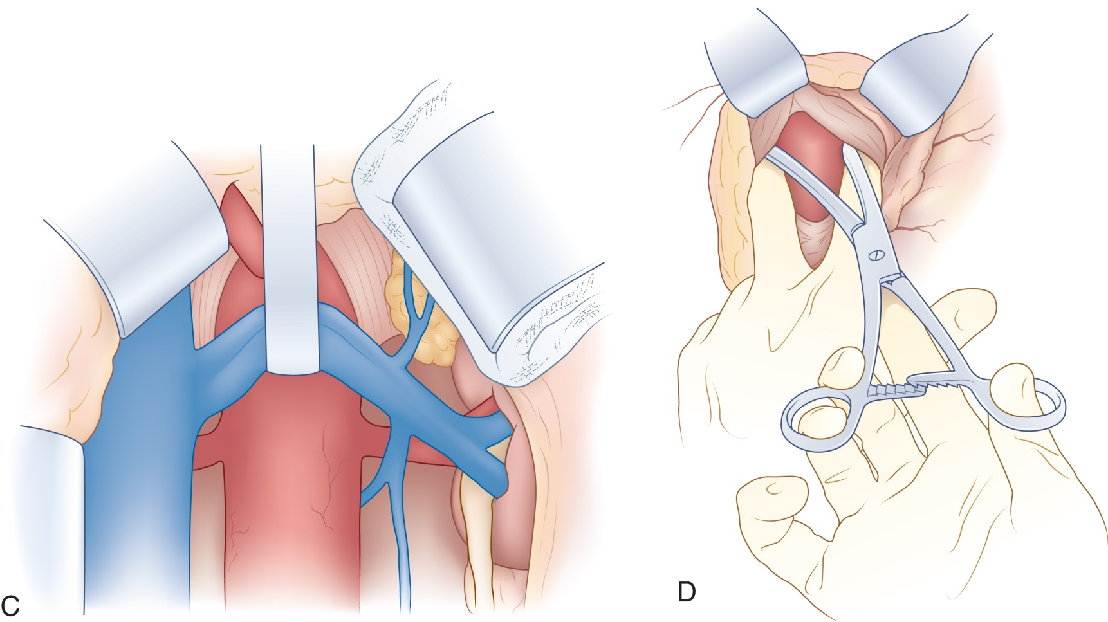
Abdominal Aortic Aneurysm Repair (Cont.)
From Ouriel K, Rutherford R: Atlas of vascular surgery: operative procedures, Philadelphia, 1998, WB Saunders.
Notes:
The plaque and aneurysm sac are sent to pathology as specimens.
Angiograms and ultrasound are used to verify patency of the vessels.

Slide 44
Endovascular Abdominal Aneurysm Repair
Approach is through the femoral artery
Bifurcated or straight stent can be placed
This procedure is under statistical review
Notes:
Peripheral pulses are carefully monitored and chest x-ray study and electrocardiogram are routinely performed in the postoperative period.
Complications include hemorrhage, infection, renal failure, and bowel obstruction.

Slide 45
Aortofemoral Bypass
Performed to treat aortoiliac occlusive disease
Graft is implanted between aorta and femoral arteries
Graft bypasses iliac arteries and produces free circulation
Notes:
Describe the area to be prepped for an aortofemoral bypass. (The prep area extends from the axillary line to the midthighs. Both legs are draped circumferentially and the genitalia are covered with a towel and barrier drape. A Foley catheter is inserted before the skin prep.)
The surgeon uses his or her fingers to perform blunt tissue dissection at the groin, creating a tunnel for the graft material.

Slide 46
Axillofemoral Bypass
Creates circulation between the femoral arteries and the axillary artery
Notes:
What are the indications for performing an axillofemoral bypass? (An important indication for axillofemoral bypass is an infected aortic graft. Perfusion of the leg [i.e., blood flow and oxygen exchange in the leg tissues] can be restored after excision of the graft.)
What are the boundaries of the prep for an axillofemoral bypass? (The skin prep includes the affected arm, shoulder, clavicular and neck areas, abdomen, and groin.)

Slide 47
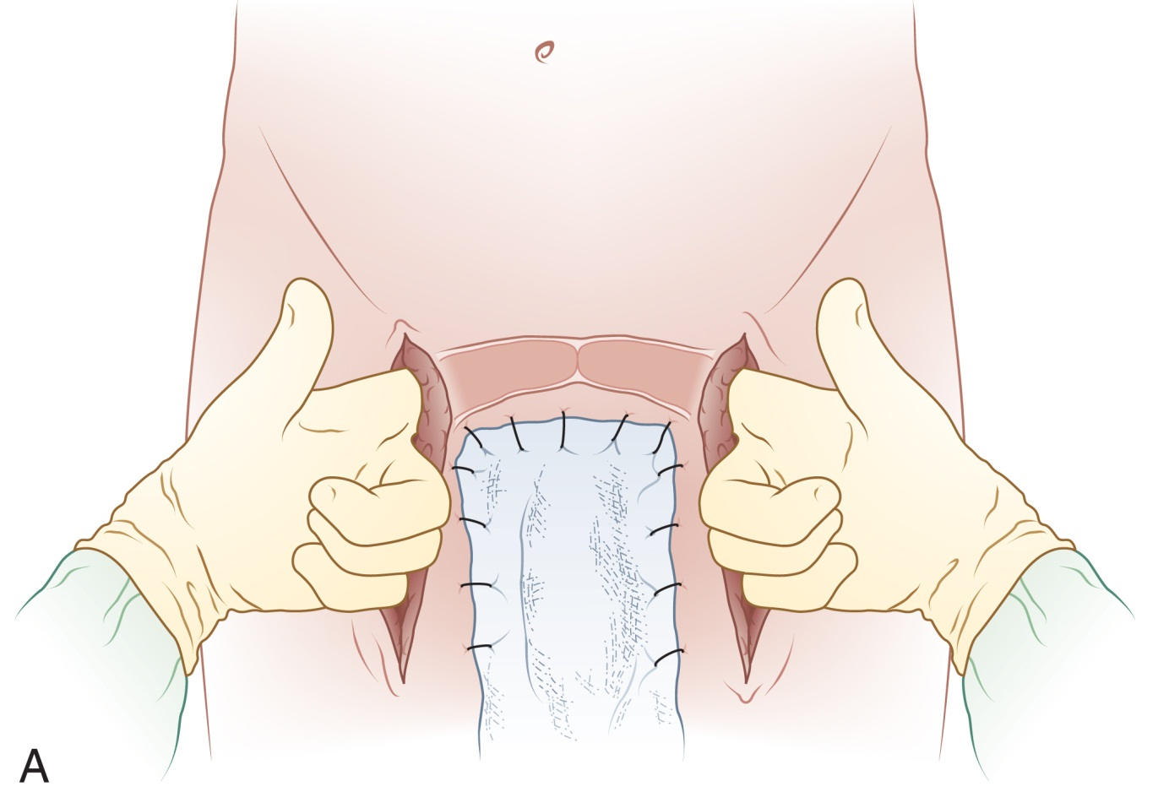
Femorofemoral Bypass
From Ouriel K, Rutherford R: Atlas of vascular surgery: operative procedures, Philadelphia, 1998, WB Saunders.
Notes:
A femorofemoral bypass involves implantation of a prosthetic graft that connects the femoral artery on the affected side to the opposite femoral artery. This is done to bypass unilateral atherosclerotic disease in the iliac artery.
A femorofemoral bypass is used only when the iliac system on the donor side is free of disease.

Slide 48
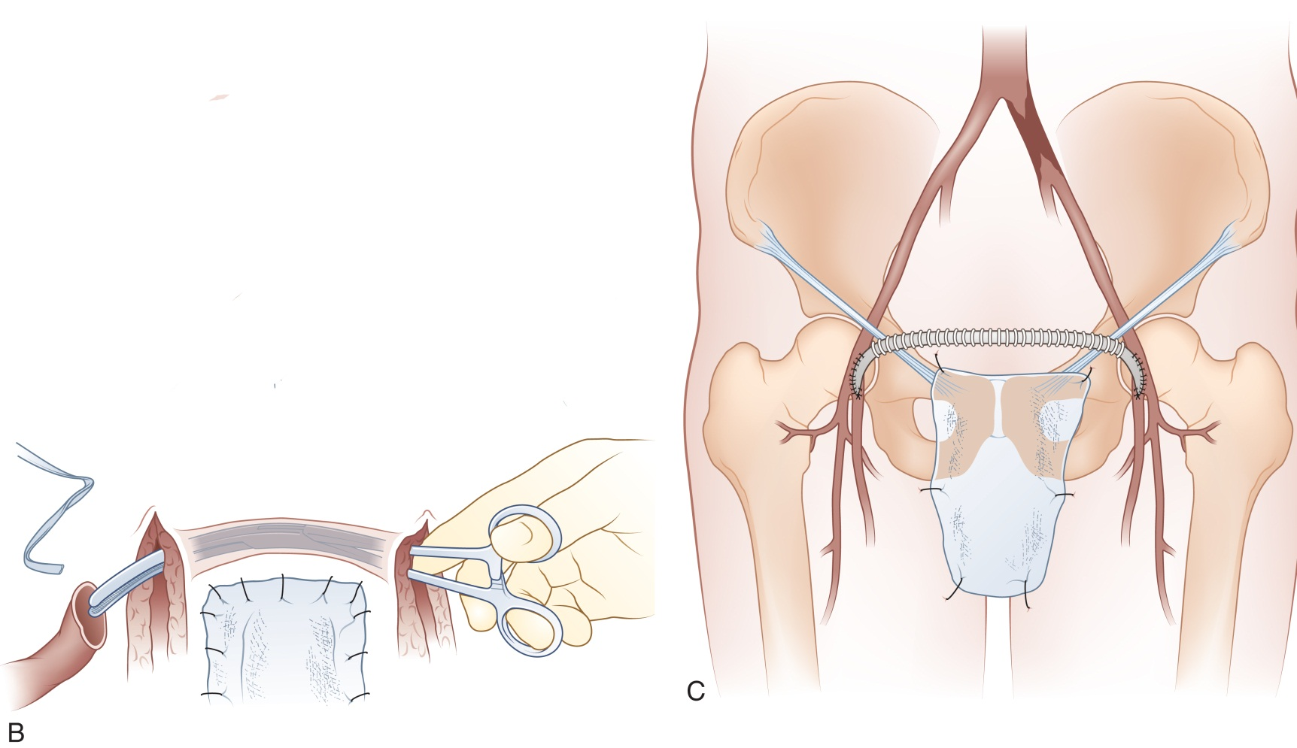
Femorofemoral Bypass (Cont.)
From Ouriel K, Rutherford R: Atlas of vascular surgery: operative procedures, Philadelphia, 1998, WB Saunders.
Notes:
A Foley catheter may be inserted and the genitalia are excluded from the prep with towels and an occlusive drape.
The procedure uses either general or regional anesthetic.

Slide 49
In Situ Saphenous Femoropopliteal Bypass
The surgical alternative to using a synthetic graft by using the existing saphenous vein, which is anastomosed to the popliteal artery
Notes:
What vein is used in an in situ graft? (Saphenous vein)
The valves of the grafted vein must be severed before being used as an arterial graft.

Slide 50
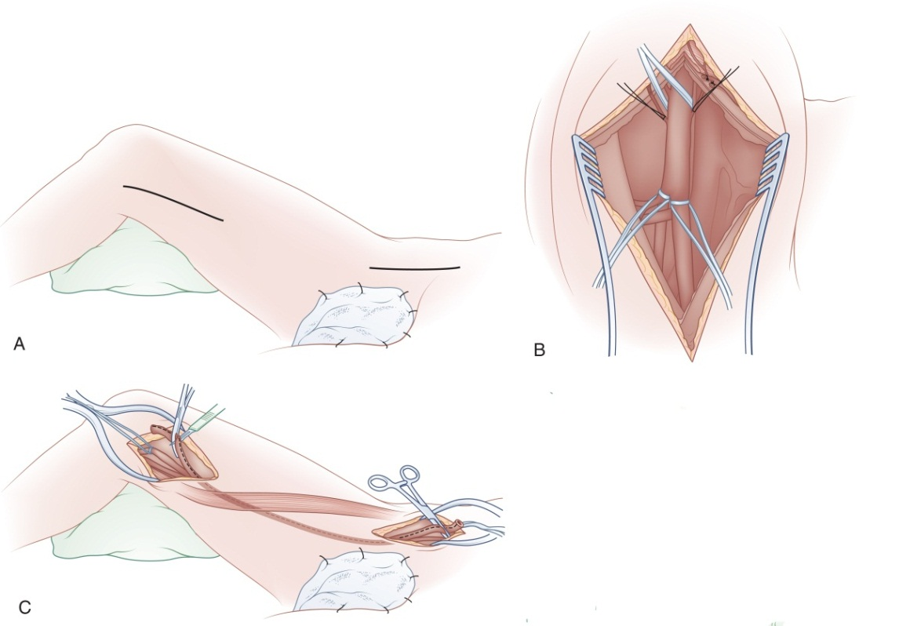
Saphenous Vein Harvesting
The saphenous vein is commonly harvested to replace a diseased coronary artery and for other bypass procedures
From Ouriel K, Rutherford R: Atlas of vascular surgery: operative procedures, Philadelphia, 1998, WB Saunders.
Notes:
Why is the greater saphenous vein the choice for grafting material? (The greater saphenous vein has been used more successfully than other materials for small-diameter arterial bypass. It is readily accessible and its connective tissue layer thickens with increased pressure. This makes it strong and able to withstand high arterial pressure.)
What is a vein bath? Why is it important? (The vein also may be placed in a basin with heparinized papaverine and normal saline solution. This is called a “vein bath.” The vein must be carefully monitored and protected at all times.)

Slide 51
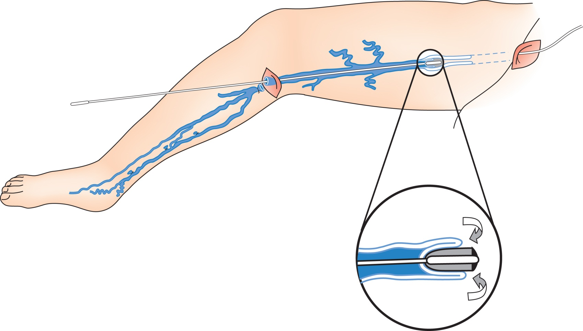
Varicose Vein Management
From Townsend CM: Sabiston textbook of surgery, ed 17, Philadelphia, 2001, WB Saunders.
Notes:
A varicose vein excision involves removing dilated and tortuous veins and their tributaries from the lower extremities.
Before surgery, the surgeon will mark the veins with a skin marker while the patient is standing.
An elastic compression bandage is placed on the leg(s) postoperatively.

Slide 52
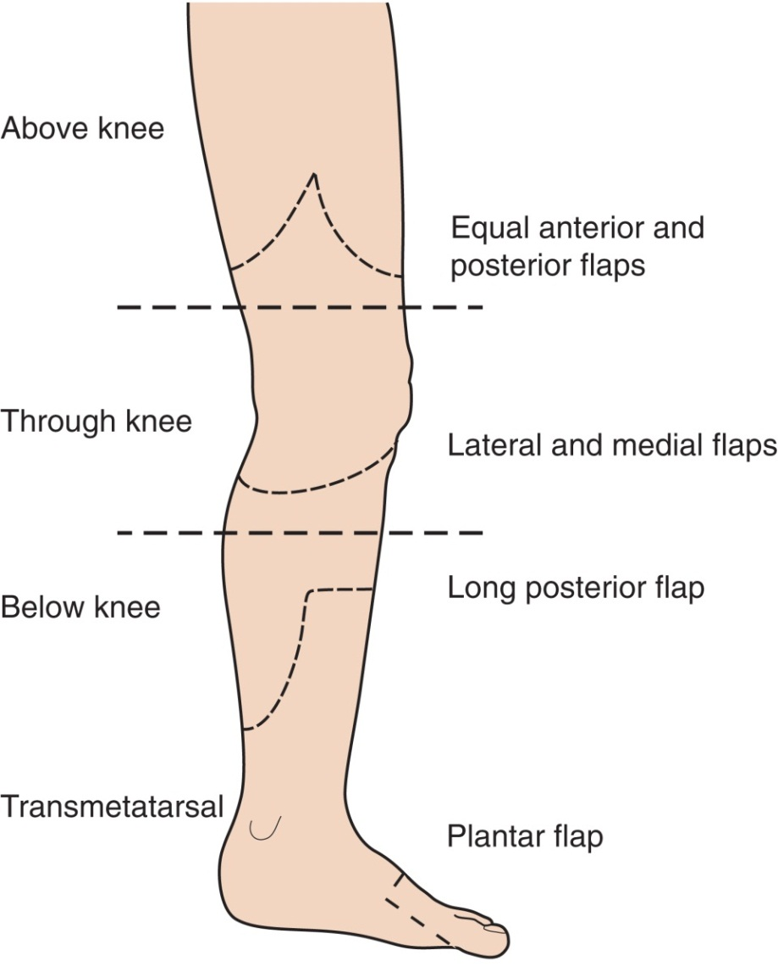
Above-Knee Amputation
From Garden O, Bradbury A, Forsythe J, Parks R: Principles and practice of surgery, ed 5, Edinburgh, 2007, Churchill Livingstone/Elsevier.
Notes:
Many surgeons prefer to place the gangrenous foot in a plastic bag to protect the wound site from contamination. The foot is excluded from the scrub prep.
After the lower limb has been removed, the sciatic nerve may be crushed with a Kocher clamp.

Slide 53
Questions?

